Slide 1
CalHOPE Support Program Admin and Supervisors Meeting March 2, 2023

Slide 2
AGENDA Requested Information and Other Data Collection First Deliverables Monthly Invoice Outreach Plan Save the Date and Invite your Support Specialists; March 9th 1:30-2:30

Slide 3
Requested Information If you are new to CalHOPE (six agencies) or if your policy has changed in the last two years, please email Taylor your agency’s PTO policy. Need Happier Life, Episcopal Community Services, FACTR, and CAMHPRO to send it in. Resource Database Updates Still Needed: Please complete for your counties. Please send deliverables to taylor.Intermill@calmhsa.org Other The CalHOPE logo information is available on the repository site under Branding Guidelines.

Slide 4
Data Collection: Forms Submitted Increased by almost 900 from last week! Or doubling the previous week’s amount.
IT Team is working on adding a pdf option to the form.
IT Team is working on adding additional identifiers to the forms.
In the meantime, if you need to delete a form, email Taylor to request a deletion by sending the following: Put in Subject Line: Request Forms Deletion
Agency Name, Type of Form (Ind, Group or Outreach), Employee name (The one entered in the form), Date the form was submitted, and (Optional) Approximate time of submittal.
Example: Accidentally submitted two forms. Request to delete the first one or delete the second one, with info above included in the email.

Slide 5
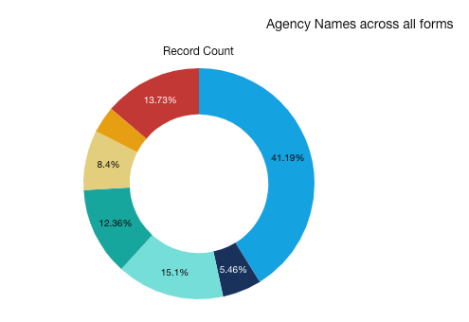
Data Collection
Who Hasn’t Submitted Forms?
Haitian Bridge Alliance Health Education Horn of Africa USC Tele-Behavioral Health

Slide 6
Data Collection
Who Hasn’t Submitted Forms?
Haitian Bridge Alliance Health Education Horn of Africa USC Tele-Behavioral Health

Slide 7
Data Collection
Who Hasn’t Submitted Forms?
Haitian Bridge Alliance Health Education Horn of Africa USC Tele-Behavioral Health

Slide 8
First Deliverables
Implementation Plan: Include your schedule with timelines for hiring and employing staff, training staff, and establishing an outreach plan and group sessions calendar.
We are reviewing your submissions, and if they’re not complete, we will email you. Payment will not be made until we determine your submissions have met our request. 13 Subs Have Submitted All Docs
8

Slide 9
Payment for First Deliverables
CalMHSA Must Have Following:
Insurance
Signed Contract; W-9, Proof of Insurance
Email W-9s: accountspayable@calmhsa.org
One month staffing costs, to be subtracted out at the end of the year.
CalMHSA requires proof of Insurance on file, see the contract for specifics.
Please send all insurance information to contracts@calmhsa.org.
9

Slide 10
Monthly Invoice Have you sent in the ACH form to accountspayable@calmhsa.org? It was emailed out on 2/13/23 and is on the repository site. Monthly invoice was emailed out last Tuesday, it’s also on rep. site. Two different invoices, the “Chat App Invoice Template” is only for the 2 subs who are staffing the Chat app. Everyone else, please use the Regular CalHOPE Provider template. Per your contract, submitted invoices which are filled out correctly, will be paid within 30 days. Email completed invoice to accountspayable@calmhsa.org and your monthly mtg staff person.

Slide 11
Monthly Invoice
Three Separate Sheets
AAC Worksheet
Instructions Tab
Invoice Tab
Additional Administrative Cost (AAC) Worksheet
The AAC is calculated at $17,800/pod for the entire contract.
We estimated $9,600 for outreach.
Budgeting Tool
Tracker for you to add to each month

Slide 12
Outreach Plan Each Agency is required to submit an Outreach Plan that will address how they plan to reach their target populations and how they plan to allocate funds within the Additional Administrative Costs line item for outreach efforts. AAC includes $800/month-pod for outreach. The Outreach Plan is due to CalMHSA no later than February 28, 2023. We have received 14 Outreach Plans thus far.

Slide 13
Save the Date:
March 9th 1:30-2:30
Keris Myrick, Peer Counseling Training
https://www.calmhsa.org/CalHOPE/
Taylor.Intermill@calmhsa.org

