Slide 1
CalHOPE Support Program All-Supervisors Meeting April 6, 2023

Slide 2
Reminders We have moved to a biweekly meeting schedule. Our next meeting will be April 20th, and then May 4th. On April 20th, CAMHPRO will present on the history of the peer movement. Please invite your Support Specialists. Updates We have added “CalHOPE Agency Information” to our repository site. Calhopeconnect.org/Resources has been updated with your information; visitors can now search by geography, language, and target population.

Slide 3
Monthly Invoice There is now a separate January Invoice and Feb-Dec Invoice on the repository site. Two different invoices, the “Chat App Invoice Template” is only for the 2 subs who are staffing the Chat app. Please email your monthly mtg staff person your January invoice to review before sending it to accountspayable. Per your contract, submitted invoices which are filled out correctly, will be paid within 30 days. Email completed invoice to accountspayable@calmhsa.org and your monthly mtg staff person.

Slide 4
Monthly Invoice Invoices are due to CalMHSA 15 days after the end of the month. We have received January and February invoices from only about one-half of you. We have not received any invoices from 11 agencies. Your January and February invoices are now overdue. Please come up to date on your invoices. Your reimbursements may get further delay.

Slide 5
Data Collection Updates
The pdfs of the data collection forms are now on the repository site.
We added “depression” to the individual/family form options under Needs Addressed.
Unique ID is now given after a form is submitted; Email Taylor, Put in Subject Line: Request Forms Deletion

Slide 6
Data Collection 6,984 Forms submitted to date, an increase of 91% from March 16th (3 weeks prior).
Who Hasn’t Submitted Forms? USC Tele-Behavioral Health
Only 1-3 Forms Submitted
San Diego Youth Services
Haitian Bridge
CAMHPRO

Slide 7
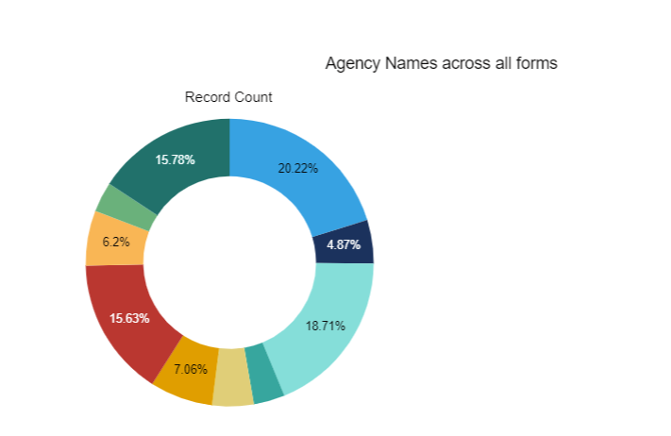
All Forms Submitted, except for Support Provided on the Chat App

Slide 8
New Open Links to View Data Collection Forms Data
CalMHSA IT Staff has created new links with Power Bi that are open to everyone to view.
You can use the links to view the data submitted for all the CalHOPE agencies or your own.
The links will be sent out later today and put on the repository site.

Slide 9
Next Meeting:
April 20th 11:00-11:50
Presentation on History of the Peer Movement, CAMHPRO
https://www.calmhsa.org/CalHOPE/
Taylor.Intermill@calmhsa.org

