Slide 1
CalHOPE Support Program Supervisors’ Meeting May 4, 2023

Slide 2
May is Mental Health Matters Month
Mental Health America’s Toolkit: there is now a Spanish version available
CalMHSA’s Take Action for Mental Health Toolkit
Take Action for Mental Health L.A. County

Slide 3
Mental Health Awareness Month! 1. What year was Mental Health Awareness month created in the United States? Answer: 1949 2. What Act was signed by John F. Kennedy in 1963 to provide federal support for the development of community-based mental health care and treatment facilities? Answer: Community Mental Health Act 3. Which President signed the National Mental Health Act which called for establishing a National Institute of Mental Health? Answer: President Harry Truman

Slide 4
Monthly Invoice Are you using the correct invoice? There is a January template and a Feb-Dec template. You can bill for admin work under Supervisor’s hours, up to the total allowed in the month. You may want to do this in the initial months. FTE=full time equivalent. You can have part-time employees; but don’t increase the FTEs.

Slide 5
Monthly Invoice Invoices are due to CalMHSA 15 days after the end of the month. Your January, February, and March invoices are now overdue. We have not received any invoices from AltaMed, Divine Truth, Episcopal Community Services, Health Ed Council, San Diego Youth Services, and USC Tele-Behavioral Health. Please send your January invoice first to the CalMHSA staff you meet with for your Monthly Mtg – me, Taylor, or Lorena.

Slide 6
Monthly Invoice Travel reimbursement: Have you established a policy? Reimbursement for mileage to outreach events is reasonable. Reimbursement for ride sharing services isn’t. Gov’t agencies don’t provide per diem for meals unless the travel is out of town and over night. Buying food for an outreach event is not the same as reimbursing for meals.

Slide 7
Data Collection Forms
The forms have been translated into Spanish. There is also now a Spanish language page on calhopeconnect.org.
Review your staff’s entries, especially the selection of “other”. Do we need to add another option to reflect their selection? For example, ECS predominately serves children, we have added “emotional regulation” to primary needs question.

Slide 8
Data Collection Forms
Outreach Form:
FB Live or Radio events are online/virtual events. Q11
We are rewording Q9, we are asking for the theme if your outreach was part of a larger event (answer yes to Q10, i.e. farmer’s market).
For Q15, we are adding “Mental Health Awareness”.

Slide 9
Data Collection Forms
Do’s
Don’ts
Upload screenshots of zoom participant names
Take photos of an individual session
Upload meeting notes or data collection notes
Upload blurry pictures
Upload images of chat messages
Share anecdotes with us about your event or group
Share pictures of group activities, including zoom pictures
Include your agency’s branding if you can in pictures
Upload Event Flyers
Delete meeting notes/data notes before submitting

Slide 10
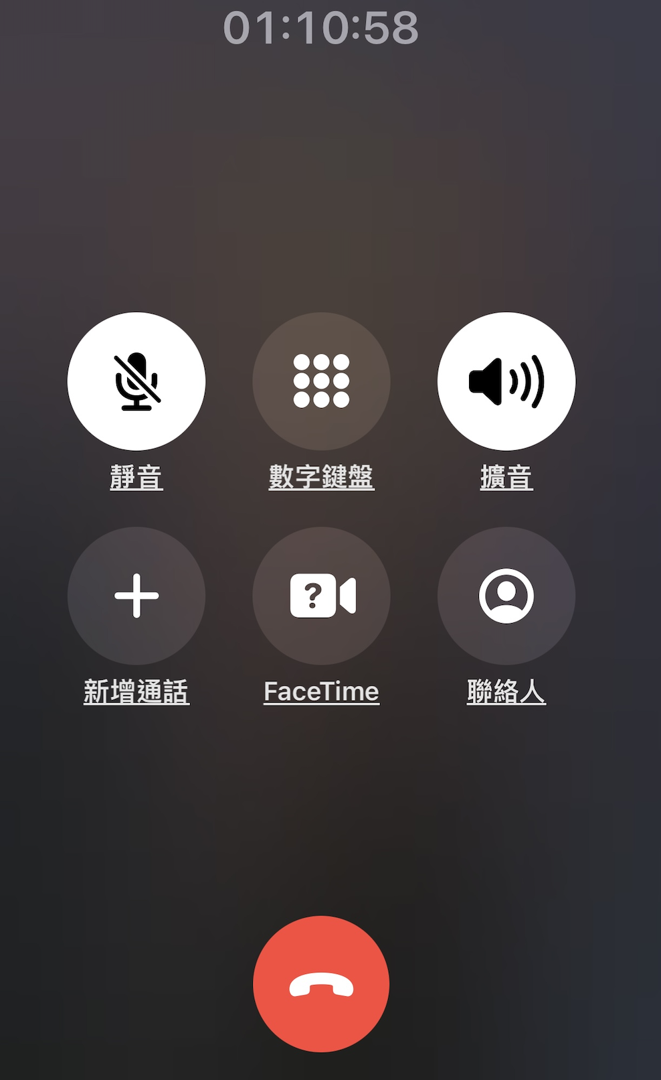
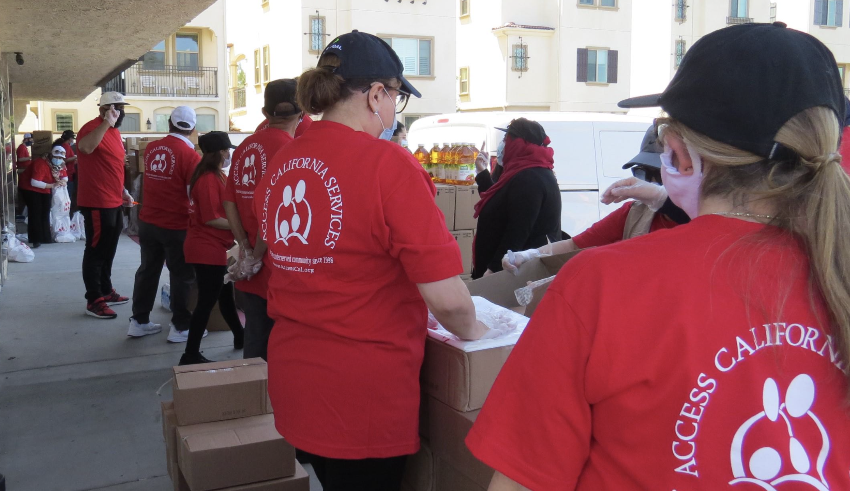
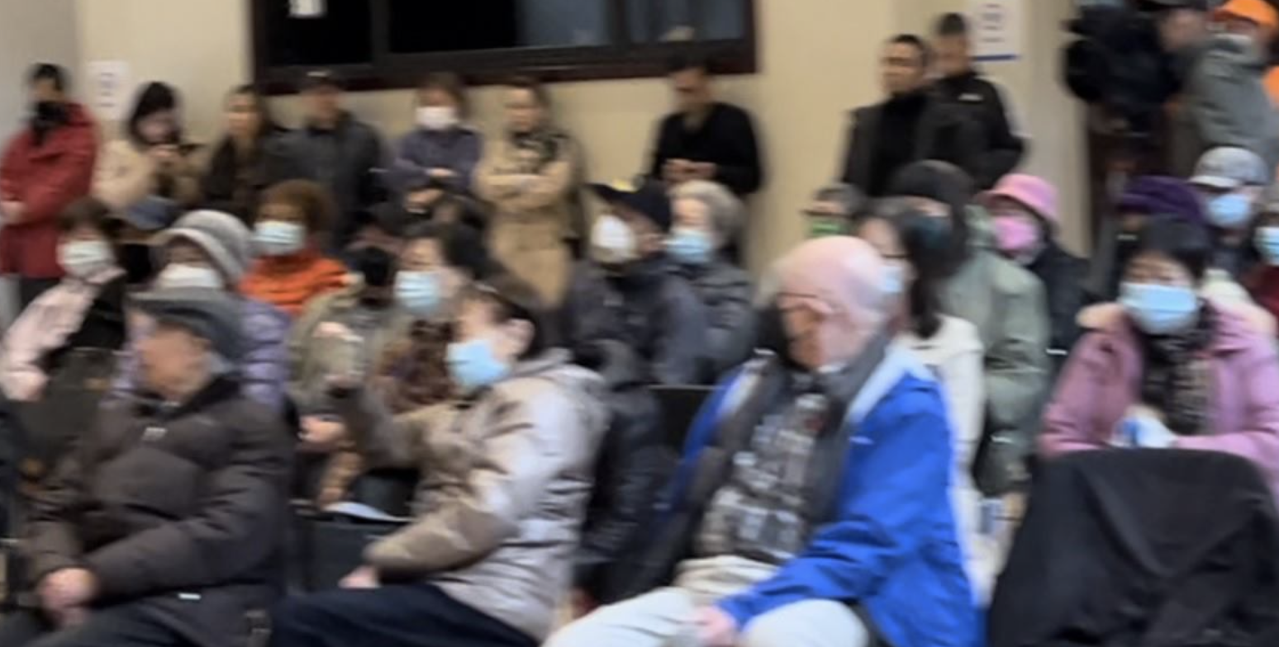
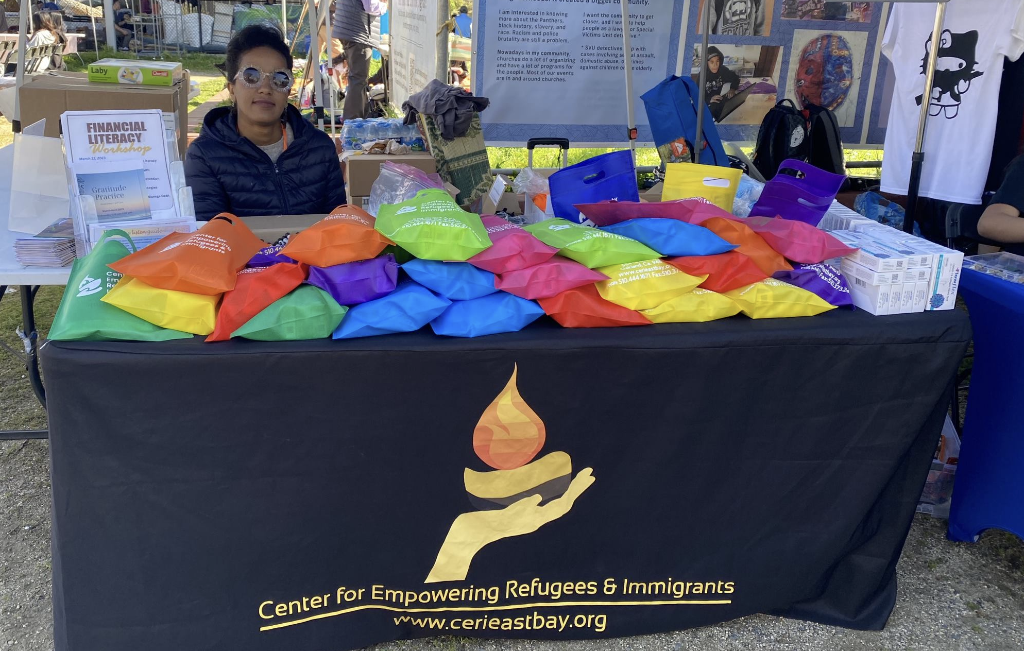
Data Collection Forms
Do’s
Don’ts

Slide 11
CAMHPRO LEAD Conference Lived Experience, Advocacy, Diversity Statewide Peer Conference, Sacramento June 12-13, 2023

Slide 12
Next Meeting:
May 18th 11:00-11:50
Presentation: How to Work with Schools and School Districts by PRO Youth and Families Collective
https://www.calmhsa.org/CalHOPE/
Taylor.Intermill@calmhsa.org

