Slide 1
CalHOPE Support Program Supervisors’ Meeting July 27, 2023 *Welcome Support Specialists

Slide 2
Updates
We cannot reimburse for attendance at NAMI Advocacy Day.
We have posted new pdfs of our data forms on the repository site. These pdfs have been updated with all our changes.
DHCS may ask you to return your devices. They have not made a definitive decision on this, however, we are required to provide a listing of devices purchased by agency.
Today’s training will be posted to Repository site. Please share with SS and others who were not able to attend today.

Slide 3
Data Collection Forms The three forms collect data and evidence of your work. We provide three reports to DHCS each month from these forms. Please fill out forms for the prior month by the 5th of the following month. How does your agency’s work compare to other agencies?

Slide 4
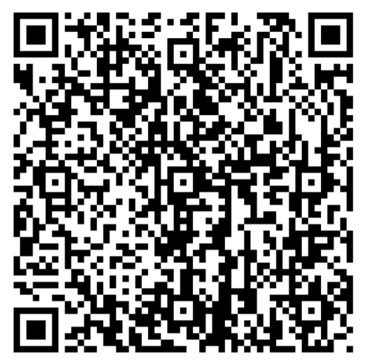
Survey for Self-Care Training CalMHSA is working with a contractor to provide a self-care training. We have created a short survey to gather information from you all to provide to our trainer. Please fill it out.

Slide 5
Sexual Orientation and Gender Identity (SOGI) Education and Data Collection
Jennifer Barnes, MA/MS
Drop in Center Team Lead, Our Safe Place, San Diego Youth Services
Pronouns: she / they
Joke (Sara) Ilanit, MSW
Youth Support Partner, Our Safe Place, San Diego Youth Services
Pronouns: she / her

Slide 6
Next Meeting:
August 10th 11:00-12:00pm
Training: Attachment Based Modality, Episcopal Community Services
https://www.calmhsa.org/CalHOPE/
Taylor.Intermill@calmhsa.org

