Slide 1
Please click the Survey Monkey link in the chat to take a quick three question survey

Slide 2
No Money No Mission: Billable vs. Non-Billable Services
June 15, 2022
California Mental Health Services Authority (CalMHSA)

Slide 3
CalMHSA Introductions
Amie Miller, PsyD Director Dawn Kaiser, LCSW, CPHQ Director of Managed Care Operations Lucero Robles, MSW, LCSW Director of Quality Assurance & Compliance
Courtney A. Vallejo, LMFT Utilization Manager
Amy Leino, PhD
Quality Improvement Specialist

Slide 4
We are Here
Transformation Webinars: For County Leadership & QI Staff
Welcome to CalAIM: Then vs. Now | 04/27/22
Shifting our Focus: Compliance vs. Quality | 05/04/22
Communication Plans: Change Messaging | 05/11/22
Initiating Treatment: No Wrong Door/Treatment Prior to Diagnosis | 05/18/22
Standardizing Documentation: Universal Assessment | 05/25/22
Identifying Treatment Focus: Problem List | 06/01/22
Documenting Care: Progress Notes | 06/08/22
No Money, No Mission: Billable vs. Non-Billable Services | 06/15/22
Outcomes That Matter: Quality Measurement | 06/22/22
You’ve Got This: CalAIM – A Summary | 06/29/22

Slide 5
Training Objectives
Participants will walk away with:
Knowledge about the importance of leveraging FFP to create a sustainable benefit
A deeper understanding of the culture change needed to effectively implement CalAIM

Slide 6
Our complicated finances in 60 seconds or less
Humans = each person has a Medi-Cal aid code that determines the % of the cost of services that will be covered by Medi-Cal or “FFP” – this varies
Local County Money
Realignment
1991
Realignment
2011
MHSA
Grants and other future IGT sources
These funding sources are related to taxes
Federal Financial Participation

Slide 7
Our complicated finances in 60 seconds or less
This person has a Medi-Cal aid code where 50% of their service value is claimed to Medi-Cal.
This person receives a therapy service, the cost of this service is $100
$50
+
Realignment
1991
= $100 Therapy Service cost
$50
Federal Financial Participation

Slide 8
SO, BIG PICTURE
Federal Financial Participation
OPTIMIZE CLAIMS THAT GET THIS
Or you will run out of this
Local County Money
Realignment
1991
Realignment
2011
MHSA
Grants and other future IGT sources

Slide 9
Big Picture
Medi-Cal Enrollment Up
Data Source: DHCS Extracted from MS/DSS 11 Apr2022
Notes:
Medi-Cal enrollment up 16%

Slide 10
Staffing – Down
Cost-Survey Analysis: LPHA Vacancies
When we look at this workforce shortage numbers, this means;
1 out of every 5
master’s level staffing positions is vacant.
Mental Health
21% of budgeted LPHA positions vacant (957 vacant positions)
23% of counties have MH vacancies over 30% (up to 52%)
SUD
20% of budgeted SUD positions vacant (38 vacant positions)
9% of counties have SUD vacancies over 30% (up to 100%)
Data Source: Cost Survey 2021
Notes:
For LPAs we are looking at

Slide 11
Staffing – Down (continued)
Cost-Survey Analysis: % Vacancy by Staff Type
Data Source: CalMHSA Cost Survey 2021
Notes:
What percentage of counties actually filled out the data?
For MH: 99% (n=57) counties filled out FTE data for at least one staff type, of those all but one (n=56) counties filled out FTE data for LPHA (at least 0.1 FTE budgeted for LPHA)
For SUD: 69% (n=40) counties filled out FTE data for at least one staff type, of those 25 counties filled out FTE data for LPHA (at least 0.1 FTE budgeted for LPHA)
Note: it is hard to identify if the 15 counties that reported some data for Staff FTEs but 0 for LPHA indicates that they truly do not have a budget for LPHA, or if this indicates missing data. So, I’m not sure percentage complete is 69% (40/58) or 43% (25/58).
What is the vacancy rate range?
For MH LPHA: vacancy rate is 13% - 52%
For SUD LPHA: vacancy rate is 0% - 57% (2 counties have 100%, but one has 0.1 budgeted FTE, the other has 2 budgeted FTE)
Is the LPHA vacancy rate congruent with the other rates? Might be good to have a few other of the vacancy rates – Medical Staff/MHRS
The LPHA vacancy rate (~20%) is in the middle of the pack, highest vacancy rate is in Nurse Practitioners, MDs (for SUD), and Peer Recovery Specialists

Slide 12
Workforce
Humans needing care
Change is essential

Slide 13
Past Us:
New day, new auditor, new advice. Rules are somewhat documented, somewhat lore.
If you do not have all documents fully compliant this is a significant audit risk.
All signatures need to be on treatment plans that are fully linked to problems in the assessment that are within the annual update.
Outreach services have incomplete forms so are not fully billable.

Slide 14
Future Us:
1. Audits are based on waste, fraud and/or abuse
2. Counties must fulfill all managed care plan obligations

Slide 15
Special Guest Speaker – Jacey Cooper Chief Deputy Director & State Medicaid Director

Slide 16
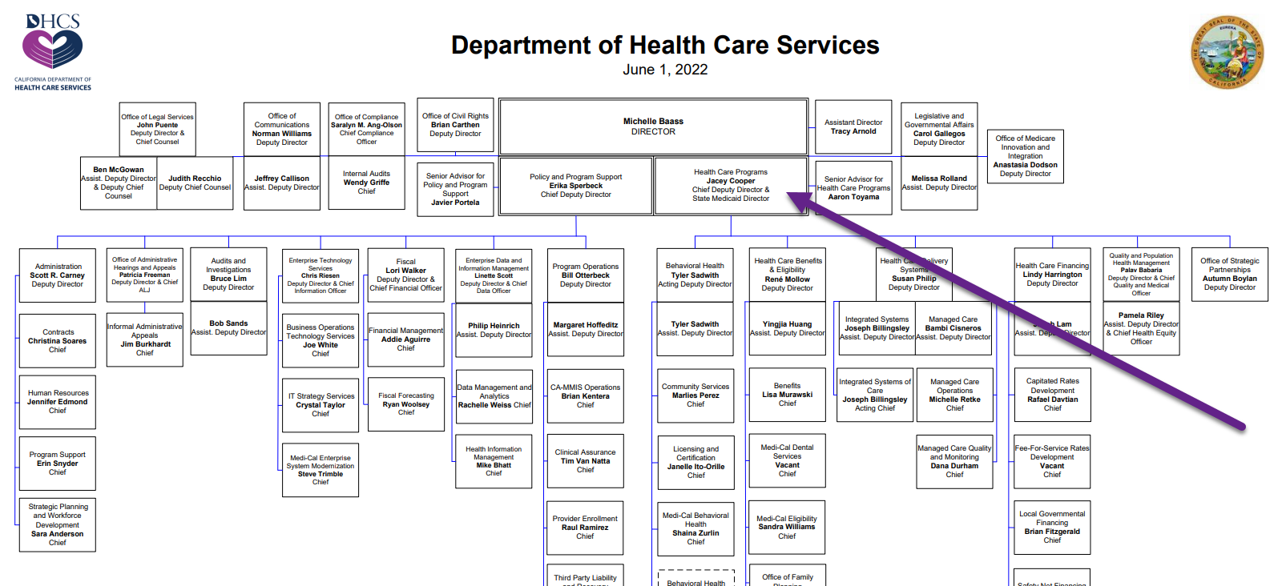

Slide 17
Idea:
Reevaluate all business practices where you are serving a person but not claiming for services.

Slide 18
ExampleS

Slide 19
Examples
Outreach to a person who is experiencing homelessness, they are interested in care, have some concern with signing consent but actively engage in services.

Slide 20
Examples (c0ntinued)
An MHSA community-based provider, does not want to meet standards of completing Medi-Cal documentation. They often complain to the Board of Supervisors because they want as few rules as possible. The services they are providing are 100% MHSA.
Notes:
Updated rules make it so easy.
You get no credit for this – we have to hold you
You could get sanctions.

Slide 21
Examples (continued)
The year is 2023, Peer Certification is up and fully functional.
A peer run wellness center located in the heart of the community is able to welcome some of the hardest-to-engage individuals struggling with severe mental illness, homelessness and substance use. All services are provided by peers, these include linkage to care and case management.

Slide 22
Examples (continued)
A person in care is receiving a service from a psychiatrist in a clinic.
In addition to the psychiatrist’s time:
Clinical staff are providing case management associated with the psychiatrist service (helping with refills, helping clarify dosage questions, finding transportation resources)
Multiple staff on the same team coordinating a person’s care in team meeting.

Slide 23
Rules that leave money on the table
And bring no substantial benefits!
Limiting billing for assessment, plan development and crisis intervention services to just clinicians, when DHCS allows a wider range of staff to bill for these services.
Narrowly limiting who can be considered a "client support person" for collateral services.
Disallowing billing for crisis intervention unless the client is placed on a 5150 at the end of the encounter.
Not allowing billing for any services while a youth was AWOL from placement, despite this not being a lockout in regulations.
Non billing any services that are documented more than 14 days after the service.
Not accepting any billing for clients who drop out of treatment prior to completion of a full assessment with diagnosis.
Enforcing an allowable diagnosis list that is more restrictive than DHCS, limiting which clients can be billed.

Slide 24
Rules that leave money on the table (continued)
And bring no substantial benefits!
Limiting how many hours can be documented as travel time, even when the time was legitimately spent traveling to provide a billable service.
Limiting the amount of time that can be spent on documentation due to fears that it will be conspicuous in an audit.
Choosing not to bill for a service because it was brief and writing a note would take too much time.
Placing "billing holds" on individual staff who have been identified as having challenges with documentation or disallowing all of their progress notes for a given time period "just to be safe".

Slide 25
Workforce limiting rules
But we don't have enough staff or nearly enough time!
Requiring a licensed co-signature on documentation and progress notes that can be approved by any LPHA (including registered clinicians) per DHCS.
Requiring a full section of the assessment to describe narrative information present in the CANS/ANSA even though that information is already present in other sections of the assessment.
Using several forms not required by the state, including several outcome measurements and screening tools, and will not allow for billing until they are all completed.

Slide 26
Billing Myths

Slide 27
Progress Notes
DEEP DIVE
REAL DEAL
"We cannot bill for the services we have provided until we determine the client meets criteria for SMHS or SUD services"
Outpatient services rendered in good faith prior to the completion of an assessment and determination of a diagnosis are reimbursable for both MH and SUD providers.

Slide 28
Progress Notes
DEEP DIVE - CONTINUED
REAL DEAL
"If my progress note is finalized after the 3-business day timeline, then we should play it safe and not bill for the service"
Services should not be disallowed or not billed due to being completed after the 3-business day timeliness requirement. Periodically, late notes will happen. It is a good practice to briefly document the reason for the late note.
Audit recoupments primarily for fraud, waste and abuse.

Slide 29
Progress Notes
DEEP DIVE - CONTINUED
REAL DEAL
"I know they say we can bill for services provided prior to the completion of an assessment, but that seems a little scary. Let's just keep doing what we have been and not bill for services until an assessment is finalized"
It can be tempting to "play it safe" and not bill until an assessment and diagnosis are in place. That is what we are used to!
However, it is important to embrace the changes brought about by CalAIM, and services rendered in good faith prior to the completion of an assessment and determination of a diagnosis are reimbursable.

Slide 30
Progress Notes
DEEP DIVE - CONTINUED
REAL DEAL
"Some services still require a treatment plan (either in the narrative of a progress note or on a separate document) and so if the treatment plan is not completed on time, we should disallow any billable services that occurred until we complete the treatment plan and obtain a signature"
Audit recoupments are mainly geared toward instances of fraud, waste and abuse and therefore, a county should not face recoupments for single examples of late or missing treatment plans.

Slide 31
Progress Notes
DEEP DIVE - CONTINUED
REAL DEAL
"If an individual seeks services and then it is determined upon completion of the assessment that they do not ultimately meet the criteria for SMHS services and would be better served by a Managed Care Plan (MCP), then the services provided cannot be billed."
Under CalAIM's Access to SMHS changes, services provided are reimbursable, even if it is ultimately determined that the individual would be best served by an MCP.

Slide 32
Progress Notes
DEEP DIVE - CONTINUED
REAL DEAL
"If a client is opened to an MCP for psychiatry and I (at the MHP)am providing therapy services, I need to be sure I do not bill for my therapy services as that would be duplicative"
Under No Wrong Door, it is possible for an individual to receive services from the MCP as well as the MHP, as long as the services are coordinated and non-duplicative. In such a scenario, the services being provided by both the MCP and the MHP are reimbursable.

Slide 33
Review of Most Current CalMHSA Offerings
Recent Additions
Forthcoming Items
Documentation Requirements P&P and attestation
No Wrong Door P&P and attestation
Revised slides for transformation webinar #1 and addition of change log for webinar slides
DMC/DMC-ODS LPHA Documentation Guide (Revised 6/3/22)
Web-based documentation trainings via CalMHSA Learning Management System (LMS):
CalAIM Overview
Access to Services
Assessment
Diagnosis/Problem List
Progress Notes
Care Coordination
Two remaining Transformation Webinars
Additional MHP and DMC/DMC-ODS Documentation Guides
Additional web-based documentation trainings:
Screening and Transition
Discharge Planning
To Access these Resources Please Visit: California Mental Health Services Authority | CalAIM Support for Counties (calmhsa.org)

Slide 34
CalMHSA LearnS: CALAIM TRAINING Dashboard

Slide 35
Feedback? Questions?
Calaim@calmhsa.org

Slide 36
Please click the NEW Survey Monkey link in the chat to complete our post-training evaluation THANK YOU!

