Slide 1
CPT Coding 101 September 29, 2022

Slide 2
1. What are CPT Codes? 2. Why are we doing this? 3. Benefits of transition 4. Now and after 7/1/2023 5. Changes 6. Q&A 7. Next Steps
Agenda:

Slide 3
Presenters today:
Amie Miller, CalMHSA
Andrew Wagner, CalMHSA
Kacey Vencill, CalMHSA

Slide 4
Pre-Training Assessment
Please click on the link in the chat box (https://www.surveymonkey.com/r/B958CKB) and answer questions
3 minutes to answer questions

Slide 5
What are CPT Codes?
- CPT = Current Procedural Terminology
- Also referred to an HCPC Level I Codes
More detailed definitions for codes that are standardized nationwide
Typically used by physicians and licensed providers
Codes specify the billing increment or a range of time

Slide 6
Why are we doing this?
The transition to CPT codes is needed because CMS expects all Medicaid programs to adopt CPT codes where appropriate to enable data analysis/comparison between states
In general, CPT codes will be used for clinical services provided by licensed professionals providing services in their scope of practice
DHCS is planning to continue to use HCPCs for non-clinical services (e.g., rehabilitation) and services provided by non-licensed staff

Slide 7
What are the benefits of this transition?
Increased ability to understand the services rendered via data analysis
Additional granularity to describe the services provided
Provides a more accurate reflection of the range of services and needs of beneficiaries served

Slide 8
Key Definitions (see appendix 2)
Direct Patient Care: If the service code billed is a patient care code, direct patient care means time spent with the patient for the purpose of providing healthcare. If the service code billed is a medical consultation code, then direct patient care means time spent with the consultant/members of the beneficiary’s care team. Direct patient care does not include travel time, administrative activities, chart review, documentation, utilization review and quality assurance activities or other activities a provider engages in either before or after a patient visit.
Maximum Units that Can be Billed: All codes will be billed in units. Most CPT codes that are listed in the manual have a time or time range associated with them.
When a code did not have a time or time range associated with it, DHCS assigned a time of 15 minutes to that code. This column lists the maximum number of units that the procedure may be billed in a 24-hour period.
A unit of service is attained when a mid-point is passed. For example, CPT code 90839 (psychotherapy for crisis, first 60 minutes) can be claimed when 31 minutes of direct service have been provided. Thirty-one minutes is more than mid-way between zero and 60 minutes.

Slide 9
Key Definitions Continued
Lockout Codes: Some codes cannot be billed together and others can only be billed together in extraordinary circumstances. Codes that cannot be billed with the procedure listed in column Code are listed in the Lockout Codes column.
If a code is not included in the service tables’ column titled Lockout Codes then it can be used with the code in the Code column.
However, it would be inappropriate to use a code describing one service to “prolong” a code that describes a different service. If a service needs to be prolonged, use add-on codes or prolonged service code G2212 if the code does not have dedicated add-on code or is an evaluation and management code.

Slide 10
Key Definitions Continued
Intern: A registered, pre- licensed mental health professional who is working in a clinical setting under supervision.
Services Provided by Interns/Residents: To indicate that the service was provided by an intern use modifier HL after the service code. If the pre-licensed professional does not have their own NPI, indicate the NPI and taxonomy of the fully licensed supervisor as the rendering provider. If the pre-licensed professional has their own NPI, they may use their own NPI to indicate they were the rendering provider.
To indicate that the service was provided by a resident use modifier GC after the service code. On the claim, indicate that the supervising professional is the billing provider. Services that have modifiers HL or GC after them, even if they are otherwise eligible for Medicare COB, should be sent directly to Medi-Cal.
Waivered Professional: A professional from another state whose license is recognized by California. Waivered professionals can bill under their own license and do not need to use an HL or a GC modifier.

Slide 11
Should I “Crosswalk” the old to the new codes
There is a 1 to many relationship between several codes
1 HCPC
Many possible CPTs
Some services will continue to be coded as is
H2017
Discipline
Duration of the service
Method of service delivery
Face to Face
Phone
A cross-walk is not straightforward and may not be necessary
Location
Telehealth
Modifers
Licensure
Method of service Delivery

Slide 12
How to approach the new CPT codes
If I don’t use a cross-walk, how will I identify the new codes to be used?
Review the descriptions to determine what services are applicable
Focus on the services provided, all codes may not apply
Review the billing manual
Set up EHR/Billing system to take the variables into consideration when selecting the CPT code(s) for claiming

Slide 13
CalMHSA Coding Reference Guides
One for MH, ODS, DMC - respectively
Tabs for each service group
Complete List of Pre CalAIM-Codes
Complete List of CalAIM Codes

Slide 14
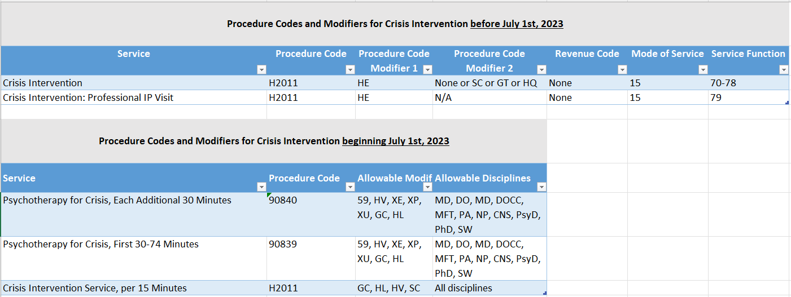
Example: SMHS
Crisis Intervention

Slide 15
Tools to compare old and new code sets Counties vary in their use of codes May not reflect the codes of your particular County
Review Coding Reference Guides​

Slide 16
Additional Key Concepts
Claims for Units of Service, not number of minutes
No partial units allowed
"Dependent on Codes"
Add-On Codes
Supplemental Services
Duplicate Services and Allowable Overrides
Whole numbers only
e.g. Claims for "1.5" units will be denied

Slide 17
Units vs. Minute based claims
Claims will be submitted for units of service, not number of minutes
Max number of units identified in the billing manual
Example:
60 minutes of Rehabilitation (H2017), will be claimed as 4 units of H2017

Slide 18
Identifying Codes based on number of Minutes:
Example 1: 19 minute Telephone evaluation and Management code service
Example 2: 25 minute Telephone evaluation and Management code service
Example 3: 5 min Telephone evaluation and Management code service, plus 6 minutes of documentation

Slide 19
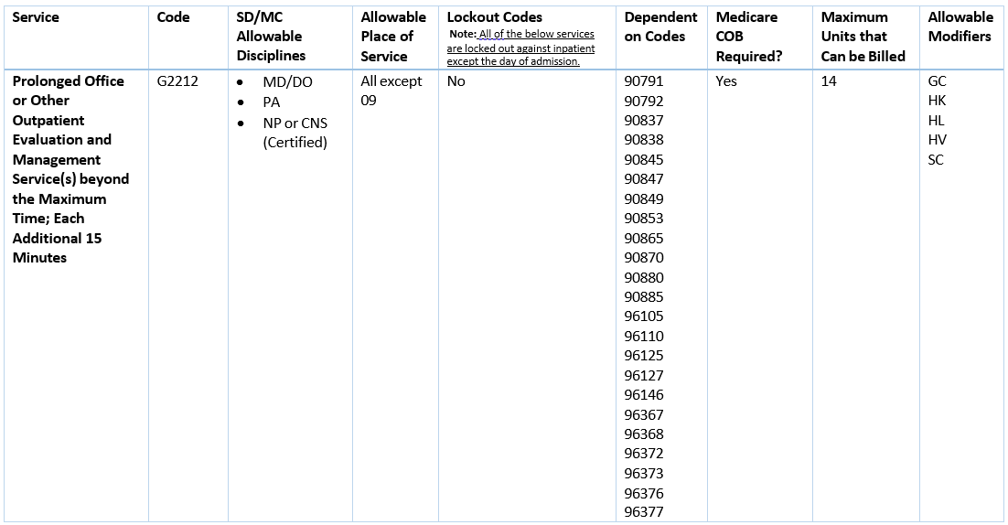
Dependent Procedure (Two types)
Add on Code Example:
See Appendix 2 - Definitions
These are procedures that either indicate that time has been added to a primary procedure (i.e., add-on codes) or modify a procedure (i.e., supplemental codes).
Dependent procedures cannot be billed unless the provider first bills primary procedure to the same beneficiary by the same rendering provider on the same date on the same claim.

Slide 20
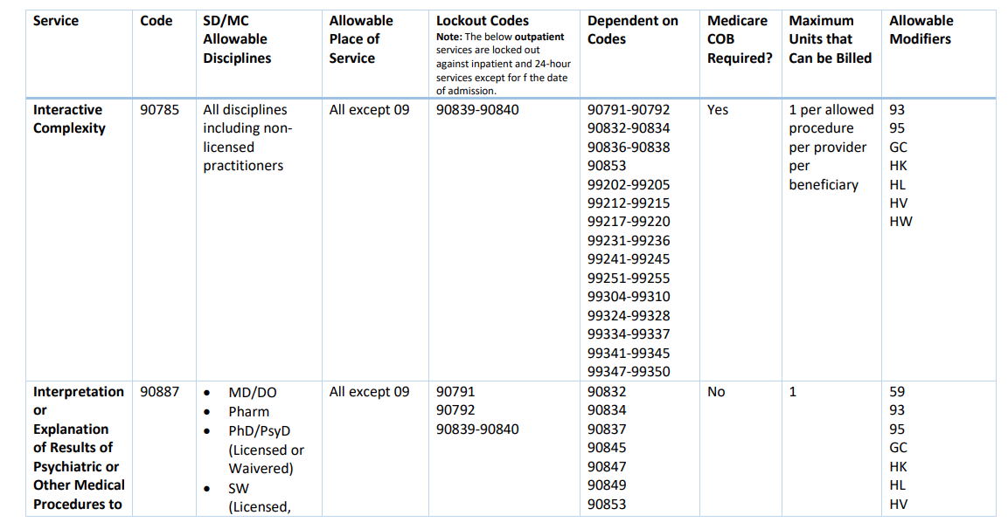
Supplemental Service Example
See -Supplemental Services Codes

Slide 21
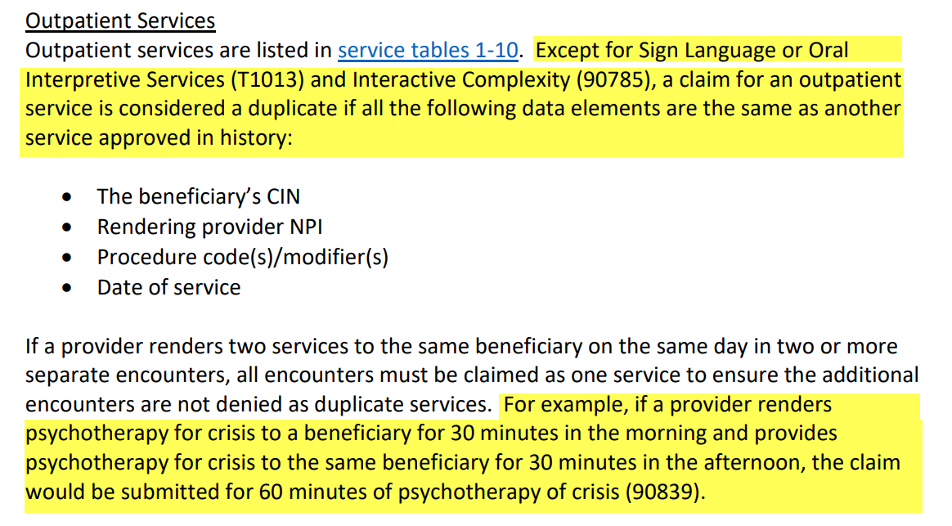
Duplicate Services
From SMHS Billing Manual (page 23):

Slide 22
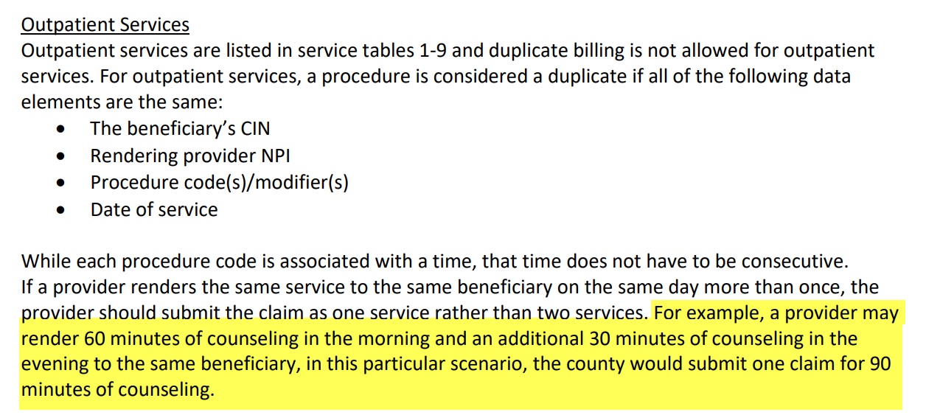
Duplicate Services
From DMC Billing Manual (page 24):

Slide 23
Allowable Overrides
Some lockouts can be overridden based on circumstances
Identified with * or **

Slide 24
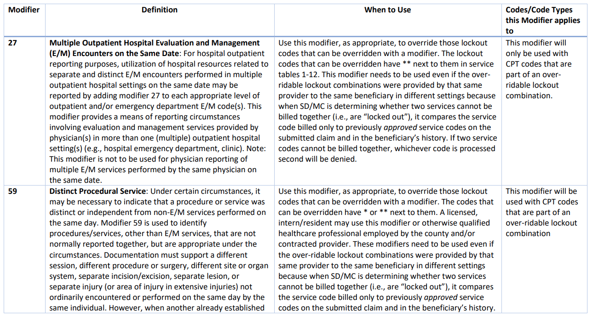
Expanded list of modifiers
Review modifier tables in each billing manual

Slide 25
In Summary
Effective 7/1/2023
Use CPT Codes when possible
Review the billing manuals
Use the coding reference tools from CalMHSA to filter/sort to identify the applicable CPT codes
Leverage EHRs/Billing Systems
To handle code determination when possible
To assist with duplicate service handling and applicable modifiers
This Photo by Unknown author is licensed under CC BY-NC-ND.

Slide 26
Next Steps
Register for future webinars at calmhsa.org
Learn more about new billing requirements
Billing Manual SMHS
Billing Manual DMC ODS
Billing Manual DMC State Plan
Learn more about CPT codes (if desired)
American Medical Association (AMA)
Print and eBook CPT manuals available for purchase

Slide 27
Questions & Answers
Please type your questions in the Chat

Slide 28
Thank You
Thank you for attending this webinar!
The recording, slides, and coding reference guides will be available on our website on the following day.
Please send your questions/comments to paymentreform@calmhsa.org.

Slide 29
Post-Training Evaluation
Please click on the link in the chat box (https://www.surveymonkey.com/r/BDSQHM7) and answer questions to provide feedback

