Slide 1
CPT Coding 102 Optimization of CPT Codes for the Majority of Behavioral Health Services October 6, 2022

Slide 2
Presenters today:
Amie Miller, CalMHSA
Kacey Vencill, CalMHSA

Slide 3
Pre-Training Assessment
Please click on the link in the chat box and answer questions
3 minutes to answer questions

Slide 4
Agenda
Overview of changes
Tips &Tricks
Frequently Answered Questions

Slide 5
General Overview of Changes
Use CPT Codes when possible
HCPCs will continue to be used in some circumstances
There are changes to the modifiers used
Lockout codes should be considered, and "Allowable Overrides" should be used to prevent denials when applicable
There are changes required when > 1 of the same service is provided by the same provider to the same beneficiary on the same day

Slide 6
It may feel like many things are changing but remember – many things are staying the same.

Slide 7
Things that remain the same:
Scope of practice
Scope of competence
County defined supervision practices
Certified sites
24-hour and Day Services
HCPCs for unlicensed staff and non-clinical services (E.g., Rehabilitation)

Slide 8
Things that change:
Additional granularity on codes and code description with CPT codes
Duplicate Service Changes
Modifier Changes
Elimination of group calculations

Slide 9
Old System – the average therapist experience
Case management
Assessment
Rehab
Collateral
Therapy

Slide 10
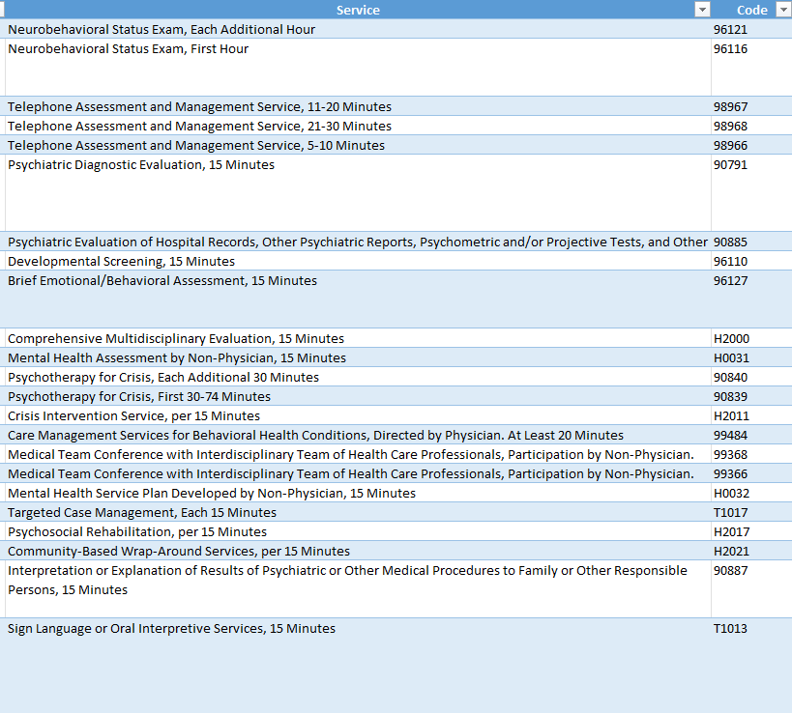
New System
>30 codes "allowed" to be used by an MFT
Too many for a single slide
Refer to CalMHSA Reference Guides

Slide 11
Think about setting up your EMR to do the heavy lifting
Limit Selectable Procedures
Program
What services does the program offer?
Person
What services are in a staff type's scope of competence?
Drive Billing Code & Modifier Determination
Location
Where was the service provided?
Method of Service
How was the service delivered?
Duration
How much time was spent on direct patient care?

Slide 12
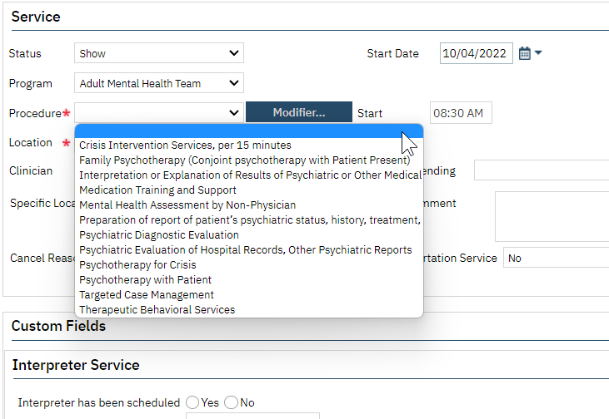
This is how the information can be presented to the clinician and how SmartCare will be set up

Slide 13
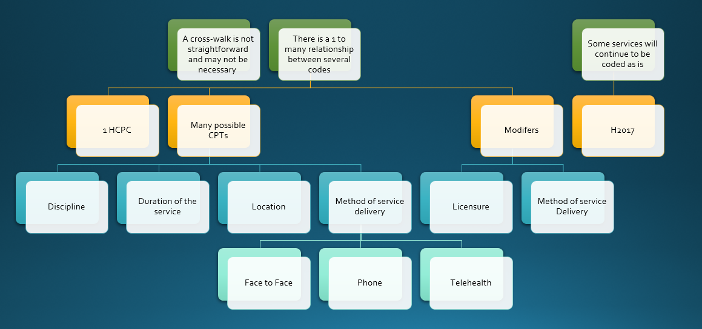
Key Concept Review
A full cross-walk from old to new codes may not be required
Too complex for all of the variables that would need to be considered
Many of the code selections for claims can be determined by billing system/EHR
CalMHSA has developed and provided reference guides that may be helpful in your analysis

Slide 14
Review Continued

Slide 15
Units of Service
Claims will be sent for "units" of service instead of number of minutes
Applies to CPT codes and HCPCs
Maximum Number of Units is denoted in the billing manual
In general, one unit is attained when the mid-point is passed
Whole numbers only, no partial units

Slide 16
Dependent Procedures
Dependent procedures can only be used in conjunction with another procedure/service code. The primary procedure code and add on code must be submitted on the same claim
There are two types noted in the Billing Manals
Add-On Codes
For example, CPT codes 99202-99205 are used to claim reimbursement for an office visit for a new patient. The maximum time that can be claimed with this series of codes is 74 minutes using CPT code 99205. If the provider sees a beneficiary for 89 minutes, the provider would bill 1 unit of 99205 and one unit of G2212
Supplemental Services: are codes that describe additional and simultaneous services that were provided to the beneficiary during the visit or codes that describe the additional severity of the patient’s condition
For example, T1013 indicates that interpretation was provided during the visit while 90785 indicates that certain factors increase the complexity of a patient’s treatment

Slide 17
Evaluation and Management Code Examples
Scenario 1: 70 min Evaluation and Management Service provided in the Office for an established patient
1 unit of 99215 (Office or Other Outpatient Visit of an Established Patient, 40-54 Minutes)
1 unit of G2212 Prolonged Office or Other Outpatient Evaluation and Management Service(s) beyond the Maximum Time; Each Additional 15 Minutes
Note: 99215 is the Primary code and G2212 is the add-on code to account for time beyond the maximum typical time for 99215

Slide 18
Evaluation and Management Code Examples
Scenario 2: 70 min Evaluation and Management Service provided in the Patient's Home for an established patient
Scenario 2:
1 unit of 99350 (Home Visit of an Established Patient, 51-70 Minutes)
Note: Procedure Code is dependent on where the service was provided, and range of time differs for each CPT in the 2 scenarios

Slide 19
Units vs. Minute based claims
Example 1:
60 minutes of Rehabilitation (H2017), will be claimed as 4 units of H2017
Example 2:
4 minutes of H2017, does not pass the midpoint

Slide 20
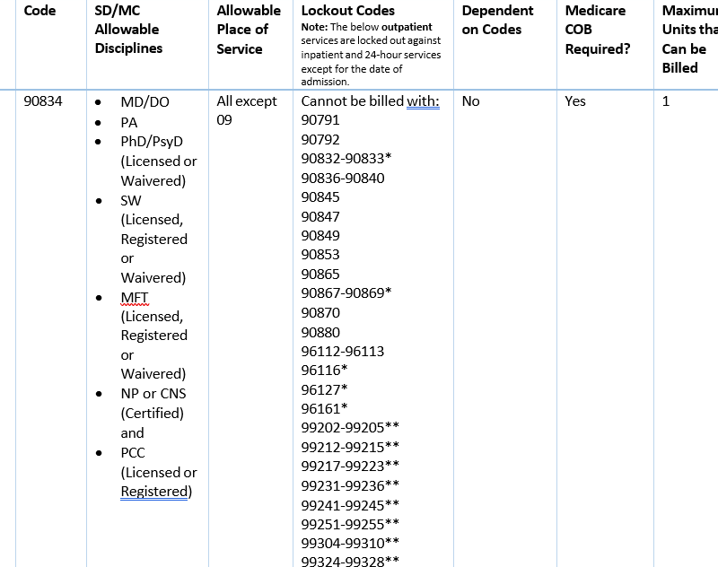
Modifiers
New allowable override for Lockout Codes
Identified in the billing manual with * or **

Slide 21
Tips and Tricks
When sending claims to SDMC, use the definitions and information from the Billing Manual; this supersedes information from CPT code manuals documents when there is a discrepancy
For example: Some Evaluation and Management Codes according to the CPT code books allow for documentation time to be included. As outlined in the Billing Manual, claims can only be sent for units based on time spent for Direct patient care.

Slide 22
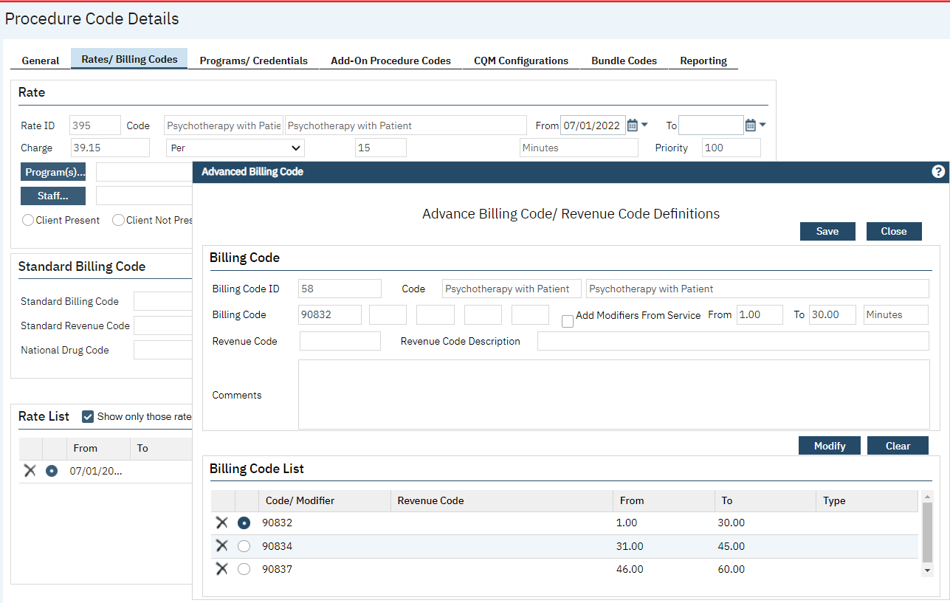
Configuration for different CPT codes based on the duration for the same type of service

Slide 23
Follow-up Questions Part 1
Q. What is the State's definition of a resident? See appendix 2.
A. Resident: According to the Medical Board of California, a resident is an individual who is issued a Postgraduate Training License [and] is enrolled in an Accreditation Council for Graduate Medical Education (ACGME)-accredited postgraduate training program in California. The resident may engage in the practice of medicine only in connection with their duties as a resident in the approved training program, including its affiliate sites, or under those conditions as are approved by the director of their program. A Postgraduate Training License is issued to an individual who has graduated from an approved medical school, passed all required examinations, has not completed 36 months of ACGME postgraduate training, and is enrolled in an approved California residency program
Q. Is there any new requirement for psychiatric resident physician supervision for billing purposes?
A. To indicate that the service was provided by a resident use modifier GC after the service code. On the claim, indicate that the supervising professional is the billing provider

Slide 24
Follow-Up Questions Part 2
Q. Are we using the modifier HE?
A. Use this modifier when billing for 24-hour and day services. For additional information about when this modifier is required refer to service table 11. Do not use this modifier when claiming for outpatient services
Q. Will the age modifier and telephone modifier requirement that is in place now still be required as of July 1, 2023?
A. The SC modifier will be used for telephone or audio-only services. Certain 24-hour services require a modifier based on age. See Table 3 in the billing manuals.
Q. What happens if we have more than 4 modifiers for a claim, especially now with all the modifier requirements?
A. For a transaction to be HIPAA-compliant, a procedure code cannot use more than four modifiers. DHCS recommends that, in the rare situations that MHPs exceed four modifiers per procedure code in a given transaction, they not use modifiers that validate services, indicate that the service was provided as a result of a federal or state mandate or facilitate payment. Telehealth modifiers fit that criteria.

Slide 25
Follow-Up Questions Part 3
Q. If someone does their documentation concurrent or collaborative with the service, does it count towards the duration?
A. Direct patient care time is defined as the time spent with the patient for the purpose of providing service.
Q. How to submit a claim if the client is Medi-Medi?
A. CPT codes that indicate Medicare COB is required should be claimed to Medicare prior to SDMC for applicable beneficiaries
Q. Do we use HL for the waivered psychologists?
A. Use this modifier when the service was performed by a registrants and interns who are working in clinical settings under supervision to obtain licensure

Slide 26
Follow-Up Questions Part 4
Q. HCPC will still allow for less than 1 unit?---so if each unit is 15 mins....and it’s less than 15 minutes, how will that work?
A. Services can be claimed once the mid-point for the CPT or HCPC has been reached.
Q. Is there a sense of how many CPT codes will actually apply to DMC since SUD is not typically under CPT/Medicare rules?
A. Yes, please review the billing manual and review those codes that indicate Medicare COB is required. The CalMHSA reference guides may be helpful for this.
Q. Are the modifier lists accurate in the manual? Confused why HE is no longer an allowed modifier for H2017.
A. Use this modifier when billing for 24-hour and day services. For additional information about when this modifier is required refer to service table 11. Do not use this modifier when claiming for outpatient services.

Slide 27
Questions & Answers
Please type your questions in the Chat

Slide 28
Post-Training Evaluation
Please click on the link in the chat box and answer questions to provide feedback

Slide 29
Thank You
Thank you for attending this webinar!
The recording and slides will be available on our website on the following day.
Please send your questions to paymentreform@calmhsa.org.

