Slide 1

Roots of the Peer Movement:
Andrea Wagner, Executive Director
California Association of Mental Health Peer Run Organizations
CalHOPE Specialist Training
April 20, 2023

Slide 2
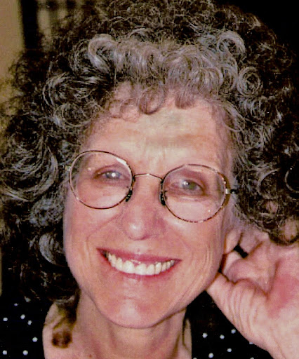
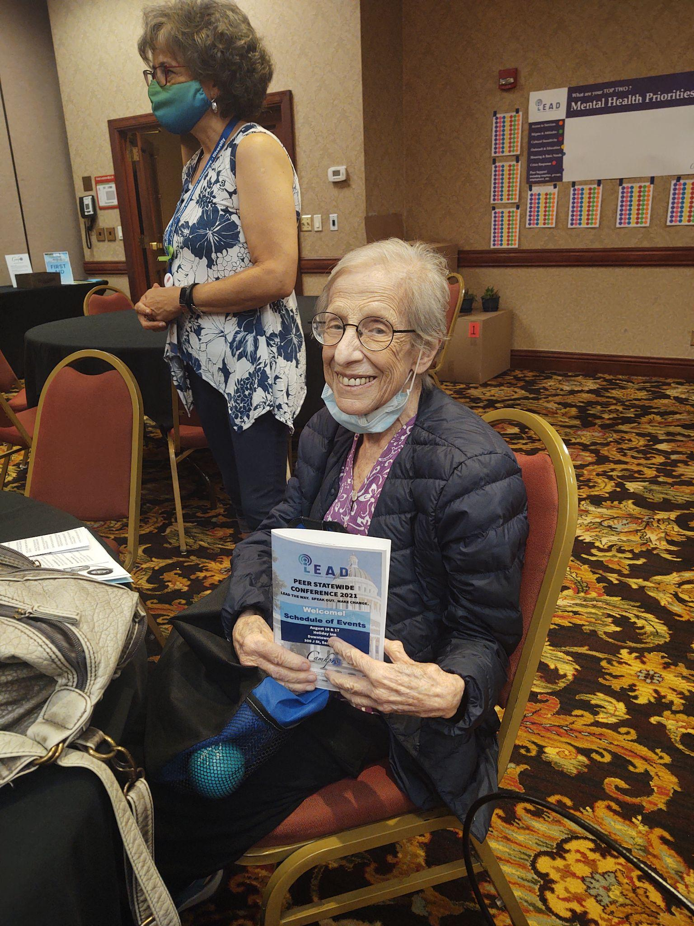
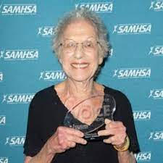
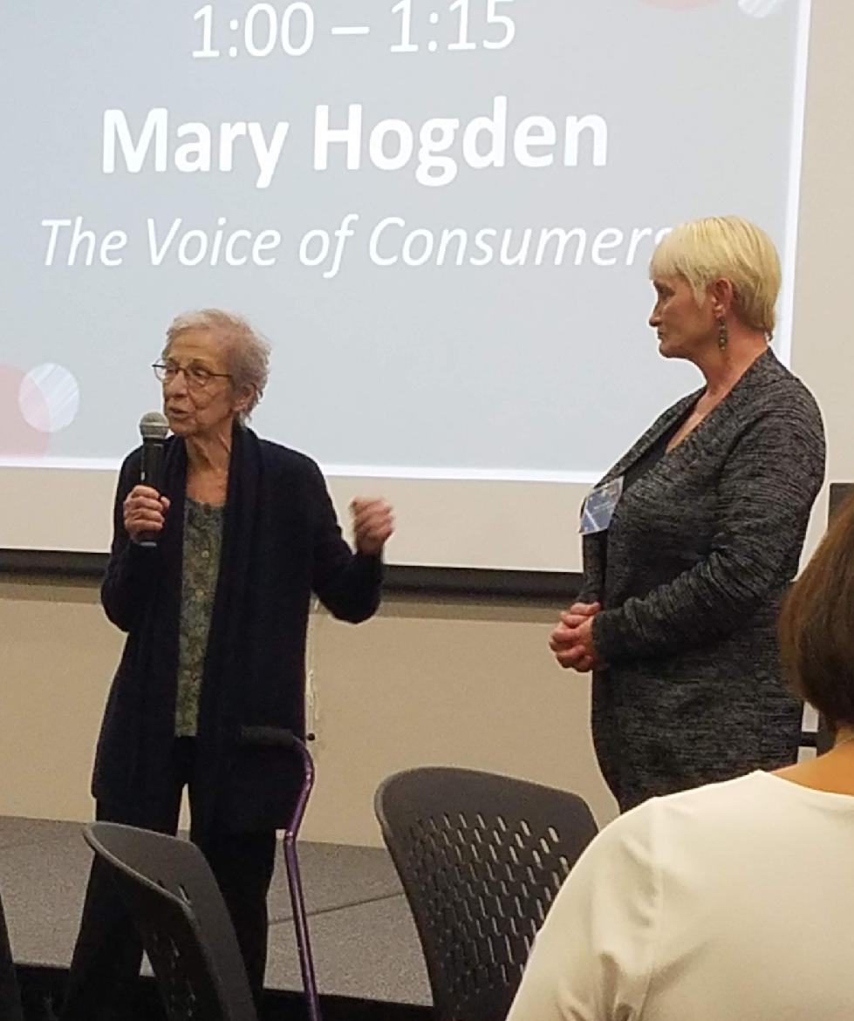
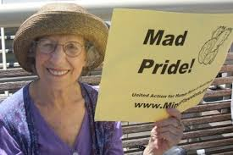
Sally Zinman
Video: “Advocacy Makes a Difference”

Slide 3
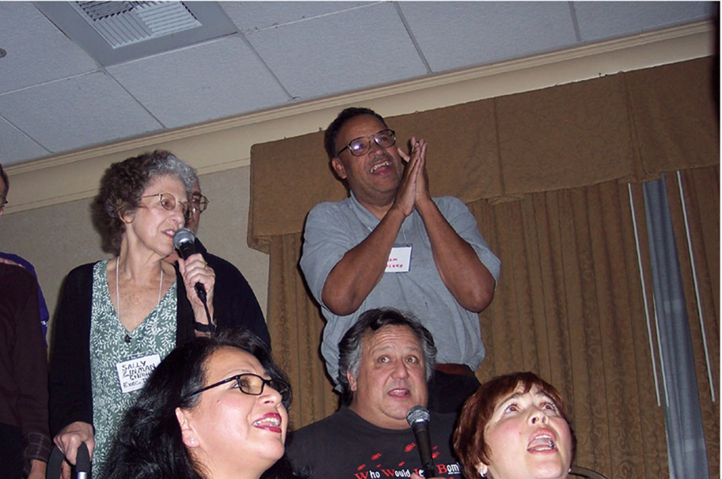
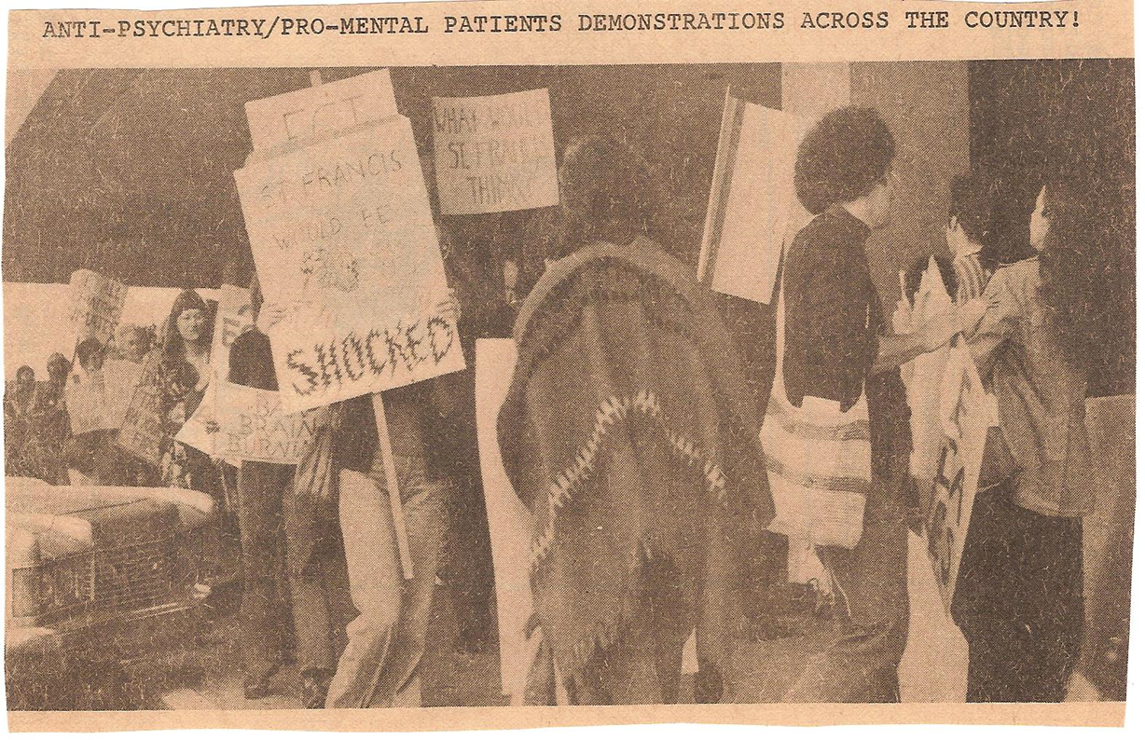
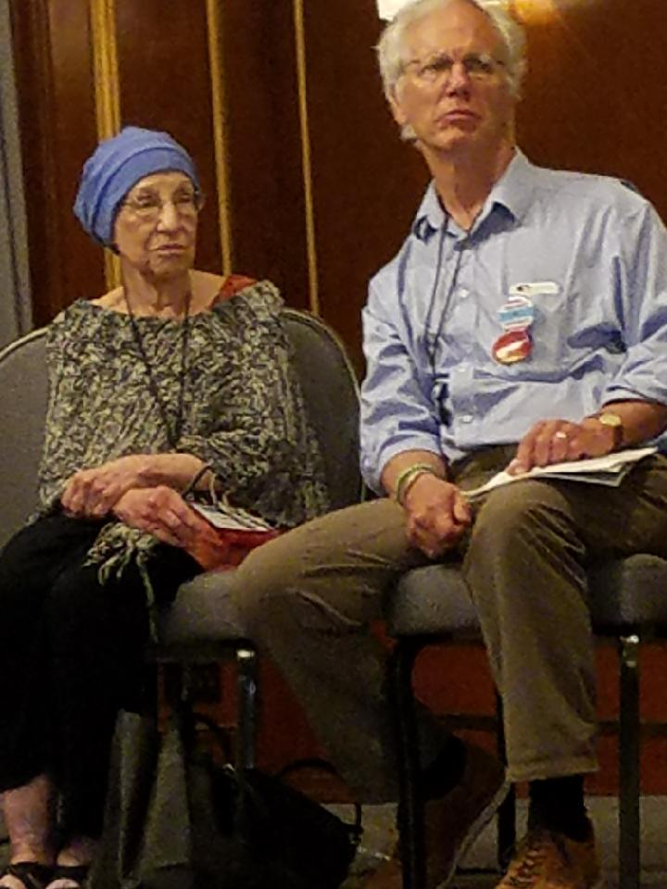
The Roots:

Slide 4
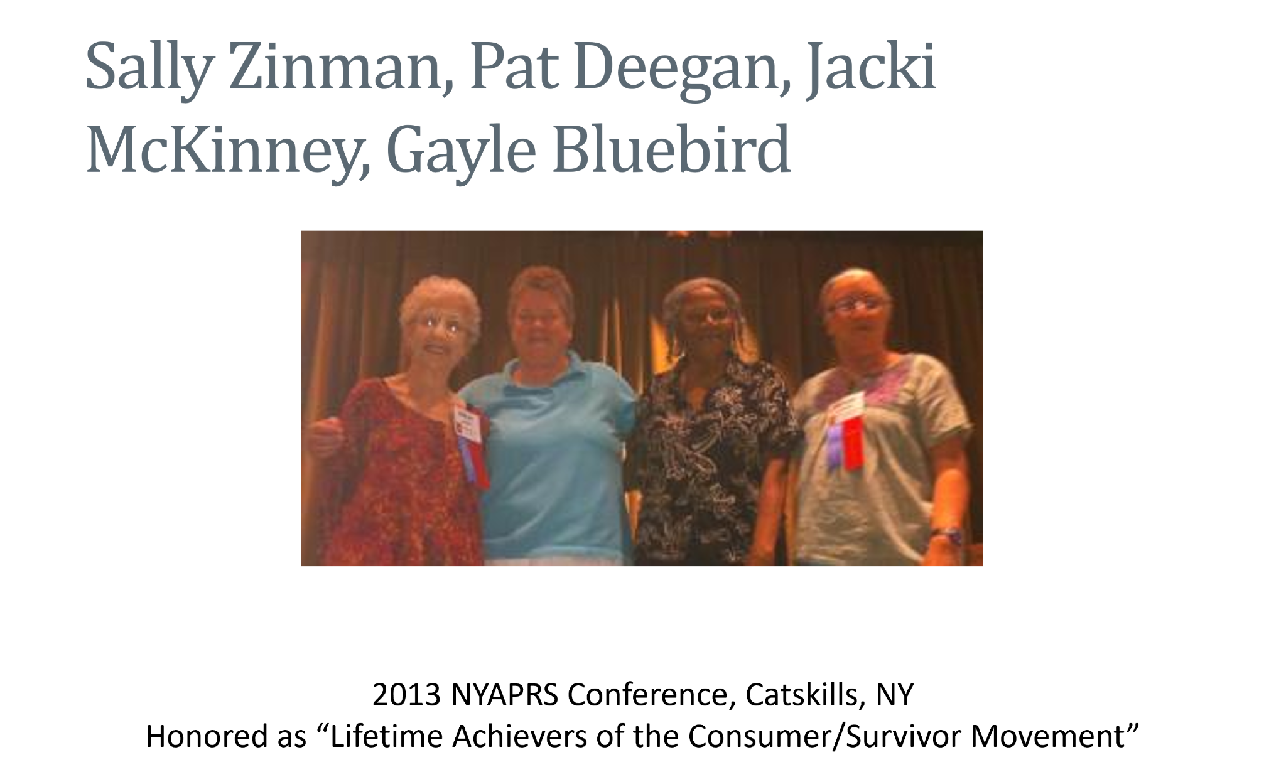
The Roots:

Slide 5

“We must stay true to our roots or we will defeat the purpose of peer support. Separate a tree from its roots and it will surely die. Stay connected to our roots and we will live long and prosper.”
Reaching Across 2: Maintaining Our Roots/The Challenge of Growth. CNMHC.“Maintaining our Roots: The Challenge for Self-Help Development” by Howie T Harp & Sally Zinman, 1994.
Notes:
We must stay true to our roots or we will defeat the purpose of peer support. Separate a tree from its roots and it will surely die. Stay connected to our roots and we will live long and prosper. (Maintaining our Roots: the challenge for self-help development, Howie T Harp & Sally Zinman.(1994). Reaching Across 2: Maintaining Our Roots/The Challenge of Growth. CNMHC.)
The base of peer support is advocacy
Peer support flourishes but on-going challenge of losing our peer/consumer values

Slide 6
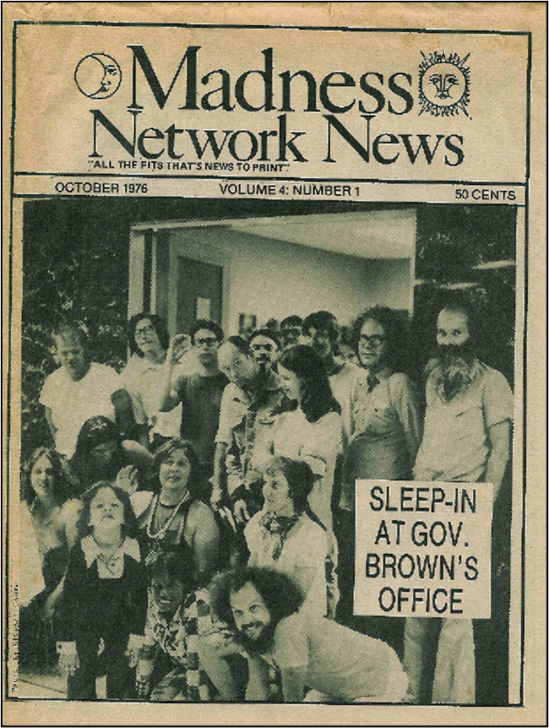
From Campgrounds to Hotels
From the early days of standing outside the halls of power with placards, to sitting at the decision-making table today, the consumer advocacy movement has been responsible for major changes in its 45+ years of organizing.
Notes:
From the early days of standing outside the halls of power with placards, to sitting at the decision-making table today, the consumer advocacy movement has been responsible for major changes in its 40 years of organizing. Advocacy makes a difference and effects change.

Slide 7
Social Change
Starting in the 1960s and into the 1970s:
Civil Rights Movement - African Americans, women, gays, and people with disabilities organized
The Sane-ism Movement - advocated for “mental patients” who were denied basic civil liberties and suffered systemic inhumane treatment, including spending lifetimes locked in state hospitals
Notes:
1960s and 1970s social change movements
Civil rights movement; African-American, women, gays, and people with physical disabilities organized
For decades, mental patients were denied basic civil liberties and suffered systemic inhumane treatment
Spent lifetimes locked up in State hospitals.
New laws limited involuntary commitment
Now big State hospitals were shut down and people released

Slide 8
Deinstitutionalization
New laws started to limit involuntary commitment
State hospitals began to close
John F. Kennedy began to federally fund community based mental health centers and closing facilities from the federal level
Movies like “One Flew Over the Cuckoo’s Nest” are examples of a culture and attitude shift in America

Slide 9
Liberation Movement
Former “patients” (like Sally) began to meet and share stories
They found validation and understanding in each other
Many felt passionate about the need for independent living in the community
A new civil rights movement was born from isolated groups across the country
Notes:
Once released from the hospital people held groups
Former “patients” shared anger about their abusive treatment
Their peers validated their feelings.
Expressed the need for independent living in the community
A new civil rights movement was born from these isolated groups across the country
Based on the desire for personal freedom and radical systemic change
A liberation movement

Slide 10
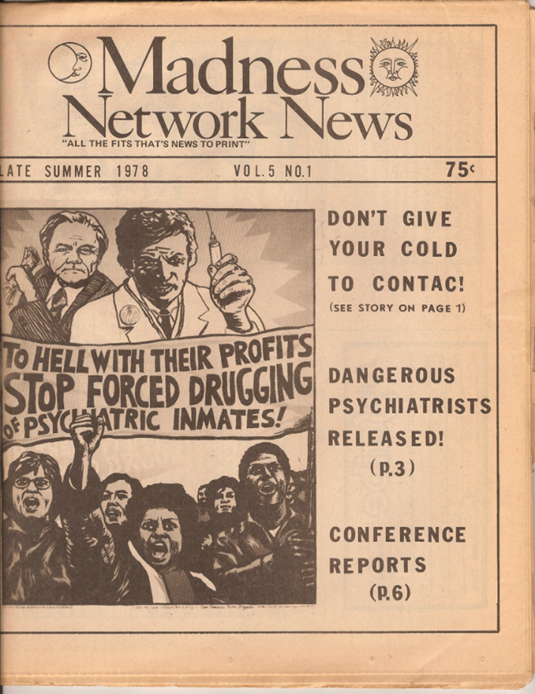
Liberation Movement
Based on the desire for personal freedom and radical systemic change

Slide 11
Core Values
For people diagnosed with mental illness
Against Forced Treatment
Against Inhumane Treatment – medications, ECT, lobotomy, seclusion and restraints
Anti-Medical Model verging on anti-psychiatry
Emergence of concept of mental patient run alternatives to mental health system and peer support
Involvement in every aspect of mental health system
Notes:
Of finding each other
Of realizing that we were not alone
Of militant groups and actions
Of self and group education
Of defining our core values
Of finding and growing our voice out of the anger and hurt bred by the oppression of the mental health system.
Of separatism as a means of empowering ourselves.

Slide 12
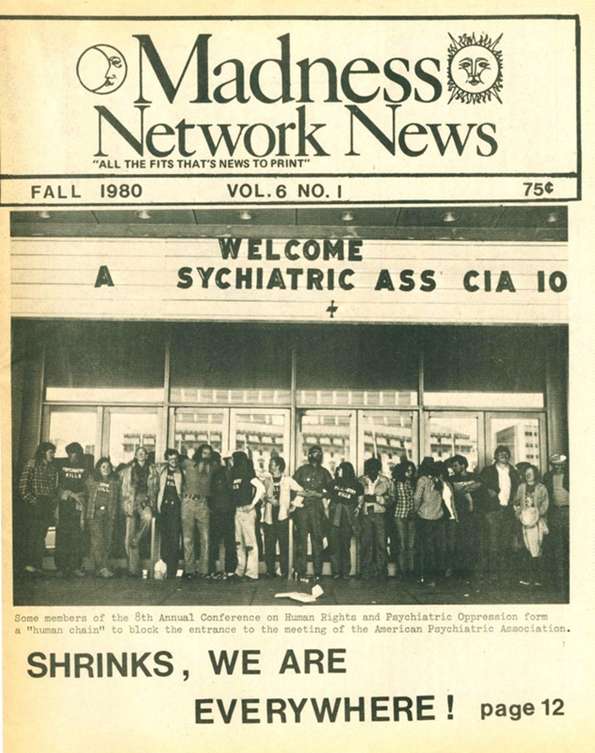
Actions
Unfunded gatherings and protests
Newspaper
Political militant activism
Notes:
Political militant activism – demonstrations
Developing and defining values and positions
Annual Conference on Human Rights and Against Psychiatric Oppression
held at campgrounds, college campuses, unfunded
Madness Network News –news vehicle for communication
Small groups, mostly on two coasts
Militant names, e.g., Network Against Psychiatric Assault, Insane Liberation Front, Mental Patient Liberation Front
Most common self-description is as “psychiatric inmate.”
Self and group information and education
Support, consciousness raising groups

Slide 13
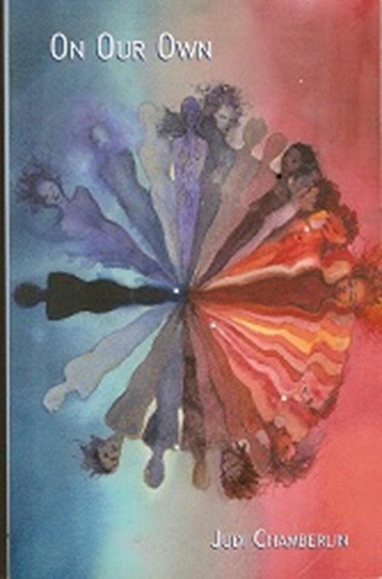
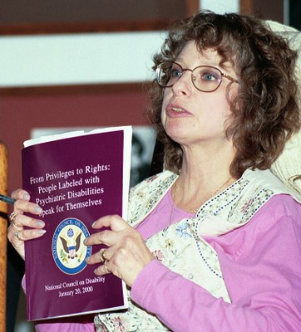
“On Our Own”
Landmark book in 1978
“On Our Own: Patient Controlled Alternatives to the Mental Health System”
By Judi Chamberlin

Slide 14
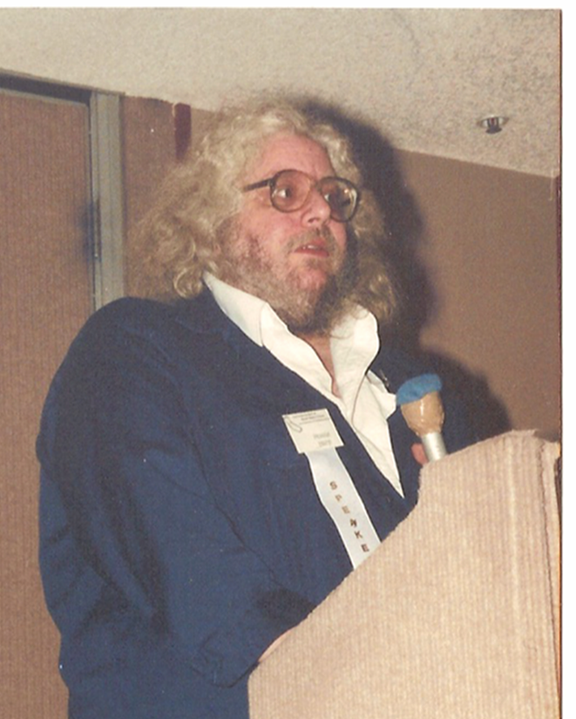
1980s
Transitional time
Split in activism
New activities and focus
Began re-entering the system
Some goals were being actualized and implemented

Slide 15
Peer Run Organizations
Early drop-in centers:
1983 On Our Own in Baltimore, Maryland
1985 Berkeley Drop-In Center, Berkeley CA
1985 Ruby Rogers Drop In Center Cambridge Mass.
1986 Oakland Independence Support Center, Oakland CA
Federal Community Support Program, NIMH, begins to fund consumer/survivor-run programs:
1988 13 consumer-run demonstration projects funded
Beginning of statewide consumer run organizations:
1983, California Network of Mental Health Clients
Notes:
Growth of mental health system funded consumer run and staffed/peer support programs, 
Federal government programs
Beginning of statewide consumer run organizations

Slide 16
More Shifts
Changes in funding and events
First national Alternatives Conference in 1985
Growth of rights protection organizations
Peers/clients/consumers were “inside” and “outside” the system
Notes:
Discontinuation
of Madness Network News and decline of radical militant groups
of Conference on Human Rights and Against Psychiatric Oppression
Many MH system funded trainings and conferences
First national Alternatives Conference 1985
Rights Protection gains/legislation
Growth of rights protection organizations
Protection and Advocacy, Inc.
Beginning to walk inside, social change from the inside as well as the outside
More “clients”, “consumers” sitting on decision making bodies

Slide 17
1990s
“Peer” came into use
Jobs for peers/consumers began to emerge more
Peer-run respite centers and self-directed care models were being developed
National advocacy groups and coalitions formed for peers

Slide 18
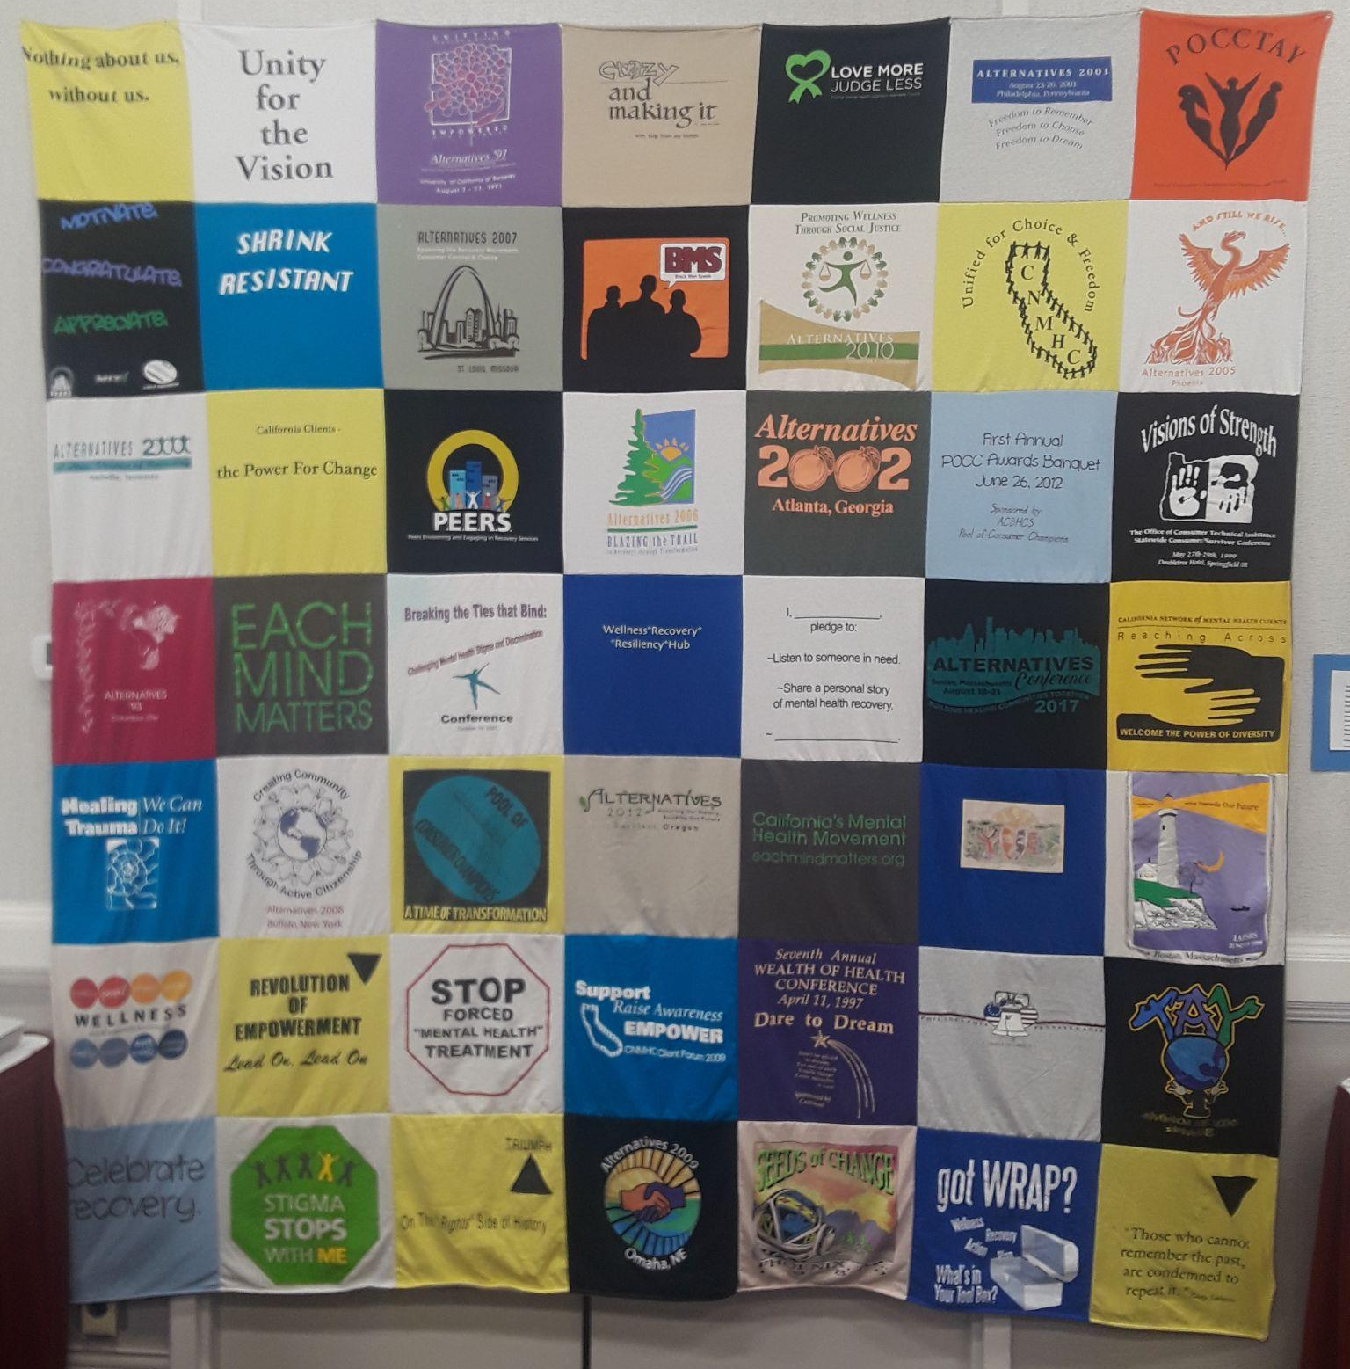
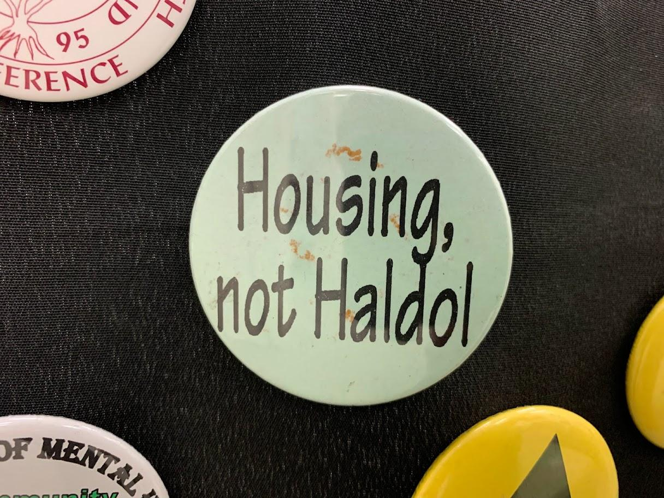
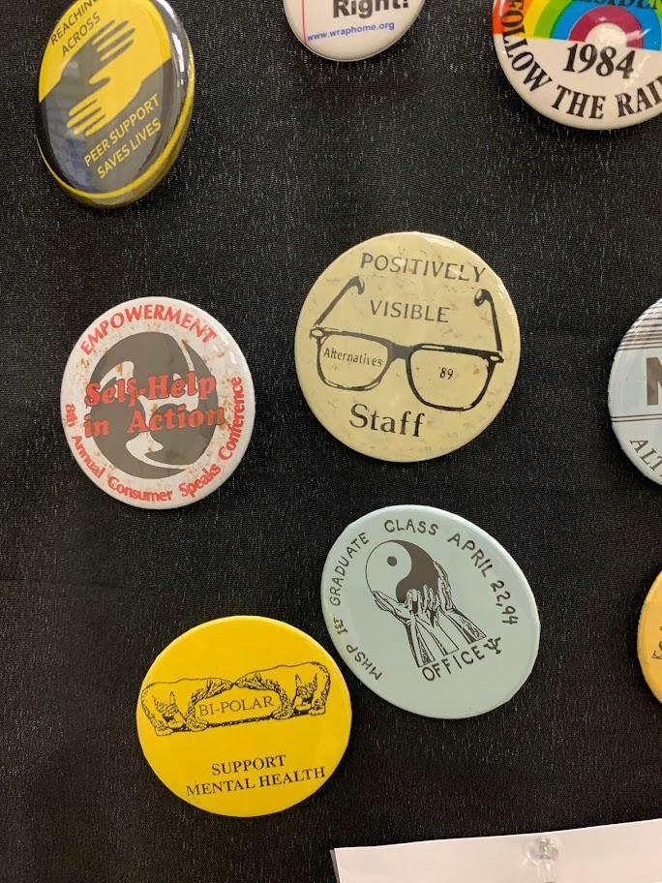

Slide 19

Mental Health Services Act (MHSA)
California voter proposition passed in November 2004
Established a 1% tax on all income more than $1 million

Slide 20
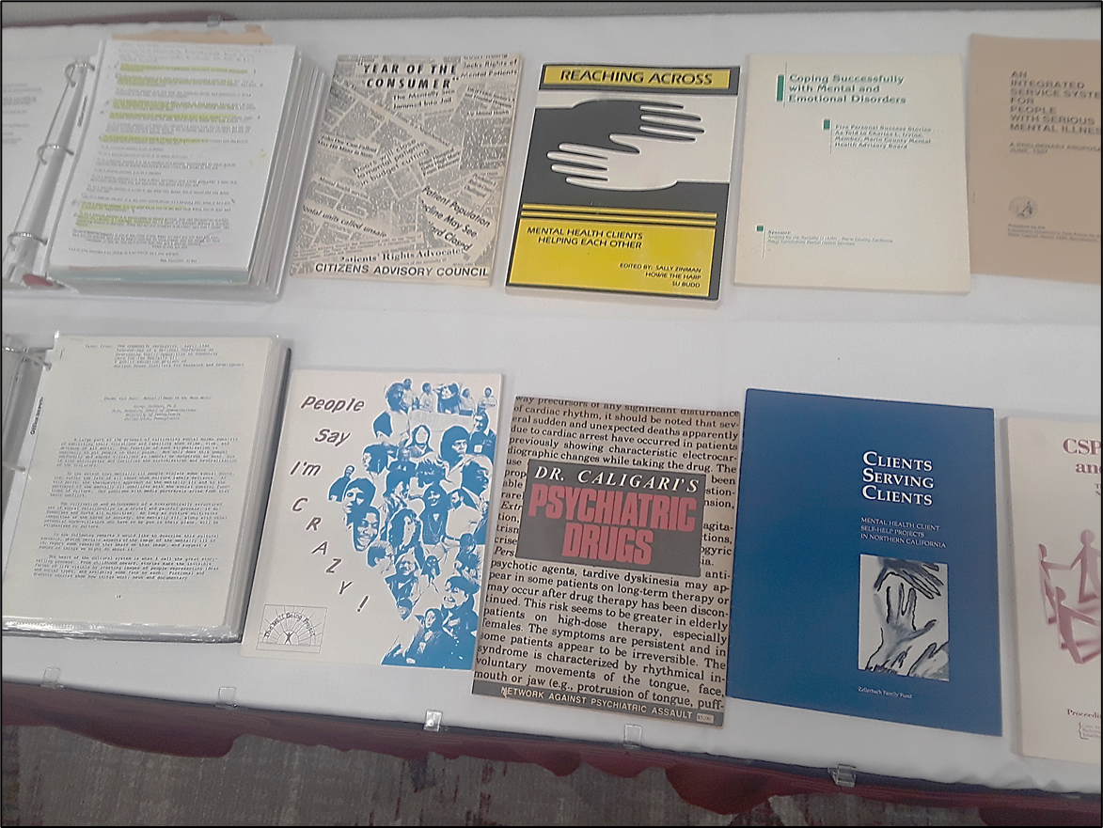
Mental Health Services Act (MHSA)
Peer values are the Guiding Principles of MHSA, which stakeholders worked on for many years before the bill was introduced.

Slide 21
Mental Health Services Act (MHSA)
“General Standards” were implemented in the WIC and CCR:
•Community Collaboration
•Cultural Competence
•Client Driven
•Family Driven
•Wellness Recovery, and Resilience Focused
•Integrated Service Experience

Slide 22
Recovery
“We envision a future when everyone with a mental illness will recover.”
Achieving the Promise: Transforming Mental Health Care in America, The President’s New freedom Commission on Mental Health, July 2003.
Notes:
Recovery replaces maintenance as the goal for people diagnosed with mental illness
“We envision a future when everyone with a mental illness will recover.”
Achieving the Promise: Transforming Mental Health Care in America, The President’s New freedom Commission on Mental Health, July 2003.

Slide 23
CAMHPRO:
501(c)3 corporation founded in 2012; peer-run & statewide
Association of established, independent peer-run organizations and individual consumer members
To promote peer-run organizations devoted to advocacy and empowerment for mental health consumers

Slide 24
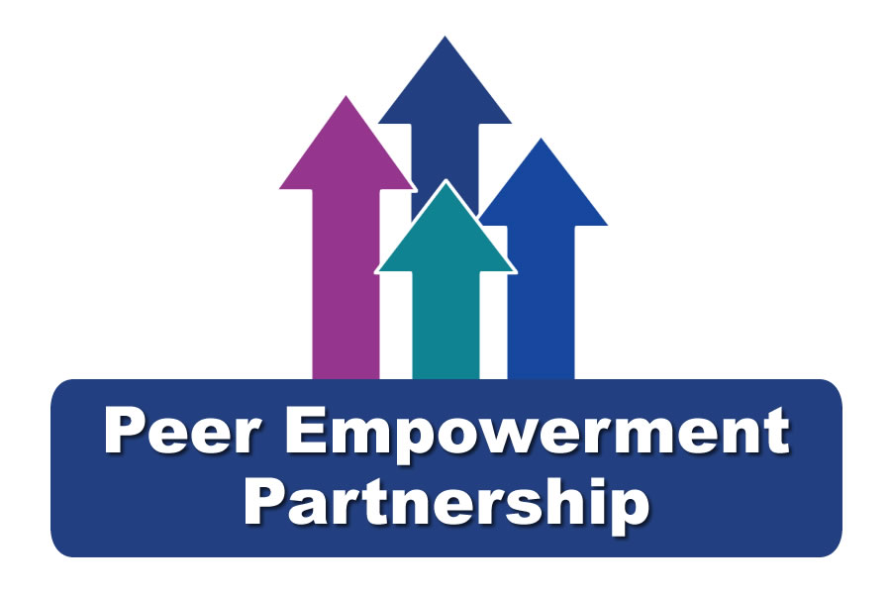

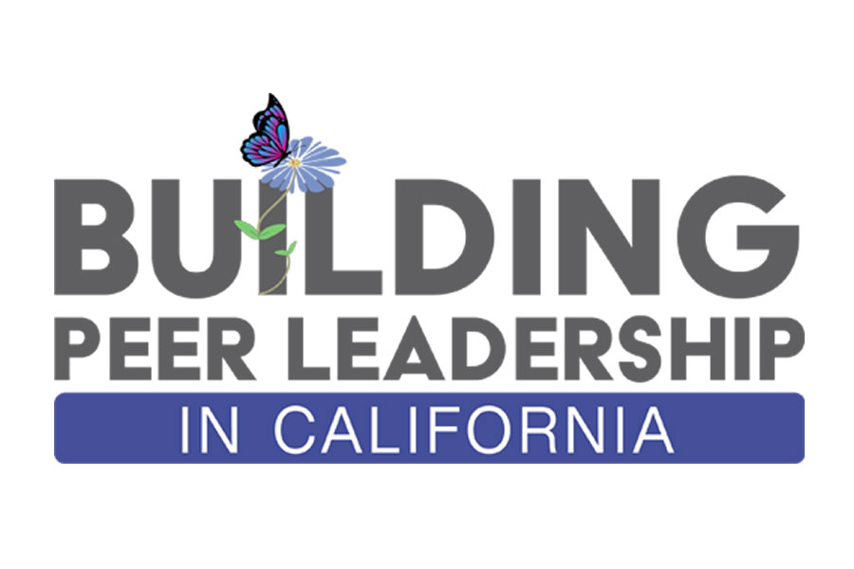


Current Programs:
VISIT CAMHPRO.ORG “Our Programs” page for more information.

Slide 25
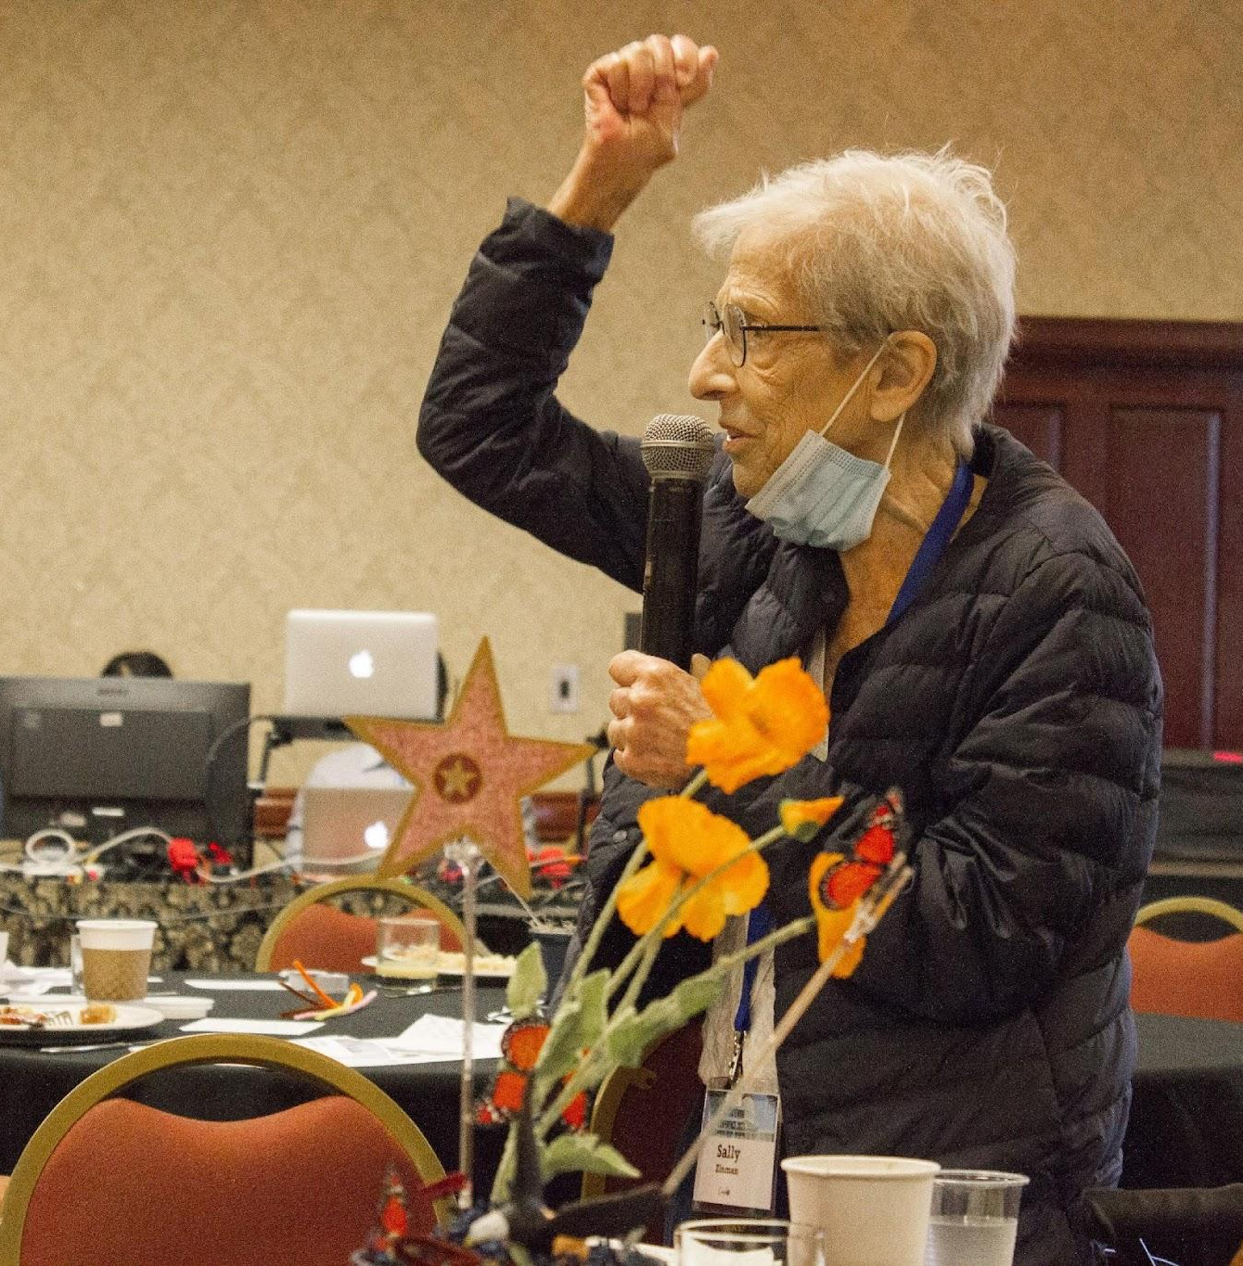
Sally’s Legacy
Founding Executive Director Sally Zinman worked 45 years as an advocate after her own lived experience and trauma of forced “treatment.”
She was a role model and advocated for:
Nothing About Us Without Us!
Video: Sally’s Story (PEERS)

