Slide 1
Understanding Social Support, Empathy, and the Therapeutic Alliance

Slide 2
Psychological burdens are lessened through the presence of social support
Schnall et al., 2008, Social Support and the Perception of Geographical Slant
Notes:
Previous studies showed wearing a heavy backpack increases perception of slope. Participants who were alone judged the slope to be significant steeper than participants with a friend. The length of the friendship was positively correlated to the decrease in perceived steepness.

Slide 3
Everyone needs social support
Negative impacts of social isolations- lessons from Romanian orphanage studies (Weir, 2014)
Infants laid in cribs all day except when fed, diapered or bathed on a fixed schedule
As they aged they showed poor impulse control, social withdrawal, poor emotional regulation, low self-esteem, & cognitive impairment
Health of social relationships correlates with physical & mental health
Notes:
Weir, 2014 https://www.apa.org/monitor/2014/06/neglect

Slide 4
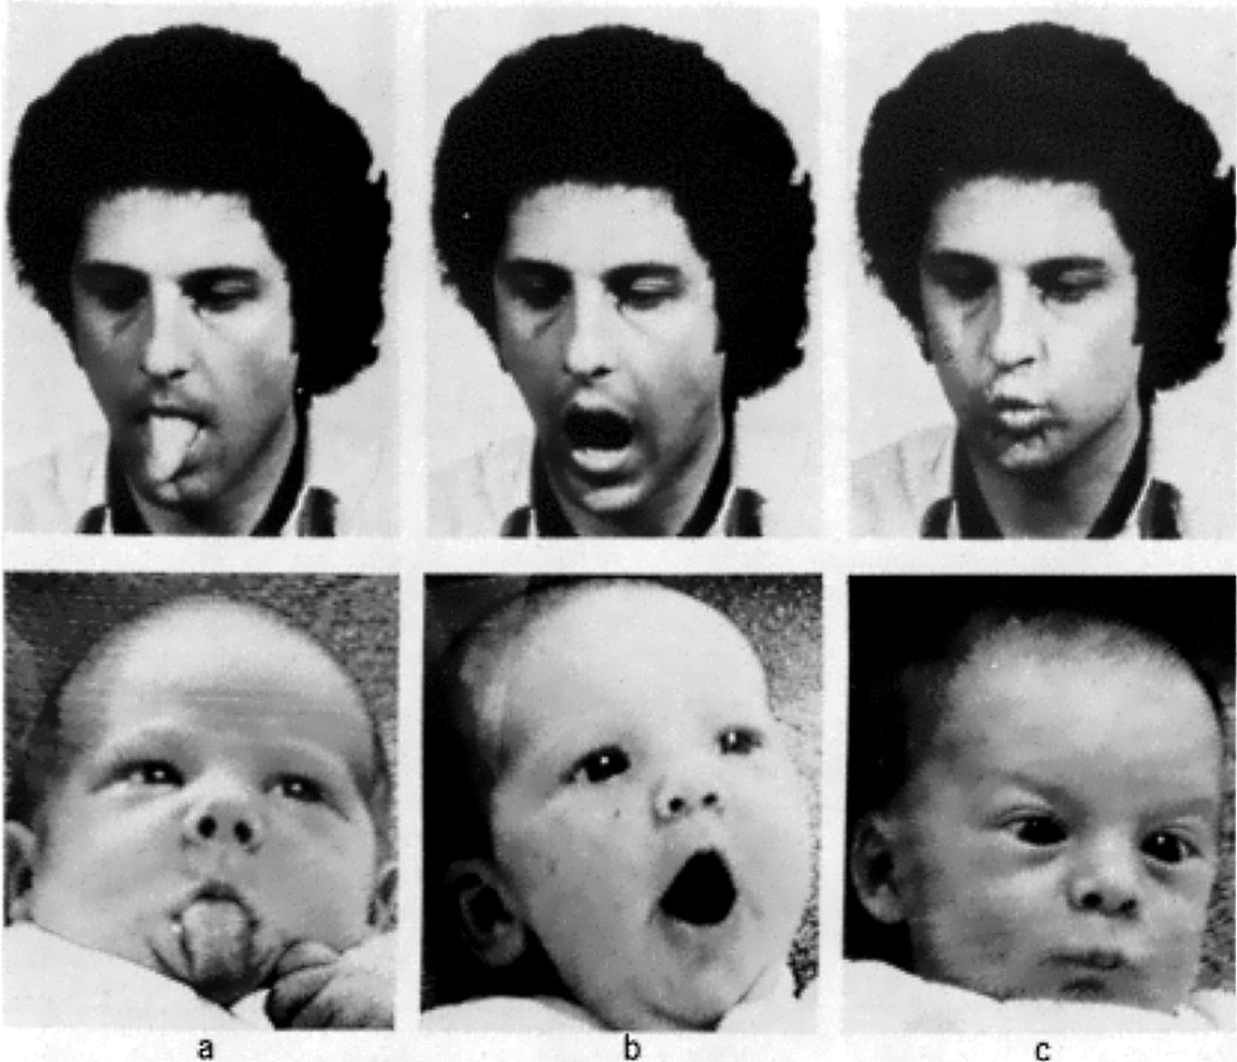
How we relate
Mimicry- The tendency to automatically synchronize affective responses, vocalizations, postures, and movements when observing another person
Meltzhoff and Moore (Science, 1977)

Slide 5
How we relate
Mirror Neurons- fire when one performs an action or experiences a sensation and when one observes another performing an action or experiencing a sensation.
Social vs. Physical Pain- Brain imaging studies suggest that social and physical pain share the same brain pathways (Eisenberger et al., 2003).
Vicarious experience of Pain- Brain areas associated with affective experience of pain are active when one experiences empathy for someone in pain (Singer et al., 2004).
Notes:
Discovered serendipitously in the laboratory of Giacomo Rizzolatti (di Pellegrino et al., 1992)
Female partner placed in MRI with shock-generating electrode on right hand
Male partner also has shock-generating electrode on right hand visible to female in MRI scanner via a mirror
Acetaminophen (Tylenol) has been shown to reduce social pain as well as physical pain (DeWall et al., 2010).

Slide 6
Emotional Contagion
The tendency to acquire another person’s emotions
Babies cry when they hear other babies crying
For mimicry and emotional contagion to lead to empathy requires self-awareness and self/other distinction.
Did the affective experience originate from within or was it triggered by another person?
Without this distinction, emotional contagion could simply result in just personal distress and a self-centered response rather than empathy.

Slide 7
Theory of Mind
The ability to understand that others have beliefs, desires, and intentions that are different than one’s own
Notes:
Often tested through false belief tasks

Slide 8
What is Empathy?
When an observer perceives or imagines another’s affect and triggers a response so that the observer partially feels what the other is feeling
Affect sharing

Slide 9
Sympathy, Compassion, & Empathic Concern
Often treated synonymously
Psychological assessments of empathic concern involve self-report of sympathetic or compassionate feelings.
Key distinction between empathy and sympathy:
Empathy = affective sharing or “feeling with” the other
Sympathy & Compassion = inherently other oriented “feeling for” the other

Slide 10
Mimicry
Emotional Contagion
Understanding
Imagine Self
Imagine Other
Low
Empathic Concern
High
Empathic Concern
Personal Distress or Apathy
Empathy
Withdrawal or Aversive Response
Altruism or
Prosocial Action

Slide 11
How do we become more empathetic?
Perspective taking (Lamm et al., 2007)
Participants viewed videos of patients undergoing painful treatment:
First group was asked to imagine that they were in the patient’s place (imagine-self)
Second group was asked to focus on the patient’s feelings and affective expressions (imagine-other)
Results showed imagine-self group to have higher levels of personal distress and less empathic concern coupled with more activation of brain areas involved in action control related to escaping the situation

Slide 12
How do we become more empathetic?
Establishing an Emotional Frame of Mind (Barraza & Zak, 2009)
Results:
Viewing an emotional video raised oxytocin levels by an average of 47% over baseline compared to those who watched an emotionally neutral video
There was a positive relationship between the degree of empathy experienced and the change in OT
An increase in experienced empathy was associated with greater generosity in the ultimatum game

Slide 13
How do we become more empathetic?
Establish Ingroup Mentality- People fail to empathize to the same degree with outgroup members as ingroup members
Soccer fans watching a fellow fan get shocked are more likely to receive an electric shock themselves in order to reduce the shock to the other. However, soccer fans watching a rival fan get shocked were unwilling to relieve rival’s pain by only receiving half of the shock and in fact demonstrated schadenfreude (Hein et al., 2010).
White and Asian participants demonstrated less pain circuit activation when viewing other-race vs same-race faces being pricked by a needle (Xu et al., 2009)

Slide 14
How do we connect with a help seeker?
Establish a strong therapeutic alliance- Collaborative relationship between client and counselor/therapist.
Highest predictor of successful outcomes outside of client’s own willingness to change.
Most current conceptualizations of the alliance are based upon the work of Edward Bordin (1979).
Agreement on goals
Assignment of tasks
Development of bonds
Notes:
Revise color scheme here

Slide 15
Power of Human Connection
Therapist effects on treatment outcomes can account for up to 55% of variance with larger effects occurring with more severe patients (Bergen & Imel, 2013).
The client-counselor alliance has 7x the impact on treatment outcomes over the specific treatment methodology chosen (Delgadillo et al.,. 2020).

Slide 16
Psychological burdens are lifted through the presence of social support

