Slide 1
CALHOPE CONNECT: Meeting people where they are
Keris Jän Myrick, M.B.A., M.S, CPMC

Slide 2
https://dailyevergreen.com/37410/news/welcome-sign-greets-visitors-in-dozens-of-languages/

Slide 3
Language Matters
“LANGUAGE IS OFTEN A REFLECTION OF CULTURE, and when unchecked, can be used to perpetuate violence and oppression. Words have the power to reinforce stereotypes, marginalize the most vulnerable among us, and support harmful ideas about race, gender, sexual orientation and gender identity, socioeconomic status, and other factors. Language also has the power to be a revolutionary tool in dismantling existing power structures. Language has the capacity to liberate and empower.”
National Black Justice Coalition: Words Matter Justice Toolkit

Slide 5
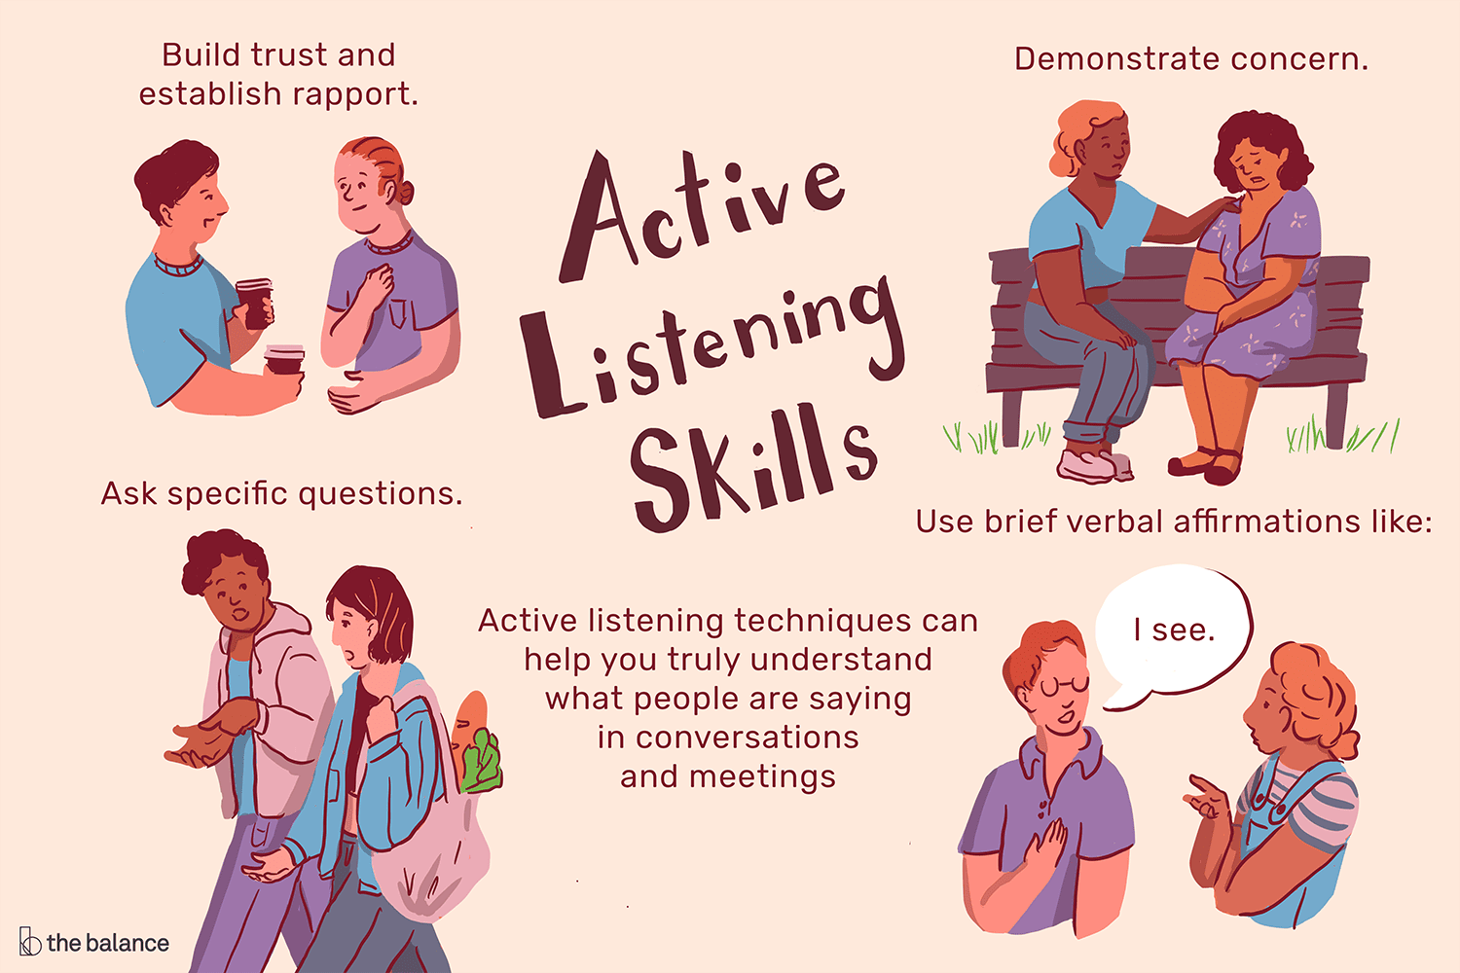

Slide 7
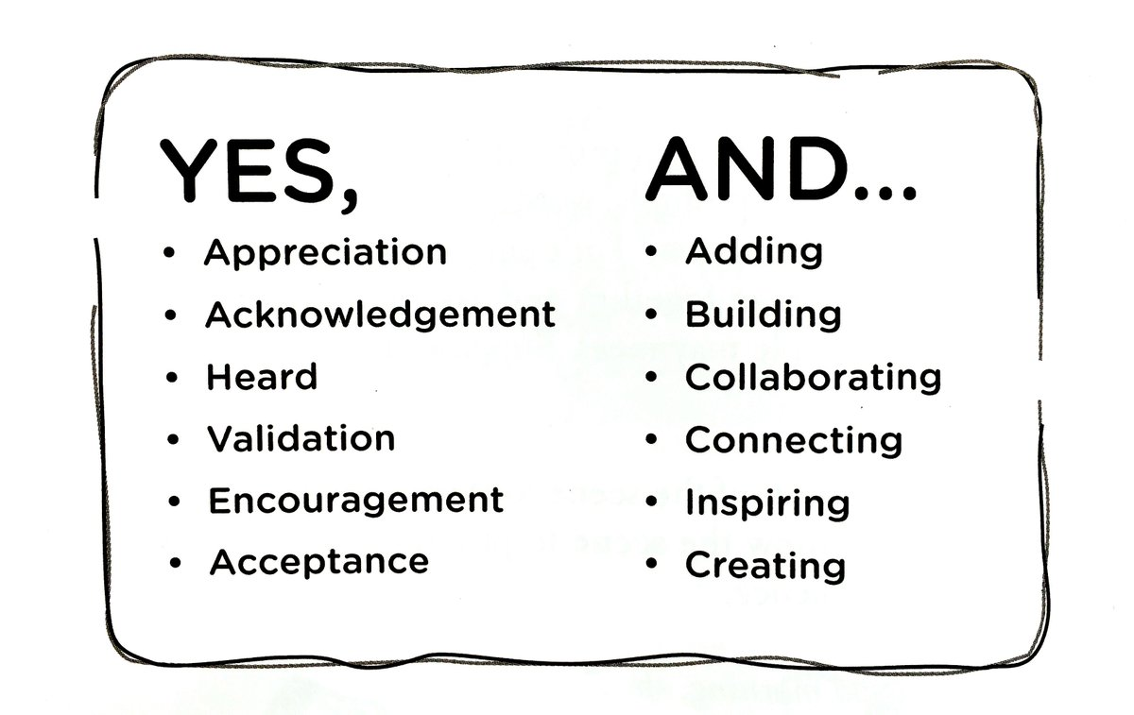

Slide 8
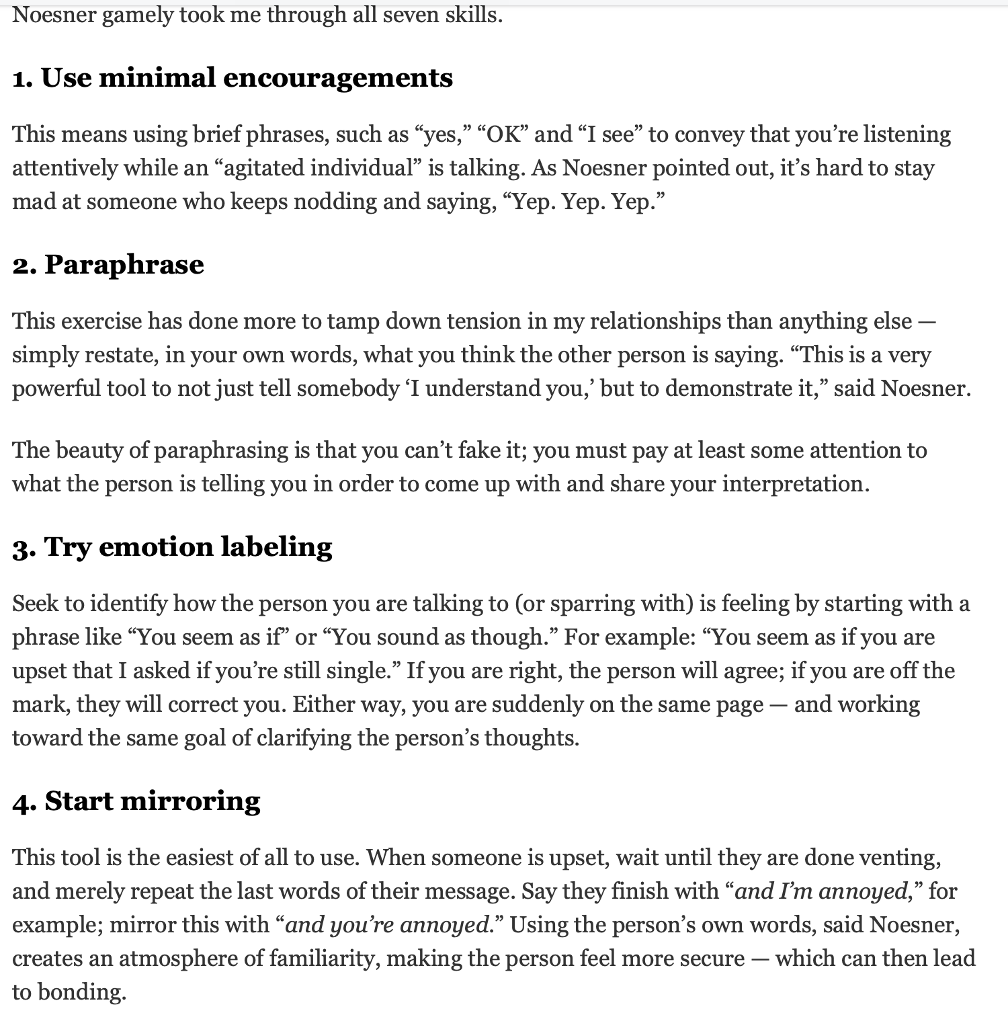
https://www.nytimes.com/2022/12/22/well/family/active-listening-skills-fbi.html

Slide 9
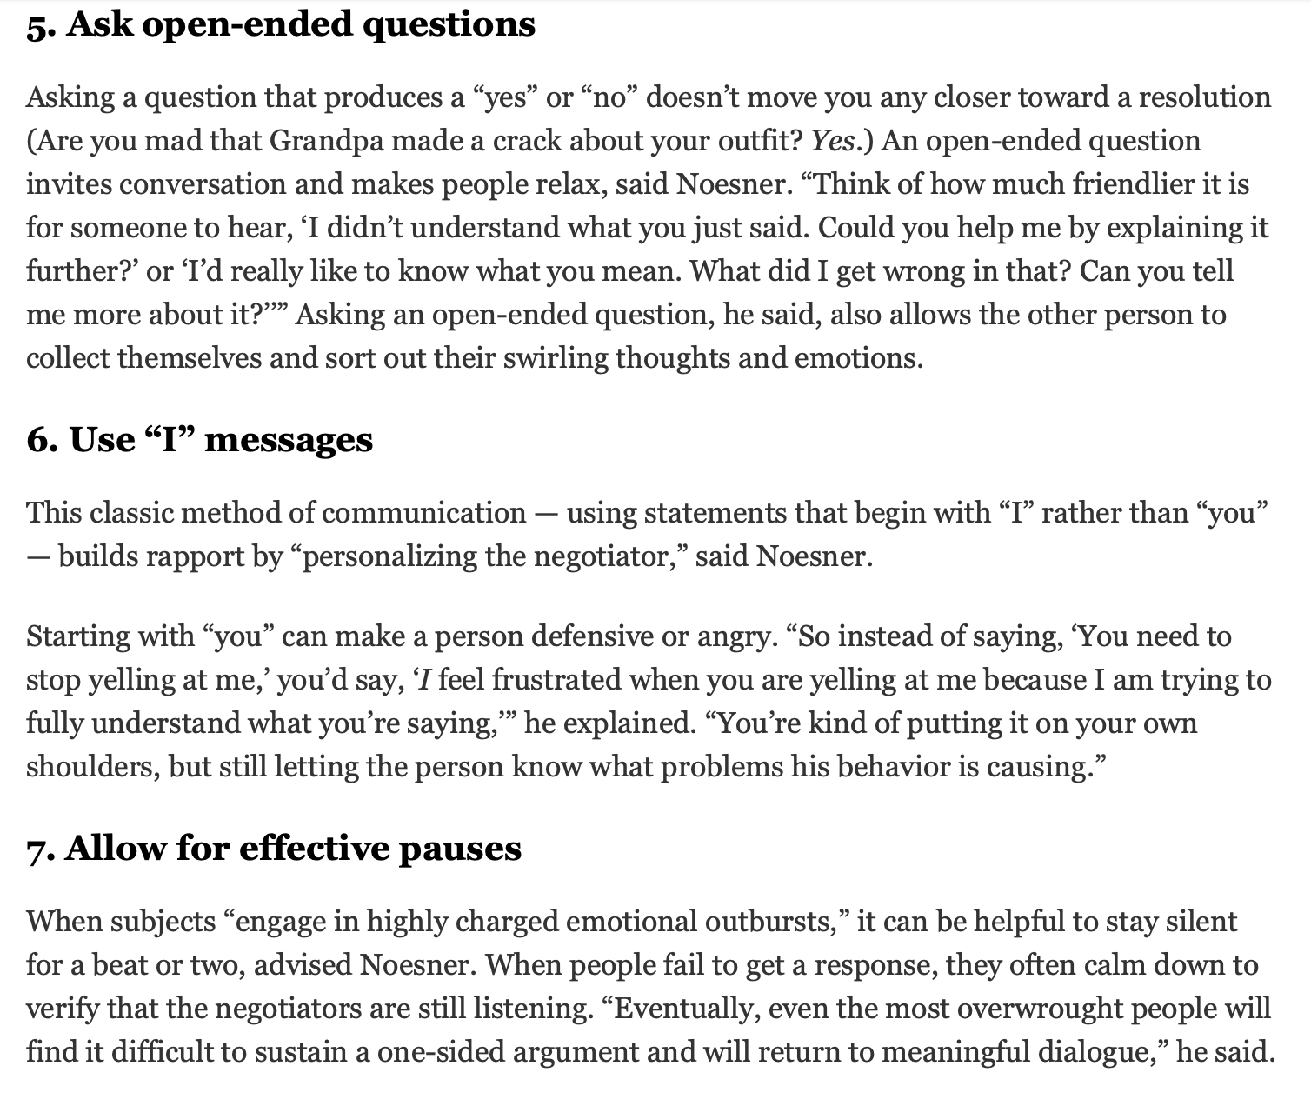
https://www.nytimes.com/2022/12/22/well/family/active-listening-skills-fbi.html

Slide 11
https://beckinstitute.org/center-for-recovery-oriented-cognitive-therapy/

Slide 12
https://beckinstitute.org/center-for-recovery-oriented-cognitive-therapy/

Slide 13
https://beckinstitute.org/center-for-recovery-oriented-cognitive-therapy/

Slide 14
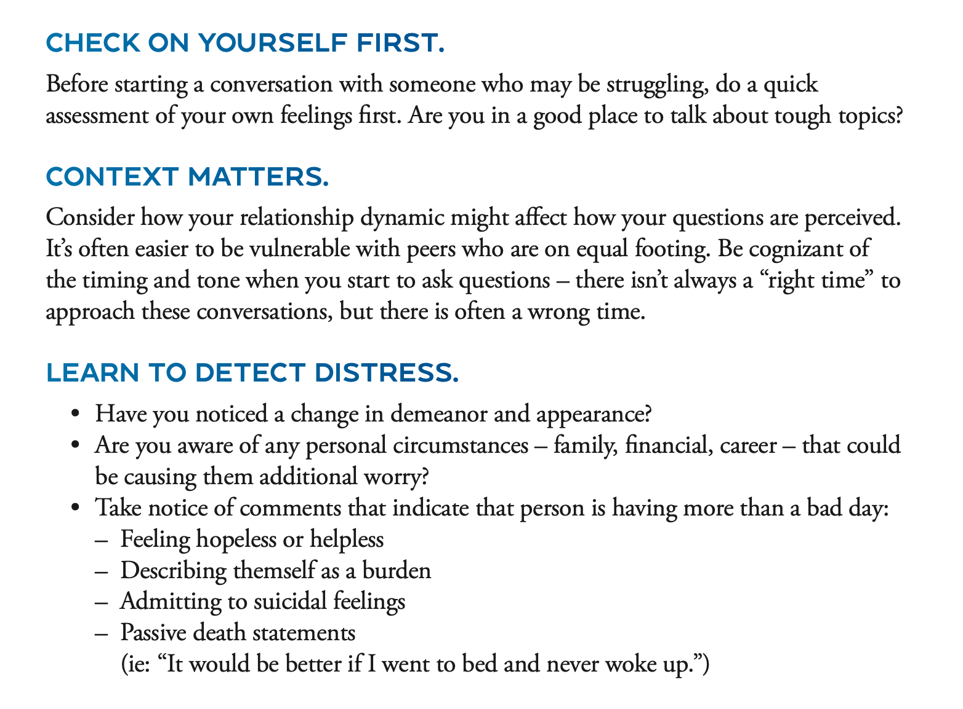

Slide 15
Tips for GROUP Tough Stuff:
THE STEPS TO A CARING RESPONSE:
Show that you understand the member's position or dilemma: State that you understand the reason(s) the member’s needs
Use "I" or ”we” statements, which show what is happening impacts you and the group while insuring the member is being heard. For example, "I know things are difficult for you, but right now we're trying to figure out what Camilla can do about child care and then we can talk about your situation.”
Set limits: Gently but firmly redirect. Explain your reasons; letting the member know why you need to change the situation will like them to participate. For example, "I know things are difficult for you, but right now we're trying to figure out what Camilla can do about child care, and and interruptions make it difficult to help her.”
Suggest an alternative: Explain what you'd like to see the member do instead of the negative behavior. For example, "I know things are difficult for you, but right now we're trying to figure out what Camilla can do about child care, and it's hard to do with interruptions. I wonder if we could wait to talk about your problem until after we've come to some conclusions about what Camilla can do.”
Get the member's agreement on the alternative: Make sure the member understands what is being asked of them and agrees to do it. For example, "I know things are difficult for you right now, but we're trying to figure out what Camilla can do about child care right now, and it's hard to do when you keep interrupting. I wonder if we could wait to talk about your problem until after we've come to some conclusions about what Camilla can do. Is that okay with you?”
IT MAY BE HELPFUL – to have another Peer Facilitator to support folks who may need more one on one time and attention as well as support them in while in the group

Slide 17
RESOURCES
https://www.calmhsa.org/programs/fema-covid19/
CRISIS resources:
National Suicide Prevention Lifeline: 988 or 1-800-273-8255
Trans Lifeline: 1-877-565-8860
The Trevor Project: 1-866-488-7386
Crisis Text Line: Text HOME to 741741
24/7 California Peer-Run Warm Line: 1-855-845-7415
Warmline.org contains the links to Peer run or staffed Warm Lines in every state
Veterans Crisis Line: 1-800-273-8255
*NOTE: Many of these resources could utilize restrictive interventions, like active rescues (wellness or welfare checks) involving law enforcement or emergency services (with the exception of Trans Lifeline). You can ask if this is a possibility at any point in your conversation if this is a concern for you. You can also utilize these resources if you are concerned about someone in your life approaching a crisis.
KNOW YOUR AGENCY’S PROTOCOL FOR REPONDING to SELF HARM and FOLLOW YOUR AGENCY’S PROTOCOL

Slide 18
Q & A

