Slide 1
CalHOPE Support Program Admin and Supervisors Meeting February 23, 2023

Slide 2
AGENDA Requested Information Data Collection Paid Time Off (PTO) First Deliverables Training Your Staff Outreach Plan Save the Date and Invite your Support Specialists; March 9th 1:30-2:30

Slide 3
Requested Information Resource Database Updates Still Needed: Please complete for your counties. Please send deliverables to taylor.Intermill@calmhsa.org

Slide 4
Data Collection: Forms Submitted Increased by 600 from last week.
IT Team is working on adding a pdf option to the form.
IT Team has debugged the upload documents sections.
IT Team is working on adding additional identifiers to the forms.
In the meantime, if you need to delete a form, email Taylor to request a deletion by sending the following: Put in Subject Line: Request Forms Deletion
Agency Name, Type of Form (Ind, Group or Outreach), Employee name (The one entered in the form), Date the form was submitted, and (Optional) Approximate time of submittal.
Example: Accidentally submitted two forms. Request to delete the first one or delete the second one, with info above included in the email.

Slide 5
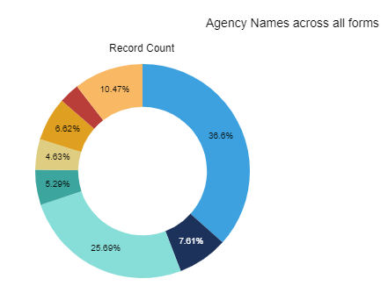
Data Collection
Who Hasn’t Submitted Forms? CAMPRO Haitian Bridge Alliance Health Education Horn of Africa Karen Org. of S.D. Majdal: Arab Community Center of S.D. NAMI California Painted Brain Refugee Assistance Center SDYS Somali Bantu Southern Sudanese Community Center of S.D. UWEast Africa Support Team USC Tele-Behavioral Health

Slide 6
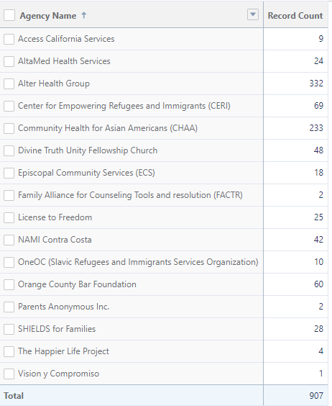
Data Collection Who Hasn’t Submitted Forms? CAMPRO Haitian Bridge Alliance Health Education Horn of Africa Karen Org. of S.D. Majdal: Arab Community Center of S.D. NAMI California Painted Brain Refugee Assistance Center SDYS Somali Bantu Southern Sudanese Community Center of S.D. UWEast Africa Support Team USC Tele-Behavioral Health

Slide 7
Paid Time Off (PTO)
DHCS has agreed to honor agencies’ PTO policies up to CalMHSA’s policies. Up to 15 days per year of vacation accrued per year for the three years. This increases to 20 days from 3 to 10 years of employment and to 25 days from 10 to 15 years of employment. 30 days a year are earned after 15 years of employment.
Paid Holidays: DHCS agrees to recognize up to 13 paid holidays per year.
If you are new to CalHOPE (six agencies) or if your policy has changed in the last two years, please email taylor your agency’s PTO policy.
7

Slide 8
First Deliverables
Implementation Plan: Include your schedule with timelines for hiring and employing staff, training staff, and establishing an outreach plan and group sessions calendar.
We are reviewing your submissions, and if they’re not complete, we will email you. Payment will not be made until we determine your submissions have met our request.
8

Slide 9
Payment for First Deliverables
CalMHSA Must Have Following:
Insurance
Signed Contract; W-9, Proof of Insurance
W-9 and COI Missing: CAMHPRO, ECS, FACTR, Happier Life, SHIELDS, and USC Tele-BH
Email W-9s: accountspayable@calmhsa.org
One month staffing costs, to be subtracted out at the end of the year.
CalMHSA requires proof of Insurance on file, see the contract for specifics.
Please send all insurance information to contracts@calmhsa.org.
9

Slide 10
Training Your Staff: See your contract “Agency specific onboarding training may include up to forty (40) hours of training for staff new to a peer support specialist position and up to twenty (20) hours of training for staff new to the agency but with prior peer support experience.” CalMHSA will reimburse staff time up to these limits. If your regular training requirements are longer than these limits, you may have staff attend them as long as their time is paid for by a different funding source.

Slide 11
Training Your Staff: See your contract “Contractor shall document the time and place of each training session, the content of the session, the number of participants and their titles (CHSS or Supervisor). Contractor shall maintain such documentation for the duration of the Program. Upon reasonable request, this documentation may be subject to audit by DHCS and/or CalMHSA, or their designated personnel, at any time throughout the Program.” Each agency is provided $5,000/pod for quality improvement training. For any trainings purchased, you must provide CalMHSA with a written justification of the need for training beyond agency’s required training, training curriculum, and copy of certificate provided upon completion by training entity.

Slide 12
Outreach Plan Each Agency is required to submit an Outreach Plan that will address how they plan to reach their target populations and how they plan to allocate funds within the Additional Administrative Costs line item for outreach efforts. AAC includes $800/month-pod for outreach. The Outreach Plan is due to CalMHSA no later than February 28, 2023. Gigi Crowder, Executive Director, NAMI-Contra Costa Nwe Oo, Program Director, Community Health for Asian Americans Jacob Daruvala, Operations Manager, Divine Truth Unity Fellowship

Slide 13
Save the Date:
March 9th 1:30-2:30
Keris Myrick, Peer Counseling Training
https://www.calmhsa.org/CalHOPE/
Taylor.Intermill@calmhsa.org

