Slide 1
Fiscal Data Modeling of Proposed Rates 101
November 10, 2022

Slide 2
Agenda
Overview of Outpatient Services Rates
Fiscal Data Modeling Tool
Next Steps

Slide 3
Rates Under CalAIM Behavioral Health Payment Reform
Plan Administration
UR/QA
Inpatient psych services
NTP services
Partnership Regional Model
Mobile Crisis
DMC-ODS Inpatient
Outpatient services
(SMH and DMC)
24 hour services
(residential)
Crisis Stabilization
Therapeutic Foster Care
Day Rehab/DTI
Notes:
Justice involved

Slide 4
Overview of Outpatient Services Rates
State DHCS is implementing CPT coding transition under CalAIM Behavioral Health Payment Reform
In general, CPT codes will be used for clinical services provided by licensed professionals providing services in their scope of practice
DHCS is planning to continue to use HCPCs for non-clinical services (e.g., rehabilitation) and services provided by non-licensed staff
Prospectively determined Fee-for-Service rates will be applied to all services
Separate outpatient service rates for each CPT/HCPC code and each practitioner type
Pre-defined minutes are assigned to all CPT/HCPC codes

Slide 5
Overview of Outpatient Services Rates
Minutes associated with each code are based on direct patient care time
Excludes travel and documentation time
Taxonomy coding becomes extremely important
Taxonomy code that is registered with the providers NPI number should be used for billing

Slide 6
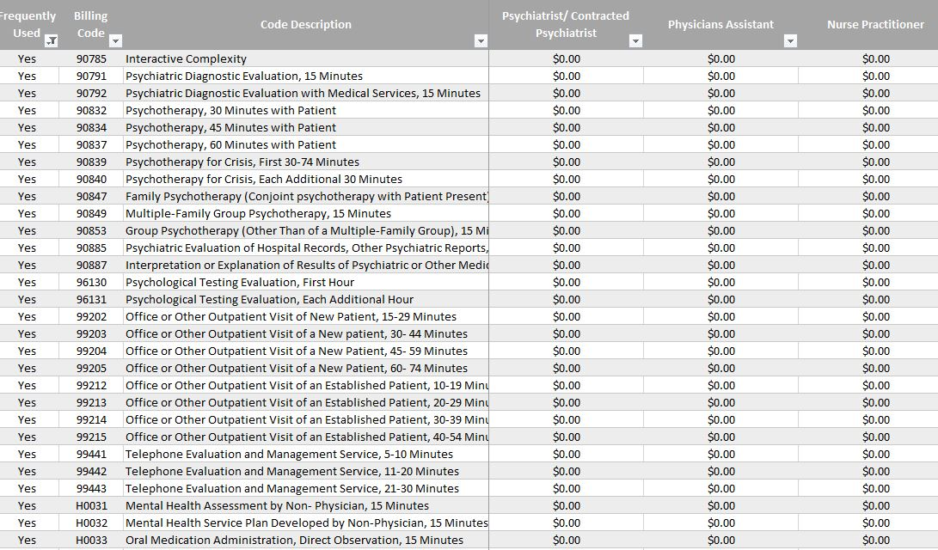
Fiscal Data Modeling Tool

Slide 7
Next Steps
Counties can compile unit data to populate “Units” tab in Fiscal Impact Model
DHCS to provide outpatient rates to counties
Individual county rates
Overview of methodology
Counties can insert rates into model to estimate gross Medi-Cal billings
Register for the November 17th Best Practices for System Shifts Related to Payment Reform webinar

Slide 8
Questions & Answers
Please type your questions in the chat

Slide 9
Thank You
Thank you for attending this webinar!
The recording and slides will be available on our website on the following day.
Please send your questions/comments to paymentreform@calmhsa.org.

