Slide 1
CalHOPE Support Program Supervisors’ Meeting June 1, 2023

Slide 2
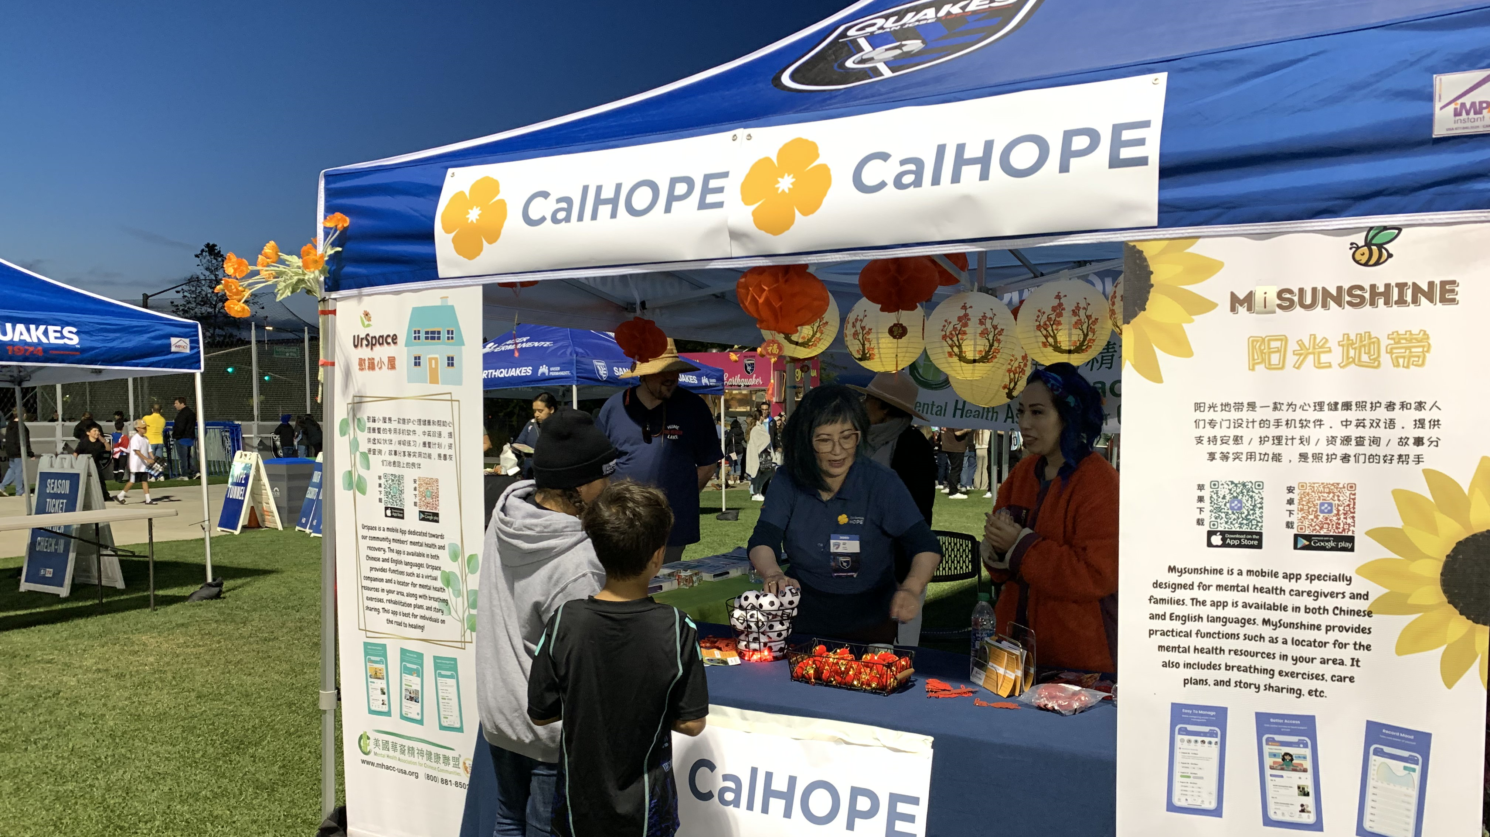
MHACC at the San Jose Earthquakes CalHOPE Game

Slide 3
Operations Allies Welcome
Afghan Support Center: Sacramento Convention Center, June 21-June 24th
Cherokee Federal is coordinating with USCIS, ORR, the California State Refugee Coordinator’s Office, and local refugee resettlement agencies and service providers to set this up.
Afghan Support Centers act as a “one-stop-shop” with a wide variety of information, service connection, and direct services with the goal of supporting Afghans in your community who are in the second stage of their resettlement and integration experience. Services available at the events may include public health, education, legal assistance, employment, social services, and housing.

Slide 4
CAMHPRO LEAD Conference Lived Experience, Advocacy, Diversity Statewide Peer Conference, Sacramento June 12-13, 2023 Pre-Approval Form due June 2nd.

Slide 5
Monthly Invoice Are you using the correct invoice? There is a January template and a Feb-Dec template. Have you purchased your devices? Please do so and include receipt with your invoice. You can bill for admin work under Supervisor’s hours, up to the total allowed in the month. You may want to do this in the initial months, can bill from 1/16/23 forward. Can submit supplemental invoice.

Slide 6
Monthly Invoice Invoices are due to CalMHSA 15 days after the end of the month. Invoices through April are now overdue. We have not received any invoices from Divine Truth, Episcopal Community Services, and USC Tele-Behavioral Health. Please cc the CalMHSA staff you meet with for your Monthly Mtg – me, Taylor, or Lorena when sending in your invoice.

Slide 7
Outreach
Do you have a county fair? Parents Anonymous purchased a table at the L.A. County Fair and attended all 17 days of the Fair.
We are making changes to the outreach form to include more options: direct individual outreach, CBO collaboration, and Business collaboration.
7

Slide 8
Data Collection Forms
The forms have been translated into Simple Chinese. Thank you MHACC. They will be available early next week.
Review your staff’s entries, especially the selection of “other”. Do we need to add another option to reflect their selection?
Google Chrome is the recommended browser, however the forms should run smoothly on Mozilla Firefox and Microsoft Edge as well.

Slide 9
Data Collection Forms
These are important, they are the only evidence of your work. We are waiting for the 2023-24 Budget to be passed by the Legislature, they have asked for data on the CalHOPE program.
I will be preparing a report pulled from the forms to submit to the Asm and Sen Budget Committees.

Slide 10
Next Meeting:
June 15th 3:00-4:00 pm
Presentation: History of the Family Movement by Gigi Crowder, E.D., NAMI-Contra Costa
https://www.calmhsa.org/CalHOPE/
Taylor.Intermill@calmhsa.org

