Slide 1
RECOVERY ALLY Training
UConn Recovery Community. (2021). Online Recovery Ally Training [PowerPoint presentation]. University of Connecticut.
Notes:
SAY: Welcome to the Recovery Ally Training. We are so happy that you are with us today. If you are here to learn how to be an Ally to Students, Friends, Family Members, or colleagues in Recovery, then you are in the right place.
DO: Introduce yourself and other facilitators if applicable:
Name
Any relevant information in regards to recovery (if you feel comfortable sharing)
Why you’re leading the training
HOUSEKEEPING:
--If you are not speaking, please stay on mute
-Utilize chat feature

Slide 2
April 9, 2020
Author’s Note:
Inspired by the CT Community of Addiction Recovery’s (ccar.us) Recovery Coach Academy, this training program was authored by Sandy Valentine, RCP at the University of Connecticut in the Fall of 2019. Since that time, it has been updated and delivered over twenty times by Jenna Clavette and Zachary Green during their graduate assistantships while students of University of Connecticut’s School of Social Work.
We share this in honor of all those who are seeking are looking for someone they are comfortable asking for help from, instead of feeling stigmatized. For those who want to be able to intervene with empathy and resources when they encounter someone struggling, and for those working to build a world where recovery is understood, respected and celebrated.
We wish you the best as you leverage this program to be a part of the solution. Warm regards, Sandy, Jenna and Zachary
Permissions | Recommendations | Venues
You may use this presentation with permission as long as a fee is not charged for attendees to attend. | Include one facilitator with lived experience as a person in recovery, or a family member, friend or ally. Share personal examples to bring content to life, and set the example for sharing during the program by participants. | This presentation can by used in person or virtually. The Speaker’s Notes allude to delivery via virtual platforms, such as Webex; Microsoft Teams; Zoom; and Adobe Connect, with breakout room capability.
You may customize the Scenarios to suit your audience. | Offer a quick break halfway through the program. On Slide 36, insert the local resources you recommend to your community. | We use polleverywhere.com for the interactive exercises. Other methods can be employed, including flipcharts when delivered in person. We strongly encourage you to do this exercise, it has proven to be transformational in the experience of our participants.
You may customize the resources introduced to align with your local community. | Follow up with an invitation to any friends and family meetings you host, a digital or print token “I am a Recovery Ally”, and an infographic highlighting key resources and talking points.
You may be inspired by the approach we took, and create your own content. In doing so, we ask you to change the slide design and cite specific content appropriately. | Find ways to learn how folks ally, and share them.
UConn Recovery Community. (2021). Online Recovery Ally Training [PowerPoint presentation]. University of Connecticut.

Slide 3
Community Agreements
Community agreements are guidelines developed by a group of people regarding how they will work together to create a positive, productive learning experience. They describe a set of desired behaviors all members of the group agree to exhibit.
Notes:
SAY:
-In order to learn and grow together today, we want to establish a learning community where everyone can feel safe to share their thoughts and opinions freely and openly.
DO:
-Read the definition of community agreements
SAY:
Let’s look at a list of suggested community agreements, and then see if there is anything missing that you want to add, or perhaps take away.

Slide 4
COMMUNITY AGREEMENTS
What is learned here leaves here; what is heard here, stays here.
No one is required to share, it's ok to "pass".
Even if you feel you know a lot about the topic - keep an open mind.
Listen to understand and listen to learn.
Be willing to be vulnerable about your beliefs and attitudes.
Allow everyone to share without fear of judgment or ridicule.
Apply the Stretch rule. If you tend to contribute a lot, listen first. If you are usually an observer, contribute first
Speak from your own experience,
Say "ouch" if something said impacts you negatively. Understand that intentions are good and this is a learning environment.
Notes:
DO:
-ASK A PARTICIPANT TO READ THE COMMUNITY AGREEMENTS.
ASK:
-Any questions about any of these?

Slide 5
Introductions
About Me
I'm Deanna French
A woman in recovery from substance use and mental health
A Certified Peer Recovery Specialist
An MSW student
A mom, wife, sister, daughter, friend, and so much more
Notes:
DO:
-Go down participant list – invite participants to turn on their webcam and audio.
DO:
-Invite each participant to introduce themselves using the prompts on the screen.
-Take attendance

Slide 6
Key Points
Understand the complex nature of addiction as a disease and that substance use disorders often cannot be resolved by the individual simply choosing to stop.
Confront myths and stigma regarding addiction and recovery and how its negative impact deters individuals from seeking support.
Use empathetic language and effectively listen when a person chooses to honor you by disclosing that they are struggling with substance use.
Define and understand that recovery is a life-time journey with multiple pathways to achieving wellness in recovery.
Know available recovery support resources that are on and off campus and how to access them.
UConn Recovery Community. (2021). Online Recovery Ally Training [PowerPoint presentation]. University of Connecticut.
Notes:
SAY:
Today’s plan consists of 5 objectives. The first objective is…
Understanding the complex nature of addiction as a disease and that substance use disorders often cannot be resolved by the individual simply choosing to stop.
(Alternate)

Slide 7
Key Point
Understand the complex nature of addiction as a disease and that substance use disorders often cannot be resolved by the individual simply choosing to stop.
Notes:
SAY:
Let’s dive into the first objective – understanding the complex nature of addiction as a disease.

Slide 8
Addiction is a disease.
Addiction to alcohol or drugs is a chronic but treatable brain disease that requires medical intervention, not moral judgment.
The Surgeon General’s Report on Alcohol, Drugs and Health, 2016
Notes:
SAY:
Addiction is a disease. According to the American Society of Addiction Medicine (ASAM), addiction is a primary, chronic, neuro-biologic disease with genetic, psychosocial, and environmental factors influencing its development and manifestation.
Addiction is a progressive, chronic, and oftentimes fatal disease. It is considered a brain disorder, because it involves functional changes to brain circuits involved in reward, stress, and self-control.
Something to keep in mind is that choice does not determine whether something is a disease. Heart disease, diabetes and some forms of cancer involve personal choices like diet, exercise, sun exposure, etc. A disease is what happens in the body as a result of those choices.
Addiction is NOT a moral failure by any means and once an individual is addicted, we have lost the power to choose.

Slide 9
SUBSTANCE USE DISORDER
When the recurrent use of alcohol and/or other drugs cause clinical and functional impairment, such as health problems, disability, and failure to meet major responsibilities at work, school, or home.
Behavioral, physical, and social changes take place that have a negative impact on life.
Substance Abuse and Mental Health Service Administration (SAMHSA), 2016
Notes:
SAY:
Along with the definition of Addiction, it is important to understand the definition of Substance Use Disorder.
According to the Substance Abuse and Mental Health Service Administration, otherwise known as SAMHSA, a Substance Use Disorder is when the recurrent use of alcohol and/or other drugs cause clinical and functional impairment, such as health problems, disability, and failure to meet major responsibilities at work, school, or home.
There are often many behavioral, physical, and social changes that take place and have a negative impact on life.
SAY:
I would also like to point out that it says Substance USE disorder instead of substance abuse disorder… I’ll let you sit with that for a moment… Does anyone have any ideas why that may be?
**Let Group think**
While this is a topic we are going to touch later on, I wanted to point out the famous saying “its not what you’re saying, its how you say it….” Sometimes the words we apply to certain diseases, particularly addiction, can be daunting or have some negative cognitive associations… for example, Mental Health vs. Mental illness.
I just wanted to plant the seed, and it is something to think about while we move through this training.
-For your first opportunity to practice allyship, you can sign the petition to change National Institute of Drug Abuse, National Institute on Alcohol Abuse and Alcoholism, Substance Abuse and Mental Health Services Administration. I have just entered the link into the chat. https://actionnetwork.org/petitions/change-the-name-end-the-stigma
ADDITIONAL NOTES _ USE ONLY IF GROUP ASKS:
Below is a list of diagnostic criteria:
Using more than intended (in quantity, frequency or duration of use)
Increasing tolerance (i.e., needing more of the substance to feel the same effect)
Withdrawal symptoms
Wanting to reduce use or stop use, but not being able to
Craving for the substance
Giving up important activities because of substance use
Continuing to use despite danger
Inability to manage commitments due to substance use
Spending lots of time obtaining, using, and recovering from use
Continuing to use despite negative consequences in relationships
Continuing to use despite making physical or psychological problems worse

Slide 10
Source: Addiction Policy Forum
Notes:
SAY:
As we have conducted this training, we heard from participants that they are very interested in the impact of addiction on the brain. So now we have a short 4 minute video to share with you.
DO:
Send link to chat https://www.youtube.com/watch?v=s0bqT_hxMwI&feature=youtu.be
SAY:
Please copy and paste the link in the chat, turn on mute, and watch the video. We will give you 4.5 minutes to do this.
SAY:
Any thoughts on the video? Did you learn anything new?
SAY:
It is clear after watching that video that once one becomes addicted, the hijacker (in reference to the character from the video) take ahold of our rational thinking.
DO:
Share personal examples.

Slide 11
Key Points
Understand the complex nature of addiction as a disease and that substance use disorders often cannot be resolved by the individual simply choosing to stop.
Confront myths and stigma regarding addiction and recovery and how its negative impact deters individuals from seeking support
Notes:
SAY:
Our next objective looks at confronting the myths and stigma regarding addiction and recovery, and how its negative impact can deter individuals from seeking support.

Slide 12
Chronic Medical Disorders and Stigma
Cancer
Heart Disease
Addiction
Weight loss, pain, hair loss, etc.
Chest pain, shortness of breath, etc.
Moody, irritable, irrational, withdrawn, lying, stealing, etc.
So if addiction is a disease…
why don’t we treat it like one?
Notes:
SAY: When the symptoms are behavioral vs. physical, it is harder for those that love the person to see it as a chronic medical disorder.
DO: Walk through the comparisons of how we treat other diseases in comparison to substance use disorder

Slide 13
The Power of Labels
Stigma: a mark of shame or discredit
(source: Webster’s Dictionary)
Labels impact identity and have the ability to either:
empower
humanize
engender compassion
motivate
comfort
unite
dis-empower
objectify
fear and hatred
deflate
wound
create enmity
http://www.williamwhitepapers.com/pr/2001RhetoricofRecoveryAdvocacy.pdf
Notes:
SAY:
-The words we use, even with good intention, have the ability to cause the opposite effect.
-William White, one of the founders of the modern day recovery movement, reminds us that labels can:
empower OR dis-empower
humanize OR objectify
engender compassion OR fear and hatred
motivate OR deflate
comfort OR wound
unite OR create enmity
CLICK and SAY: Webster defines stigma as ‘a mark of shame or discredit.
ASK: Any thoughts or reactions to what we’ve been discussing?
SAY: As an ally, you can have such a powerful impact by not using the negative labels.
Citation: (1) White, W. The rhetoric of recovery advocacy: An essay on the power of language. Posted as www.facesandvoicesofrecovery.org. In White, W. (2006). Let’s Go Make Some History: Chronicles of the New Addiction Recovery Advocacy Movement. Washington, D.C.: Johnson Institute and Faces and Voices of Recovery, pp. 37-76.

Slide 14
Speak the language
Messages to Abandon
Messages to Adopt
Substance Abuse
Clean/Dirty
Addict
Ex-addict
Battling with an addiction
Medication as a crutch
Addict, junkie, druggie
Relapse prevention
Relapse
Substance use
Sober or substance-free
Person with a substance use disorder
Person living in recovery
Person living with an addiction
Medication as a treatment tool
Person using alcohol or illicit drugs
Recovery Management/Enhancement
Return to use
UConn Recovery Community. (2021). Online Recovery Ally Training [PowerPoint presentation]. University of Connecticut.
Notes:
SAY:
Here we have two lists: you can see words to abandon on the left, words to use on the right. Let’s go through these together
DO:
Read the slides as the words come up
AFTER CLEAN / SOBER OR SUBSTANCE FREE SAY:
Does anyone know why we would want to abandon the word clean?
CONTINUE READING SLIDE.
SAY:
We don’t label someone who has cancer as “You are cancer” but we can refer to them as “Having Cancer.” So, instead of calling someone a junkie, we can reframe the way we speak and say “person using alcohol / illicit drugs”. Again, the language we use is so important – as an ally, try to actively substitute the words to abandon with the words to use. Let’s dive into a scenario where we can apply some of the things we just learned to a real life situation.

Slide 15
Scenario
Your friend talks about how annoying a mutual friend of yours has been recently. Your friend begins complaining, "How all this person does is smoke/vape cannabis” and how much of a “loser” this person is, constantly referring to them as “a hippie pot head with no friends…” As an Ally, how might you step in to help this situation?
Notes:
DO: ASK PARTICIPANT TO READ
DEBRIEF: Group
Option: Use Breakout Rooms for small group discussion. - 5 minutes

Slide 16
Scenario
A student comes to your office for an appointment and reveals they are 30 days into recovery. They reveal that their roommates are partying and using substances around them, which makes it hard to sleep. You notice that they are failing some of their classes. You would like to support this student in recovery, how do you respond?
Notes:
DO: ASK PARTICIPANT TO READ
DEBRIEF: Group
Option: Use Breakout Rooms for small group discussion. - 5 minutes

Slide 17
Key Points
Understand the complex nature of addiction as a disease and that substance use disorders often cannot be resolved by the individual simply choosing to stop.
Confront myths and stigma regarding addiction and recovery and how its negative impact deters individuals from seeking support
Use empathetic language and effectively listen when a person chooses to honor you by disclosing that they are struggling with substance use.
Notes:
SAY: Our next objective includes using empathetic language when a person chooses to honor you by disclosing that they are struggling with substance use.

Slide 18
Active Listening
FOCUS ON THE SPEAKER
ALLOW SPEAKER TO FINISH WITHOUT INTERRUPTION
SUMMARIZE WHAT YOU HEARD
SHOW YOU ARE LISTENING
ASK CLARIFYING QUESTIONS
UConn Recovery Community. (2021). Online Recovery Ally Training [PowerPoint presentation]. University of Connecticut.
Notes:
SAY:
Active listening is one of the most important skills an ally needs to possess.
Active listening is also a skill that is transferable to your everyday life.
DO: Read through the bullet points.
SAY:
The first part of active listening is to focus on the speaker. The second part is to show you are listening. These go hand in hand – it is important to use body language to do both of these. For example:
-Eye contact
-Nodding head
-Body towards theirs
-Not on your phone
There are also things you can say to show you are listening
“I was impacted when you said”
“I felt connected to you when you said”
“I was inspired when you shared”
These skills show you are being attentive to what the person is telling you.
The next part is allow speaker to finish without interruption.
-Be patient. Often times, we are so concerned with how we are going to respond to someone, that we don’t really listen to them – and this can lead to interruptions or further misunderstandings.
The next part of active listening is to ask clarifying questions. Sometimes, people are afraid to ask questions. However, if you ask questions, it will give you more to the story, clarify, and show that you genuinely care about what the person is saying.
The last part is to summarize what you heard. This is important because you may get it wrong. And that is okay. The person speaking will most likely correct you – so that now you fully understand the situation.

Slide 19
LISTEN AND SILENT...
...HAVE THE SAME LETTERS.
Notes:
SAY: And if you’ve never noticed before…Listen and Silent have the same letters.

Slide 20
How should an Ally treat the recoveree?
Object
Recipient
Resource
What are some examples you
may have experienced?
Discovering the meaning of prevention: a practical approach to positive change. [William A Lofquist]
Notes:
SAY: In addition to active listening, it is important to understand the different ways we treat people. We treat people in one of three ways – as an object, as a recipient, or as a resource. These three ways are true in all of our relationships – our significant others, our neighbors, our coworkers, our friends – even the person you bought your coffee from this morning.
OBJECT SAY: We treat people as an object when we think we know what is best for them and they have no say in the matter. Our culture is filled with examples of people treating us as objects. Educational and prison systems often treat us as objects as do health care systems, as we often feel we have limited control over what happens to us.
RECIPIENT SAY: I treat one as a recipient when I still believe that I know what is best for the other, but I "give" the other the opportunity to participate in decision-making because it will be "good" for the other person or group. Thus, the other is supposed to receive the benefits of what the first person gives to them. The person being the recipient often figures out that the decisions have already been made.
RESOURCE SAY: Finally, we have treating people as resources. Here there is an attitude of respect by the first person or group toward what the other person or group can do. This attitude and the behaviors that follow it can be closely associated with two matters of great concern: self-esteem and productivity. Creating a culture in which people are viewed as resources is a worthy goal.
ASK: Can anyone offer an example of any of these?
SAY: For most people, being treated as an object or as a recipient is a negative experience and being treated as a resource most often elicits positive feelings. The lesson for us is that when we are helping others as a recovery ally, it is important to treat people as resources as much as possible. People are the experts on their own experience. They may need help in knowing about or accessing resources, but ideally, it is their choice to make.
Citation: Discovering the meaning of prevention: a practical approach to positive change. [William A Lofquist]

Slide 21
Scenario
Your close friend is in recovery, just got out of rehab, 2 months sober. You have tickets to a sports game and invite him. As you walk in and pass the beer stands, he says “You can get a beer, it won’t bother me. I’m totally good.” If he wasn’t with you – you probably would have a couple. What do you do?
FRIEND
Notes:
DO: ASK PARTICIPANT TO READ
DEBRIEF: Group
Option: Use Breakout Rooms for small group discussion. - 5 minutes

Slide 22
Key Point
Define and understand that recovery is a life-time journey with multiple pathways to achieving wellness in recovery.
Notes:
SAY: Let’s continue on this journey of being a recovery ally by talking about recovery as a lifetime journey with multiple pathways (pun intended).

Slide 23
What is Recovery?
Group Chat
Notes:
DO:
Breakout rooms & Set timer for 5 minutes
Debrief:
One person from each group say their definition of recovery.

Slide 24
RECOVERY
A process of change through which individuals improve their health and wellness, live a self-directed life,
and strive to reach their full potential.
Substance Abuse and Mental Health Service Administration (SAMHSA), 2016
Notes:
SAY: From SAMHSA we have this definition.

Slide 25
Types of Recovery
Abstinence-based - complete and sustained cessation of one’s primary drug(s), any other non-medical psychoactive drug and/or gambling (with nicotine and caffeine historically excepted)
Moderation-based recovery - the sustained deceleration of alcohol, other drug use and/or gambling to a sub-clinical level, that is, a level that no longer meets diagnostic criteria
Medication-assisted recovery - the use of medically monitored pharmacological drugs to support recovery from addiction
UConn Recovery Community. (2021). Online Recovery Ally Training [PowerPoint presentation]. University of Connecticut.
Notes:
SAY:
While we refer to multiple pathways of recovery, we must reference those pathways.
As we have discussed in your definitions and as well as SAMHSA’s definition of recovery, we have learned that Recovery doesn’t always mean SOBER. Lets review options….
Abstinence based recovery - complete and sustained cessation of one’s primary drug(s), any other non-medical psychoactive drug and/or gambling (with nicotine and caffeine historically excepted)
Moderation-based recovery - the sustained deceleration of alcohol, other drug use and/or gambling to a sub-clinical level, that is, a level that no longer meets diagnostic criteria
Medication-assisted Recovery (MAT) - the use of medically monitored pharmacological drugs to support recovery from addiction
SAY:
You may encounter some arguments from people saying abstinence is the only way… You don’t need to argue with them, but who are we to determine the right way to do something.
Now we are NOT advocating for an of these over the other, but what if in order for someone to get to an abstinence based recovery they must first start in a moderation-based recovery and then move to abstinence…
We want recovery to be inviting, not limiting.

Slide 26
The UConn Recovery Community supports the following definition:
"You are in recovery when you say you are."
UConn Recovery Community. (2021). Online Recovery Ally Training [PowerPoint presentation]. University of Connecticut.
Notes:
SAY:
The UConn Recovery Community supports the following definition: “ You are in recovery when you say you are.”
If we consider the recoveree a resource, then it is up to them to make choices about their own recovery.
We don’t need to debate programs, treatment plans, relapse, etc. It is like two people climbing Mount Everest following a different path and when they meet at the top they fight about who did it right. They both made it!

Slide 27
Key Points
Define and understand that recovery is a life-time journey with multiple pathways to achieving wellness in recovery.
Know available recovery support resources that are on and off campus and how to access them.
Notes:
SAY: Now lets talk about available resources.

Slide 28
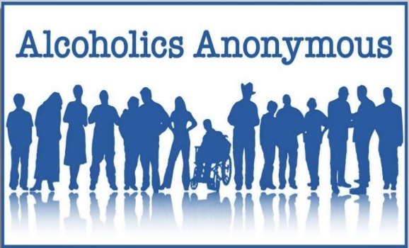
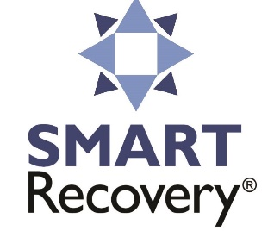
No Wrong Door
What are some other resources that might be available that aren’t listed here?
UConn Recovery Community. (2021). Online Recovery Ally Training [PowerPoint presentation]. University of Connecticut.
Notes:
SAY:
Bottom line, there is no wrong door to recovery.
It is what works for the individual.
Their ability to recover from their disorder and move into healthy productive lives.
We have listed some of the most commonly used programs in your Resource Guide. Let’s walk through some.
SAY:
AA, probably the most talked about program, founded in 1939, it is based on a group of principles called the 12 Steps.
The next is Narcotics Anonymous, started in 1983, it follows the same principles as AA but with a focus on drug addiction. Both of those programs rely on the concept of a higher power.
Up next is Recovery Dharma, which uses Buddhist practices and principles to heal the suffering of addiction.
The next door, is SMART Recovery. It stands for Self Management and Recovery Training. It takes a more science-based, self-empowered approach to addiction recovery, and complements 12 step recovery for those who practice both.
12 Step Recovery Yoga combines the wisdom of yoga with the practical tools of 12-step programs.
In The Rooms is a Global Recovery Community found online, allowing individuals to access meetings day and night, and specializing in specific types of addiction.
And the final door we will highlight today is Celebrate Recovery. a Christ-centered, 12 step recovery program for anyone struggling with hurt, pain or addiction of any kind.
In addition, there are a wide array of treatment providers that help an individual initiate recovery.
It is not pictured here, but treatment is also an option for individuals just getting into recovery. While a treatment program is not required to begin recovery, it can often be a useful tool to initiate recovery. There are various treatment options on drugfreect.org.
SAY: Does anyone else have any other programs they like or are familiar with that they would like to share?

Slide 29
Roles
Therapist
Licensed
12 Step Sponsor
Senior member of 12 step program
Recovery Coach
Motivator and Cheerleader
Recovery Ally
Friend
Supporter
Helper
Partner
Advocate
Community Organizer
Lifestyle Consultant
Advocate
Focused on present: How can I help with your recovery today?
Confidant
Helper
Mentor
Guide
Therapeutic
Considerable focus on what is happening today, as well as past experiences.
Ally and Confidant
Truth Teller
Role Model and mentor
Problem Solver
Resource Broker
Focused on present: How can I help you today?
Focus dependent on fellowship and stage of recovery of the sponsee
Assesses mental health functioning.
Notes:
SAY:
When learning about resources, it’s important to know about the difference between these 4 roles.
SAY:
Therapist – this is a trained professional that helps clients improve their mental health, manage symptoms of mental illness and change maladaptive behaviors and thinking patterns. Therapists also explore previous trauma to further understand the present issues.
Sponsor – usually a senior member of a 12 step program, a confidant, helper, mentor, or guide. They focus on the teachings of the fellowship and stage of recovery of the sponsee.
Recovery Coach – wears many hats, and is focused on the present. How can I help you with your recovery today?
Recovery Ally – read slide

Slide 30
Scenario
Your friend discloses to you that they are struggling depression and anxiety. They tell you that they like drinking because it, "numbs the pain." When they drink, they tend to drink a lot, and have gotten physically injured multiple times while consuming alcohol. They also discuss previous trauma history. How do you respond?
FRIEND
Notes:
DO: ASK PARTICIPANT TO READ
DEBRIEF: Group
Option: Use Breakout Rooms for small group discussion. - 5 minutes

Slide 31
Local Resources
Thehappierlifeproject.org - Peer Support Services, resource navigation, Narcan training and distribution
Inland Empire Harm Reduction - Narcan and Fentanyl Test Strips distribution
211 – Find resources near you
Findtreatment.gov - locate treatment centers at varying levels
Teens4teenshelp.org - Resources for teens
NAMI.org - Mental health peer support

Slide 32
Providing Warm Hand-offs
You can support someone by being a bridge to the resource that they need so that they don't have to do it alone.
Make calls with them
Drive them to treatment
Go to appointments with them, even if it just means waiting in the lobby.
Notes:
SAY:
-In learning about all of these different resources, it is important to understand and practice the concept of warm-hand offs.
A warm hand off is connecting someone to the proper resources, but not just telling them where to go or giving them someone’s card, but in a way going with them to meet that resource, showing them the website, connecting them with the person who can help, etc…)
For example – if one of my students needed additional support from Center for Students with disabilities, I could walk them over and connect them with someone. In times of COVID – it may be harder to do this. Offering to do a Zoom call could be helpful.

Slide 33
Scenario
A friend has been exhibiting diminishing performance and participation in class. One day in class you notice your friend struggling to stay awake and you detect the smell of alcohol on your friend's breath and body. How do you respond?
FACULTY/STUDENTS
Notes:
DO: ASK PARTICIPANT TO READ
DEBRIEF: Group
Option: Use Breakout Rooms for small group discussion. - 5 minutes

Slide 34
Scenario
A student worker comes into your office who looks like she is experiencing flu-like symptoms. Usually a very responsible student, she has recently missed a shift and was late to another. After some gentle probing, she reveals that she has been struggling to stop using drugs, but has not used in 48 hours. How do you respond?
STAFF
Notes:
DO: ASK PARTICIPANT TO READ
DEBRIEF: Group
Option: Use Breakout Rooms for small group discussion. - 5 minutes

Slide 35
What can an Ally do?
Understand that Addiction is a Brain Disease
Speak the Language of Recovery
Treat People as a Resource
Listen Actively
Support Multiple Pathways of Recovery
Know the Resources in your Community
Provide a Warm Hand-off
Mindfulness 101 | Meditation
UConn Recovery Community. (2021). Online Recovery Ally Training [PowerPoint presentation]. University of Connecticut.
Notes:
SAY:
- In the past two hours, we've gone over a lot. Before you leave us today, let’s review what an Ally can do.
They can:
Read points on slide

Slide 36
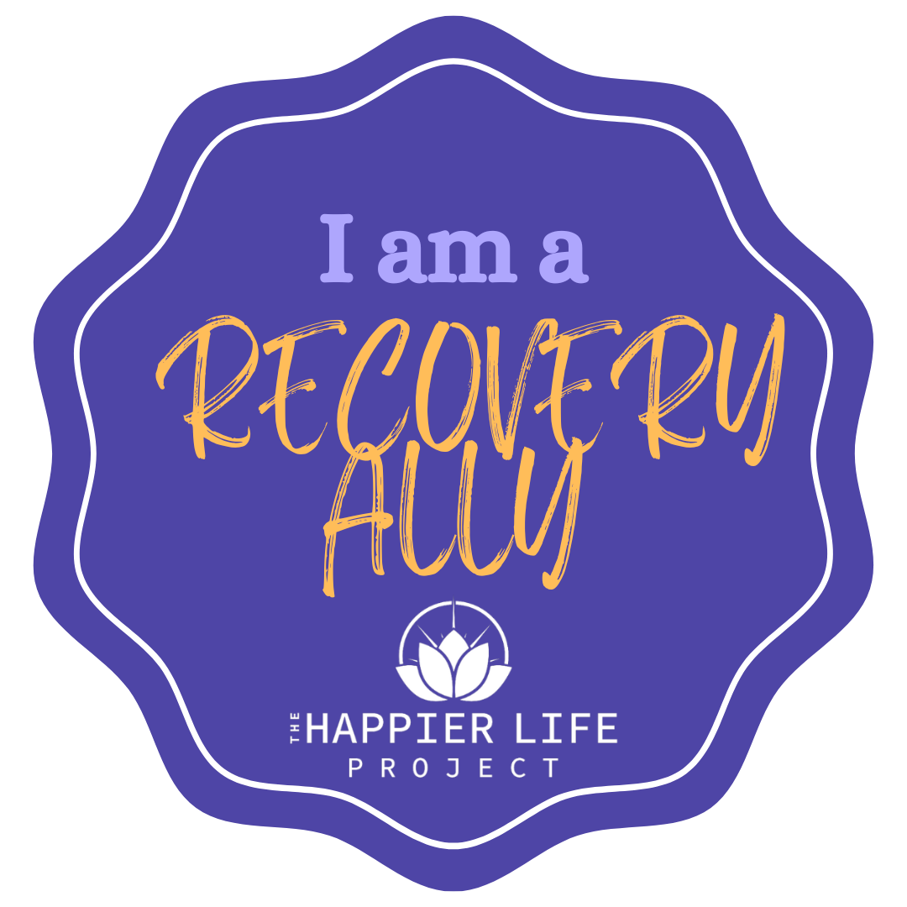
Are you an Ally?
As an Ally, do you commit to being a friend, supporter, helper, partner and advocate for those in recovery?
Notes:
SAY:
Do you promise?

Slide 37
Thank you!
UConn Recovery Community. (2021). Online Recovery Ally Training [PowerPoint presentation]. University of Connecticut.
Notes:
SAY:
Our hope is that as a result of this training, you begin to see those with substance use disorders community through a new set of lenses.
Each of us have an opportunity to influence the community in a positive way.
As a recovery ally, we ask that you advocate for those already in recovery, or those who may be seeking recovery.
By being part of this training today, you are helping us reach our goal of a Recovery Friendly campus, so for that, we thank you.
If you have any questions or comments, please feel free to reach out. Have a great rest of your week!

