Slide 2
LGBTQ+ Training Presented by San Diego Youth Services, Our Safe Place Joke Ilanit (She/Her) Gilbert Gontes (They/Them) Roisin Mackenzie (They/Them)
Notes:
Introductions, pronouns, position – DIC, Years/months in program, experience working with LGBTQ+
Group agreements
Training involves videos and is interactive

Slide 3
Today’s Topics
LGBTQ+ terminology
Risk & protective factors for LGBTQ+ youth
How to create safer spaces
Pronouns
How to support LGBTQ+ clients & families
Local and community resources

Slide 4
Questions to consider
What were the earliest messages you got about gender roles and expectations? How and by whom were those ideas conveyed?
What were the earliest messages you received about LGBTQ+ people or those perceived to be LGBTQ+? Were they positive, negative, or neutral? How and by whom were those ideas conveyed?

Slide 5
ACTIVITY
Notes:
6. I was raised to believe men are inherently better at math and science than girls. *
7. I was raised to believe women are “naturally” more empathetic and sensitive than boys.*
8. Regarding gender, I believe our society gives everyone an equal shot at success and happiness.*
9. My gender has no influence on how I dress and act in certain spaces. *
10. My gender makes me afraid sometimes of experiencing physical violence.*
11. The way I express my gender makes me afraid of experiencing physical violence.*
17. I was raised to believe there are only two genders.*
18. I know what transgender means.*
MADS
Multiple choice on mentimeter
This is a silent activity. Ask folks to stand up (raise their hand if mobility is an issue) when the statement is true for them. Give folks a few seconds to look around the room and notice who stands up and who doesn’t each time a statement is read out loud).
1. I was raised to believe only girls can like or wear the color pink.
2. I was raised to believe boys should not cry and if they do, they’re weak.
3. I was raised to believe girls should be submissive.
4. I was raised to believe there are toys and colors for boys and toys and colors for girls.
5. My gender dictates the type of clothes I wear and how I behave around others.
6. I was raised to believe men are inherently better at math and science than girls. *
7. I was raised to believe women are “naturally” more empathetic and sensitive than boys.*
8. Regarding gender, I believe our society gives everyone an equal shot at success and happiness.*
9. My gender has no influence on how I dress and act in certain spaces. *
10. My gender makes me afraid sometimes of experiencing physical violence.*
11. The way I express my gender makes me afraid of experiencing physical violence.*
12. I have made fun of someone because their gender expression did not match how I perceived their gender
13. I have made fun of someone because they weren’t acting masculine enough.
14. I have made fun of someone because they weren’t acting feminine enough.
15. I know someone who has been verbally harassed because of their gender expression.
16. I know someone who has been physically harassed because of their gender expression.
17. I was raised to believe there are only two genders.*
18. I know what transgender means.*
19. I know transgender people.
20. I know people who are transgender.
21. I believe transgender people have the right to be safe and affirmed.
22. I believe all people have the right to be safe and affirmed.
------
Questions about the activity
What was it like to do the activity?
Did any of the statements make anyone feel uncomfortable?
We are often raised to believe things, but our own experiences often change those perceptions or unconscious bias.
Are youth too young to understand sexuality and gender? Reflection: when did you first realize you were a girl/boy?

Slide 6
TERMINOLOGY
Lesbian
Gay
Bisexual
Transgender
Queer/Questioning
Intersex
Asexual / Agender
+

Slide 7
Discussion: What other terms have you heard?

Slide 8
LGBTQ+ Terminology
Gender Binary
Classification of gender as two distinct categories, male and female
Adapted from The Trevor Project Lifeguard Curriculum
Notes:
Gender binary
Begin by separating gender from biology

Slide 9
LGBTQ+ Terminology
Sex Assigned at Birth
What we are assigned (typically male or female) based on a visual inspection of genitalia. Often, the third word ever spoken about humans relates to sex: “it’s a [boy or girl]!” in some ways we are also assigned an expected gender identity at birth.
Adapted from The Trevor Project Lifeguard Curriculum

Slide 10
Intersex Video
Intersex
Notes:
https://www.youtube.com/watch?v=cAUDKEI4QKI

Slide 11
LGBTQ+ Terminology
Gender Identity
Refers to the internal perception of one’s gender, and how they view themselves
Common identity labels: man, woman, genderqueer, trans
Often confused with sex assigned at birth

Slide 12
LGBTQ+ Terminology
Gender Expression
The way in which someone expresses gender outwardly.
Gender expression doesn’t necessarily align with gender identity.
Society dictates many ways in which gender is expressed.
Expression through: clothing, jewelry, make up, hair length, and nail length, vocal expression, body language, and movement.
Privilege, depending on comfort and safety
Adapted from The Trevor Project Lifeguard Curriculum

Slide 13
LGBTQ+ Terminology
Sexual Orientation
Who we are sexually attracted to physically
Separate construct from gender identity
Self-determined. There’s no way to discern someone’s sexual orientation unless they share it with you.
Sexual behavior also does not necessarily reflect a person’s sexual orientation.

Slide 14
Transgender-Specific Terminology
Transgender- An umbrella term for people whose gender identity does not correspond with the sex they were assigned at birth.
Cisgender - Person whose gender identity and sex assigned at birth align.
Cisnormativity: We often assume all/most people are cisgender
Non-Binary - Gender identity that falls outside the binary of male and female.

Slide 15
Transgender-Specific Terminology
Transition
Social Transition: Coming out, Name Change, Pronouns Change, Change of Appearance, Gender Affirming Gear
Medical Transition: Hormone Blockers, Hormone Replacement Therapy (HRT), Surgery
Gender Affirmation Surgery
Refers to doctor-supervised surgical interventions, and is only one aspect of transition.
Adapted from The Trevor Project Lifeguard Curriculum

Slide 16
LGBTQ+ Terminology
Gender Non-Conforming - A term used to describe some people whose gender expression is different from conventional expectations of masculinity and femininity.

Slide 17
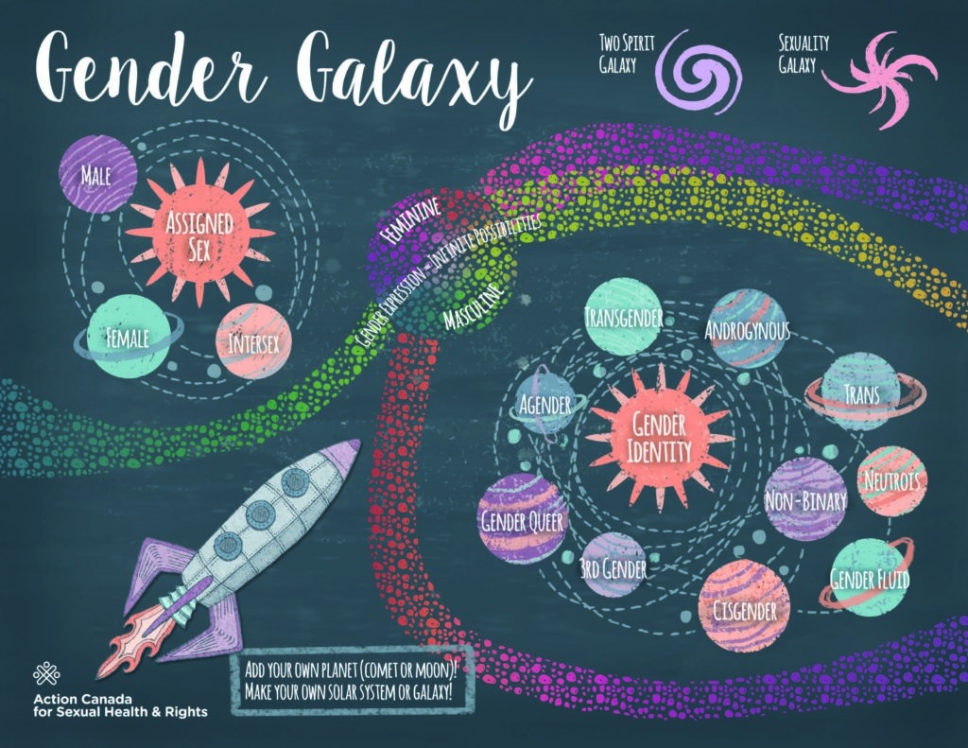

Slide 18
Terms to Avoid
Avoid: Transgendered, Transgenders, a transgender
Instead: transgender, transgender people, trans man, trans woman
Avoid: Sex change, pre-operative, post-operative
Instead: transition, Gender Affirmation Surgery
Avoid: biologically male, biologically female, genetically male, genetically female, born a man, born a woman, MTF, FTM
Instead: assigned male at birth, assigned female at birth or designated male at birth, designated female at birth.

Slide 19
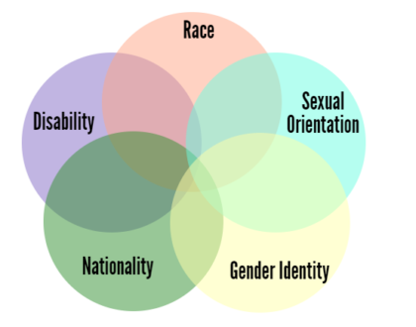
Intersectionality
Social categorizations or identities, such as race, class, and gender that create systems of discrimination or disadvantage.
Notes:
Different struggles/issues for different identities + being a teenager

Slide 20
Intersectionality
Intersectionality Video

Slide 21
Risks Factors for LGBTQ+ Youth
Rejection, harassment, discrimination, and bullying
School-based
At home
Public spaces
Mental health services

Slide 22
School-Based Harassment, Discrimination, and Bullying
83.1% LGBTQ+ students experience harassment or assault at school based on personal characteristics, including sexual orientation, gender expression, gender, religion, race and ethnicity, and disability
76.1% experience verbal harassment
31.2% experience physical harassment based on sexual orientation or gender expression
61.5% of LGBTQ+ students who were harassed or assaulted in school did not report the incident to school staff, most commonly because they did not think school staff would do anything about the harassment even if they did report it
GLSEN 2021 National School Climate Survey
Notes:
GLSEN 2017 National School Climate Survey
https://www.glsen.org/article/2017-national-school-climate-survey
GLSEN 2017 National School Climate Survey
23,001 students ages 13-21 from all 50 states
*****

Slide 23
School-Based Harassment, Discrimination, and Bullying
68% of LGBTQ+ students felt unsafe at school because of their sexual orientation
50.6% because of their sexual orientation
43.2% because of their gender expression
40.3% because of their gender
32.2% of LGBTQ+ students missed at least one entire day of school due to feeling unsafe or uncomfortable
Approximately 4 in 10 students avoided gender-segregated spaces in school due to safety concerns
bathrooms 45.1%
locker rooms 42.76%
Gym class 39.4%
GLSEN 2021 National School Climate Survey
Notes:
GLSEN 2017 National School Climate Survey
Https://www.glsen.org/article/2017-national-school-climate-survey
****

Slide 24
Rejection at Home / By Family
Youth report coming out to family as “extremely stressful.”
HRC 2018 LGBTQ+ Youth Report:
67% of LGBTQ+ youth hear their families make negative comments about LGBTQ+ people
Only 24% of LGBTQ+ youth can “definitely be themselves as an LGBTQ+ person at home”
Only 25% of LGBTQ+ youth have families who show support for them by getting involved in the larger LGBTQ+ and ally community
HRC 2018 Youth Report
Notes:
https://assets2.hrc.org/files/assets/resources/2018-YouthReport-NoVid.pdf
Human Rights Campaign 2018 Youth Report
Over 12,000 youth aged 13-17 representing all 50 states and DC

Slide 25
Homelessness and LGBTQ+ Youth
40% of all homeless youth are LGBTQ+ identified.
LGBTQ+ youth are 120% more likely to experience homelessness
58.7% of LGBTQ homeless youth have been sexually victimized compared to 33.4% of heterosexual homeless youth LGBTQ youth are roughly 7.4% more likely to experience acts of sexual violence than heterosexual homeless youth LGBTQ homeless youth attempt suicide at much higher rates (62%) than heterosexual homeless youth (29%).
HRC 2018 Youth Report & National Coalition for the Homeless
Notes:
Assessing for this when working with LGBTQ+

Slide 26
Sexual Violence
HRC 2018 Youth Report:
47% of transgender people are sexually assaulted at some point in their lifetime.
11% LGBTQ+ youth report to have been sexually attacked or raped because of their LGBTQ+ identity
77% LGBTQ+ youth report receiving unwanted sexual comments, jokes, and gestures
HRC 2018 LGBTQ Youth Report
CDC, 2010
Notes:
https://www.hrc.org/blog/sexual-assault-awareness-month-2019
The 2015 US Transgender Survey
https://www.cdc.gov/violenceprevention/pdf/cdc_nisvs_victimization_final-a.pdf
LGBTQ survivors of sexual assault, LGBTQ identities -- and the discrimination faced surrounding those identities -- often make LGBTQ people hesitant to seek support from police, hospitals, shelters or rape crisis centers, the very resources that are supposed to help.

Slide 27
Effects of Risk Factors on Mental Health
Self-harm
38% to 53% of lesbian, gay and bisexual teens engaged in self ham compared to 10% and 20% of heterosexual teens
Suicide risk
45% or LGBTQ youth seriously considered attempting suicide in the past year
Nearly 1 in % transgender and nonbinary youth attempted suicide and youth of color reported higher rates then their peers.
14% of LGBTQ+ youth attempted suicide in the past year
40% trans adults report having made a suicide attempt
92% before 25 y.o.
The 2015, US Transgender Survey & Trevor Project National Survey on Mental Health 2022
Jama Pediatric Network June 3 2019
Notes:
https://www.thetrevorproject.org/resources/preventing-suicide/facts-about-suicide/

Slide 28
Desire for and Access to Mental Health Care
Desire for mental health care​
82% Wanted care​
18% Didn’t want care
Access to mental health care​
60% Wanted but did not receive care​
40% Wanted and received care​
​
Trevor project 2022 report
Notes:
https://assets2.hrc.org/files/assets/resources/2018-YouthReport-NoVid.pdf
School counselors can put youth in danger by outing them
Youth have no way to know if counselors are LGBTQ supportive

Slide 29
Risks for LGBTQ+ Youth
School-based Harassment, discrimination, and bullying
Effects of victimization and discrimination:
Miss school
Lower GPA
Don't pursue post-secondary education
Lower self-esteem and higher levels of depression
GLSEN 2021 National School Climate
Notes:
GLSEN 2017 National School Climate Survey
https://www.glsen.org/article/2017-national-school-climate-survey

Slide 30
LGBTQ+ Youth and Their Families
Reactions vary; highly accepting to highly rejecting
Family acceptance helps to:
Protect against depression, suicidal behavior, and substance abuse
Promote self-esteem, social support, and overall health

Slide 31
Family Acceptance Statistics
HRC 2018 LGBTQ+ Youth Report:
LGBTQ+ Youth not coming out for safety reasons or fear of homelessness and fear being outed or found out
47% of LGBTQ+ Youth out to parents say their families make them feel bad for being LGBTQ+
Trans Youth are over 2 times more likely to be taunted or mocked by their family for LGBTQ+ identity
HRC 2018 Youth Report
Notes:
https://assets2.hrc.org/files/assets/resources/2018-YouthReport-NoVid.pdf
School counselors can put youth in danger by outing them
Youth have no way to know if counselors are LGBTQ supportive

Slide 32
Micro-aggressions
Microaggressions are behaviors or comments that are subtlety discriminatory to marginalized groups that can make someone feel socially uneasy, culturally out of place or physically unsafe
Stereotyping LGBTQ+ folks; saying someone doesn’t look or act gay
Inquiring a queer or trans person’s sexual or bodily privacy
Joking about pronouns
“I don’t see gender”
Encouraging someone to conform to traditional gender norms and expressions
Othering language
Demanding proof of someone’s identity
Notes:
****
*othering language?

Slide 33
Microagressions
Notes:
https://www.youtube.com/watch?v=hDd3bzA7450

Slide 34
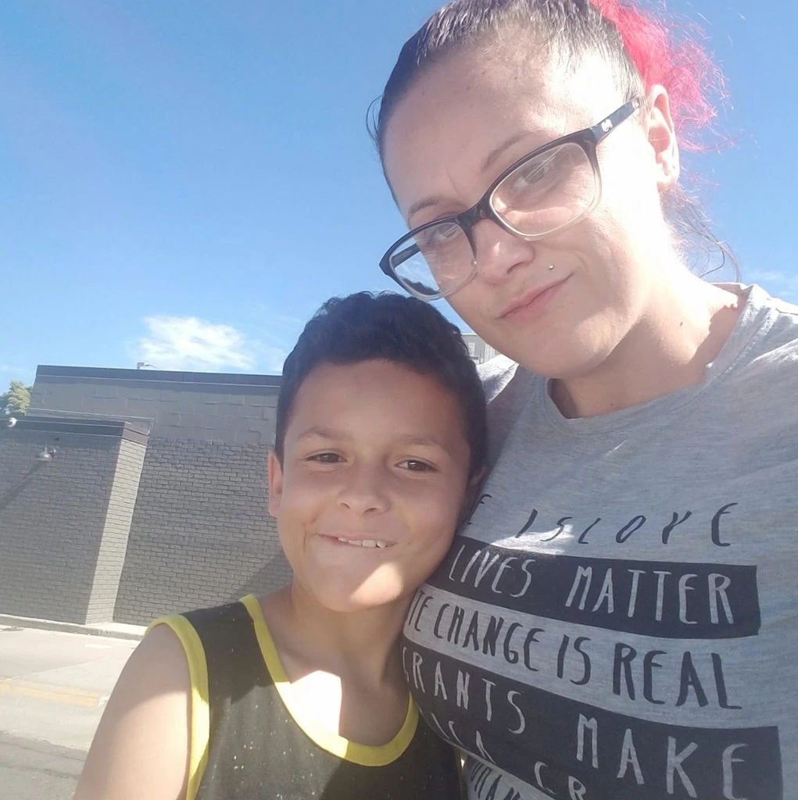
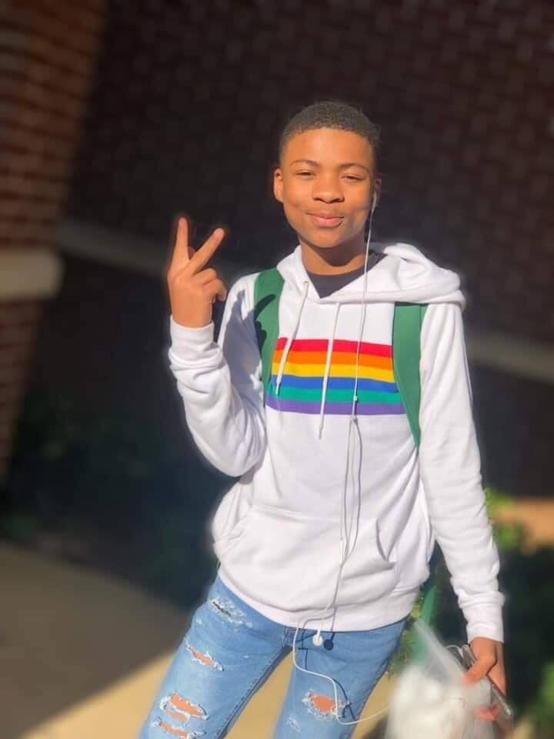
Higher levels of suicide risk in LGBTQ+ community “not because of their identity, but because of how society views and responds to their identity.”
Working with Transgender and Gender Expansive Clients: A Foundational Guide for Therapists by Traci W. Lowenthal.
Notes:
Jamel Myles, 9 year old, Colorado—came out as gay and mom believes bullying was a factor in suicide (8/2019)
Nigel Shelby, 15 years old, Alabama—died by suicide after homophobic bullying at school (4/2019)

Slide 35
Protective Factors for LGBTQ+ Youth
Policies and education
Social media
Family Support
Safer Spaces
Notes:
Policies and education
Federal, state and district policies at school to protect from bullying and violence
Safe place policies/agreements implemented (later)
Community education; being aware of community
Social media
- Youth find community and information

Slide 36
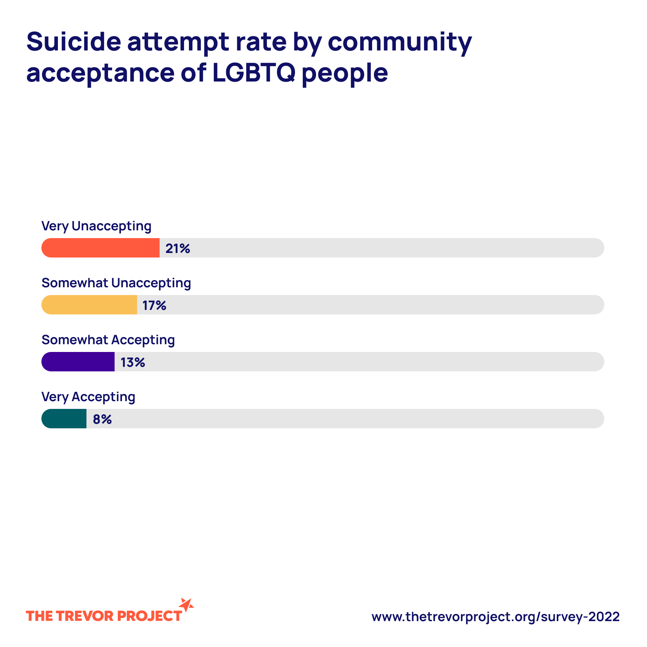
Youth who felt high social support from their family reported attempting suicide at less than half the rate of those who felt low or moderate support.
Notes:
Policies and education
Federal, state and district policies at school to protect from bullying and violence
Safe place policies/agreements implemented (later)
Community education; being aware of community
Social media
- Youth find community and information

Slide 37
Creating a SAFER SPACE…

Slide 38
What is a Safer Space?
A place where people with marginalized identities can feel comfortable expressing themselves without fear
A place where guidelines are set in place to protect people from harm
Notes:
*Simplified definitions

Slide 39
How can you promote a safer space?
ACTION PLAN
Notes:
Participants to send put their responses in the Zoom chat. Can be to everyone or just to hosts.

Slide 40
Pronouns
Don’t assume
Validate
Include them in introductions, email signature, ZOOM name, name badge
Pronouns are fluid, just like gender and sexuality
She/her/hers
He/him/his
They/them/theirs
No pronouns (refer by name)
Multiple pronouns, e.g. she/they

Slide 41
Pronouns
Misgender: using the wrong pronouns for someone
Validate youth by respecting pronouns (even if it’s hard at first)
“It’s too hard to use they/them/theirs” = “your existence and dignity is an inconvenience for me”
Deadname/Misname: using the “birth name” for someone who now goes by a different name
It is a privilege to not think about your gender
but in language and in society gender is always present

Slide 42
Pronouns and being an ally
Practice! Practice using they/them/theirs
Misgender by mistake? Apologize, correct yourself, and move on
De-gender your language:
He/she They
Guys Y’all; Folks
Ladies/Gentlemen Everyone
Man/woman Person; individual
Mankind People; human beings; humanity
Freshman First-year student
Man-made Synthetic; artificial
Policeman Police officer
Congressman Legislator

Slide 43
Creating a SAFER SPACE for LGBTQ+ Youth
Be careful about confidentiality, disclosure, and outing.
Ask pronouns/if they go by a different name
Navigating Documentation:
What names/pronouns do they use with:
Caregivers
Social Workers
Siblings
Teachers
What names/pronouns do they want documented
Notes:
Gender Support Plan https://www.tfaforms.com/4745264

Slide 44
SAFE SPACE IMAGES

Slide 45
Language Matters
Challenge homophobic and transphobic remarks or jokes in work spaces.
“That’s so gay”
Challenge comments referring to gender norms and stereotypes
“Men don’t cry”
Only asking men to do heavy lifting
Notes:
Microaggressions vs jokes (joking about someone’s identity, specially when put downs and violence are real daily threats)
Intention is not to police language but to become critical of underlying messages

Slide 46
How can you promote a safer space?
Physical/visual environment
Policies and procedures
Language and actions
Be a safe person and a role model; practice what you preach
Notes:
Action plan

Slide 47
Supporting LGBTQ+ Clients Tips to be an ally

Slide 48
How to approach questions when you are unsure of someone's gender…
First, ask yourself: “Why do I need to know how this person identifies?”
Is it curiosity?
Is there language that is gender inclusive of all identities?
Avoid asking for “Preferred Gender” Pronouns
Preferred indicates that it is the persons preference rather than identity.
Folks may not identify with the gender binary
Ask instead: What are your pronouns?

Slide 49
Supporting LGBTQ+ Clients
Avoid making assumptions about a person's sexual orientation or gender identity.
Don’t ask a trans person what their "real name" is.
Respect and use the terminology a trans person uses to describe their identity.
It isn’t appropriate to ask about a person's genitals, surgical status, or sex life.
Understand there is no "right" or "wrong" way to transition - it is different for every person.

Slide 50
Supporting LGBTQ+ Clients – Privacy
Outing: exposing/sharing someone’s LGBTQ+ identity to others without their permission.
Outing someone can have serious repercussions on employment, economic stability, personal safety or religious or family situations.
Questions for yourself:
Do you have permission to share information?
Why would it be important to share information?

Slide 51
Supporting LGBTQ+ Clients
Listen and ask; don’t assume
Offer support but don’t assume they need help
Keep in mind, identity and sexuality can change! – Be respectful of fluidity.

Slide 52
Supporting LGBTQ+ clients
Example questions that demonstrate understanding, acceptance, and compassion:
Have you been able to tell anyone else?
Has this been a secret you have had to keep from others or have you told other people?
Do you feel safe in school/home/shelter? Supported by the adults in your life?
Do you need any help of any kind? Resources or someone to listen?
Have I ever offended you in anyway?

Slide 53
Supporting LGBTQ+ Youth and Their Families:
Meet families and caregivers where they are
Allow parents and caregivers to tell their story in a supportive and non-judgmental environment.
Provide families with respectful language they can use to discuss sexual orientation and gender identity.

Slide 54
Supporting LGBTQ+ Youth and Their Families:
Educate families on how family rejecting behaviors and supportive accepting behaviors affect their LGBTQ+ child.
Assist families in supporting their children even if they don’t accept child’s identity.
Focus on small changes families can make to decrease rejecting behaviors and increase support.

Slide 55
OUR SAFE PLACE
Locations:
Golden Hill Youth Center (SDYS)
South Bay (SBCS)
North County – Escondido and Oceanside (YMCA)
East County
Clinic @ Uptown Youth Center
Notes:
update

Slide 56
OUR SAFE PLACE
Services for LGBTQ+ youth (up to age 21):
Drop-in center
Case management:
Safe housing, linkage to hormone therapy, gender affirming items
Clinical services (uninsured or MediCal)
Groups
Trainings

Slide 57
OUR SAFE PLACE CONTACTS
Central (Golden Hill) and East County: oursafeplace@sdyouthservices.org
South (Chula Vista): oursafeplace@csbcs.org
North (Escondido & Oceanside): afavela@ymcasd.org

Slide 58
Resources
Websites for more information/reading material:
Human Rights Campaign
Gender Spectrum
GLSEN
The Trevor Project
GLAAD
PFLAG
Family Acceptance Project
Notes:
Human Rights Campaign (hrc.org)
Gender Spectrum Homepage - Gender Spectrum
Homepage | GLSEN
The Trevor Project | For Young LGBTQ Lives
GLAAD
PFLAG |
The San Diego LGBT Community Center (thecentersd.org)
NSCS19-FullReport-032421-Web_0.pdf (glsen.org)

