Slide 1
The History of NAMI and the Family Movement June 15th, 2023 Gigi R. Crowder, L.E. Executive Director NAMI Contra Costa

Slide 2
Presenter
Gigi R. Crowder, L.E.
Native of Oakland California, Mom of identical 31 years old twin sons. Mother to 4 children through Divine Intervention. Executive Director of NAMI Contra Costa. Also, Founder of Black Minds Matter 2! Unapologetically committed to improving health outcomes for All individuals and their families impacted by mental illness. Currently focused on efforts to promote reduce the criminalization of those who live with mental illness.

Slide 3
Mission Statement
The National Alliance on Mental Illness Contra Costa’s mission is to provide support, outreach, education and advocacy to individuals living with, and families/communities impacted by, mental illness.
NAMI advocates for access to services, treatments, support and research and is steadfast in its commitment to raising awareness and building a community of hope for ALL of those in need.

Slide 4
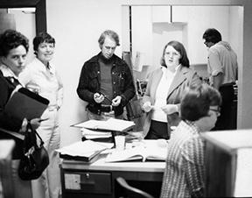
HISTORY
Dorothea Dix, a Nurse working in a psychiatric facility during the Civil War was one of the earliest mental health advocates.
Patient advocacy continued into the 1950s, with a focus on cancer.

Slide 5
NAMI HISTORY
NAMI (the National Alliance on Mental Illness) is the nation’s largest grassroots mental health organization providing advocacy, education, support and public awareness.
During the 1970s, family support groups scattered around the nation were seeking answers and treatments for their loved ones affected by mental illness.
1977 – Madison, WI: 2 Mothers (Beverly Young and Harriet Shelter) started NAMI as an answer to their frustrations with mental health care.
In April 1977, about 13 people met at a nightclub in Madison. Mrs. Shetler suggested a name, Alliance for the Mentally Ill, partly because its acronym, AMI, meant “friend” in French. Within six months, 75 people had joined.

Slide 6
NAMI CC HISTORY
1977 – Walnut Creek, CA: Families in Walnut Creek started “Families for Mental and Emotional Recovery.”
1984 – Walnut Creek, CA: Families further organized.
1990 – Secured our 501c3 non profit status.
1999 – Adopted NAMI Contra Costa as our official name with the State of California.
One of the first assignments was to write to colleges to ask them to stop blaming mothers for their children’s mental health diagnoses.
2018 – Received our first County Funding
2021 – Received our first Statewide Funding

Slide 7
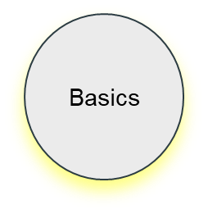
CalHOPE
AAPI & AA
Family 2 Family
(M) (Sp)
Peer 2 Peer
Faith Net
Ending the Silence
In Our Own Voice
The NAMI
Family Network
AA UPLIFT
Program
Crash Course
Family Support Group
Warm Line

Slide 8
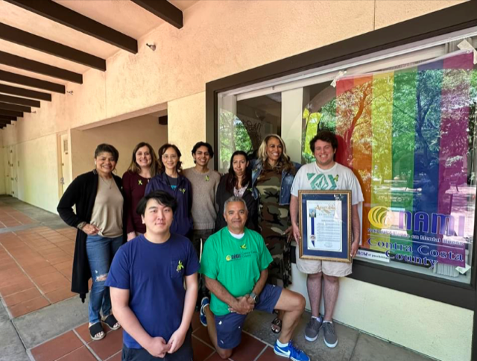
NAMI 2023
Over 1,000 NAMI State Organizations and NAMI Affiliates across the country:
58 in California under the leadership of National State Organization, NAMI California

Slide 9
Why Do Families Advocate?
For those who live with severe mental illness often family members are their voice.
There's over 100 organizations and coalitions designed to advance efforts who those who are defined as living with the most severe mental illness.
NAMI and other coalitions advocate to shape the nations public policy for people with mental illness and their families and provides volunteer leaders with the tools, resources and skills necessary to save mental health in all states.

Slide 10
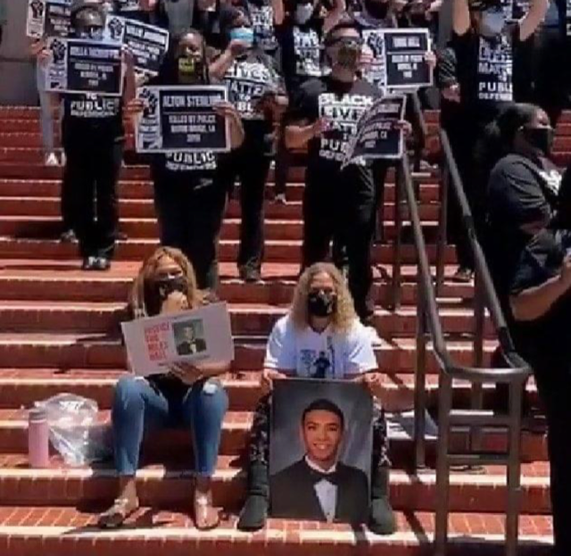
Let’s Hear From Other NAMI Family Members on Why They’ve Joined Forces with
this Movement

Slide 11
Cultural Responsiveness
All supports are delivered in a manner consistent with the cultural values and practices of the families we serve.
There is a acknowledgement that there are glaring health disparities in the mental health field. At NAMI CC we thrive to utilize culturally honoring, linguistically inclusive, community defined approaches.

Slide 12
Politics and Advocacy
FAMILY
RIGHTS

Slide 13
Advocating for a Non-Police Response 2020-2023
People with untreated mental illness are 16 times more likely to be killed during a police encounter than other civilians approached or stopped by law enforcement.
Numbering fewer than 1 in 50 U.S. adults, individuals with untreated severe mental illness are involved in at least 1 in 4 and as many as half of all fatal police shootings.
Reducing encounters between on-duty law enforcement and individuals with the most severe psychiatric diseases may represent the single most immediate, practical strategy for reducing fatal police shootings in the United States.
Sponsors of AB 988- aka, Miles Hall Lifeline and Suicide Prevention Act.

Slide 14
NAMI CC Membership
Membership at a NAMI State Organization, a NAMI Affiliate and the NAMI national organization
Eligibility to vote in all NAMI elections
A subscription to The Advocate, NAMI’s flagship magazine, as well as access to optional subscriptions to specialty newsletters, and information at the national, state and local levels.
Member discounts on brochures, videos, promotional items and registration at NAMI’s Annual Convention and many state and local conferences.
Access to exclusive member-only material on www.namicontracosta.org
Become a NAMI CC member

Slide 15
Thank You for your Time!

